Slide 1

SchoolBellQ* Services
Your one stop solution for Complete School Automation Services

Slide 2
Presentation Overview
This presentation has been broadly divided into 6 sections to help audience easily comprehend & navigate to various sections.
1
Unique Service Model
2
Maximize Admissions
3
Academic Ops
4
School Admin Ops
5
Back Office Ops
6
Cutting Edge Technology
6. Latest advanced features & functionality to stand you ahead of competition
1. Our unique service model is designed to facilitate the 'value add' delivery.
5. Manage your back offices like Inventory, HR with user friendly modules
2. Lead management CRM & Digital marketing to maximize the admissions and fill in the seats quick
4. Our Modules that offer tremendous convenience to manage your school
3. A peek in our superior tools that help you ace your academic operations

Slide 3
Unique Service Model
Service
Edge
Superlative
Platform
Complete
Bouquet
Ahead On
Technology
Parent App & Apps for All
(Teacher & Staff)
On premise dedicated resource
Dedicated Accounts Manager for seamless co-ordination
Active customization & constant upgrades
Auto scaling for load Management
Automated analytics
Customer care operates 24 x 7
Dedicated account manager supports the associates for troubleshooting and planning active customization
Intuitive UI/UX
Best Coding Technology
Single click drill-down for easy navigation directly from deep-dive dashboards
Powerful servers to handle complex functionalities & tasks
High-volume Online exams for bulk testing for resource-intensive activities
Automated analytics presented with graph-based Visualization and robust reporting
Extensive, exhaustive & growing portfolio of services
Social media tracking to lead management combined with the power of digital marketing modules
Online Test modules with AI-based proctoring to advanced Result analytics to Random Question paper generation
Back offices like HR & Payroll & Inventory to Advanced Fee Modules & Time-table substitution module
Continuous upgrades, embracing new technology proactively
GPS for vehicle tracking, Active or Passive RFID cards or Beacon based ID card for attendance, Barcodes or Library management or a higher level integration like Tally integration, payment gateway integration
Zero Code Report Cards
Intelligent SMS, Email & App Notification
QR Code generation
Online Payment Integration for School's MID
AI Proctored Online Tests with advanced analytics
Integration with leading admission aggregators like Admission Tree and UniApply
2 absolutely awesome Apps both on Android & iOS platforms by the name of SchoolBellQ*
Excellent Ratings of 4.5 for our android app on Play store
Both the apps have accumulated user downloads of over to 50000
Employee App* for HR Management
GPS based Attendance of employees

Slide 4
Maximize Admissions [1/3]
Lead
Management
&
Digital
Marketing
Optimising digital marketing Performance
Lead Generation Digital Marketing Campaign
& Lead Conversion with CRM
Create Custom Lead links & Leads from Multiple Sources
Lower TAT between Lead generation & its closure &
Constant Connect with Parents
Making Counsellors More Productive &Counsellor Performance measurement
Links Creation to capture leads from Social Media
Links Unique to each Counsellor
Lead Source
Performance and
Calibration of Marketing spends on Digital marketing

Slide 5
Maximize Admissions [2/3]
Vacancy Management for admissions
Enables Tracking The Ongoing Admissions Count Against The Allocated Vacancy
Counsellors Get Real-time Alerts When The Prospects For Admissions Exceed The Vacancy.
Allows The Schools To Follow Cum First Serve Principle, Especially Where School Seats Are Scarce
Integrated Online Admission Tests
Online proctoring
Varied question formats, including text-based answers or image-based response
Auto-evaluation for objective part
Manual Evaluation for subjective responses
Enquiry
Enquiry & Prospectus Module –Offline/online prospectus purchase with receipt
Automated Workflow for Admissions
Test Result Publication
Admission Test Result Publication
Admission Completion of successful candidates

Slide 6
Maximize Admissions [3/3]
Schools to manage and coordinate the applicants to be scheduled for interview/admission tests with integrated communications platform.
Applicants issued ID card that can be printed and used for school access and identification at the entrance for Entrance Test/Interview conducted by the school for various classes.
Conversion Of Enquiry to Admissions
Admit Card ID Module
Approval
Pre-
admission
Module
Integrated Fee Management for New admissions
The successful leads dovetail seamlessly into the pre-admissions and hands over the process to the admissions department
Approval Mail Received by the Principal.
Invoice Concession approval
Invoice for parent to pay.
Move candidate from Admissions list to Live class

Slide 7
Class Management Ops [1/3]
Attendance
(Online Class/ Offline Class)
Syllabus Planning
& Unit & Lesson Plan
Timetable Automation
Day wise/Period Wise Attendance
Auto attendance for Online Classes
Multiple statuses in attendance
Exhaustive attendance Reports
Integrated with Timetable
Meticulous & Rigorous planning
Defined timelines
Follow-up Alerts & Reminders
Multi-level review before execution
Auto replication
Teacher’s occupancy reports
Reflecting teacher’s leaves
Teacher’s Substitution scheduling
Optional Subjects based time-table
Extra – Curricular Activity (ECA) with participation
Close Looping
Homework Module
Diary Management
Participate Option
Event Report & instruction publication
Activity Consent forms signed by parents
Activity fee integrated with fee payment
Ready to print Co-scholastics certificates
Replaces Traditional diary for effective communication between Parent & School
Rich text features available in the editor
Allows attachment of all kinds from PDF to JPG
Read receipt feature available
Close Loop 1: Assigning Homework to students
Closing Loop 2: Uploading HomeWorks by the students from the app
Remarks by the teacher

Slide 8
Class Management Ops [2/3]
Seamless, Intuitive & Easy-to-use Platform For Creating And Administering Timed Weekly Class Tests. Provides Support For The Various Modes Of Testing Mcqs, descriptive & Reading Comprehension.
AI - Proctored
Online Testing
01
02
03
04
05
Online Tests For Students
Online Testing
Evaluation & Grading
Analytics Multivariate Analysis
Online Question Repository
Multivariate Attribute Of Questions
Question Types
Attribute Based Analysis
Calibrated Randomization Of Test Questions
Post Test Analysis Report
Screen Behaviour
Instant Result Computation
Supported Test Formats
Mcqs
Fill In The Blanks
Descriptive
Question Paper Types
Fixed Type Exam
Random Type Exam

Slide 9
Class Management Ops [3/3]
Gallery Management
Report Card Automation
Assigning & Re-assigning Roll numbers
Circular Management
Temporary ID Cards
Event’s pictures updated in the mobile app gallery visible to parents
Gallery images shared with topic, description and timestamps for each image
Like, share, download option for the event’s pictures in the gallery
Ready to print files
Ability to take your 'Detailed Report Card' online
In-Depth Result Analysis & PTM Dashboard Module
Uploading and importing marks of previous sessions by teachers
Auto Alerts for circular publishing
Manual/ Scheduled Publishing
Multiple Circular Media
Type Support
Read-Receipt Feature
Unpublish Feature
Temporary ID cards precisely like the proper ID cards.
ID cards do not have to be printed by the outside vendor printer.
Single click solution to
re-assign roll numbers
Roll numbers assigned alphabetically

Slide 10
School Admin Ops [1/5]
Student Management
Personal Details
School-related/Academic Info
Update Profile Links
Individual Parent Communication
Manage Student Status & Anecdotes
Generate Documents (TC/Bonafide/Character Certificates)
Editing student list according to class and section
Updating student request list
Uploading student profile and parent profile
Loading students to database manually and by using excel sheets
Sending Welcome email with credentials
Anecdotes (Teacher's observation on day-to-day basis)
Chairman’s Dashboard
(A treasure trove of information available at a click with rich insights on topics ranging from Finance to Operations; From HR to Academics… all at glance)
Student Count
Summary Of Daily Class Activities
Teacher's On Leave, Upcoming Exams & ECA Activity & Daily Student Attendance %
Quick Access To Notices
Daily Performance Parameters
Fee Summary
Fee Defaulter Summary For All Quarters/Months
Quick Links To Key MIS Reports That Can Be Customized
Communication & Notification
Auto-generated notifications
Customized Notifications
Notification Categories (Regular/ Important/ Extreme Urgent)
Single Click Trigger
Different Notification Channels
Delivery Report available to admins
TRAI Approved DLT Templates
Book Store / Utility Management
Facilitates The Selling Of School Materials Online To The Parents
Multiple Relevant Books & Stationery Sets With Various Subject Combinations For Each Class
Defining Composition Of Packages And Mapping To Classes.
Offered For Sale To Parents Online

Slide 11
School Admin Ops [2/5]
Fee Management
Fee Dashboard &
Fee Management
Discount &
Online approval Functionality
  Deferral or Partial Payment
  Exhaustive Reports
Admin Platform & Parent’s APP
  Fee related information in a single click.
  Admission counsellors assign
  fee plans at the time of
  admission
  Online Functionality allowed
  to make the part payment
  towards fees.
  Fee notifications sent
  before/after due date.
Pending fees across sessions
through Single Unified window
No need to toggle with academic
sessions to check the previous
pending due.
  Customizable fee components, frequency & plans
  Admissions counsellors seek
  discount approval from
  concerned authority online/
  offline
  Partial amount invoices
  generated that can be paid
  online & offline both.
  Multitude of reports available
  for internal requirement.
Previous invoices can directly
be settled from the current
session itself
  Integrated with the accounting software 'Tally" through XML files generated by our system
  Online Fee integration
  with school account
  Upon approval discounted
  invoices sent to the parents
  automatically online for payment.
Invoices can be settled
both online and offline
Previous session invoice is
settled in the database of the previous session
  Parents can pay through
  different payment modes
  Regular reconciliation
  report for fee payment
Parent’s can view all pending
invoices of current and of
previous academic sessions
Debit cards, Credit Cards, UPI, Wallets as well Net Banking.
  Bulk SMS notification with
  Student name, invoice number
  & amount.
Pending invoices can be
paid from the same screen
Payment gateways can be integrated
Parents can assess their previous
session dues conveniently
and clearing them
  Personalized single click
  payment link over mail & SMS.
Credit Note Management & Advance Fee Receipts

Slide 12
School Admin Ops [3/5]
Gate Pass
Verification of Visitor seeking student custody
OTP verification on Registered mobile number
Purposeful tweaks to enhance the security
Temporary E-ID card
Adding visitors with live photo
Recording Check-in and Check-out timings
Download pass to visit
Feedback forms available after checkout
Happiness Help Desk: Parent Concern Management
Multi-department
Relevant Stakeholders Realtime Access
Action Taken Report
Time-bound Response & Escalation Matrix
Analytics For Issues Raised
Higher Satisfaction Scores
A dedicated Happiness Help Desk Executive is assigned for a particular parent.
Booking-Based interaction available with teachers, admins and co-ordinators round the year
TAT report available for each query raised
Incident & Discipline Management
Reporting tool for school authorities to record, report and intimate authorities of all incidents taking place.
Assist To Monitor And Maintain Student Disciplinary Record
Disciplinary actions taken against the students responsible.
Types of incidents categorized into sub-categories
Visitor Pass
Capture & verify incoming visitor photograph
Accurate & Complete Records
OTP based authentication
Sending request to concern person for appointment
Building & Syncing of database of visitors
Optional Approval from the visited person
Storage & Retrieval of Records

Slide 13
School Admin Ops [4/5]
Library Management
Surveys & Feedback
Transport Management
Intuitive And Easy To Use UI
No Limit On The Fields & Books To Be Uploaded
Auto-fine Calculation And Integration With Main Fees
Barcode on books, option to issue books with Scanning bar code
Adding and maintaining newspaper register
Book availability reports
Status check of verified, unverified and discarded books list
Transport Management - Fleet, Route and corresponding fees linked to the students
Bus Management – Complete details of vehicle including Driver details, Photo, contact details ad GPS Id
Route Planning - Adding Route Name and Number & Mapping Route to students.
Transport linked with stops & Fees system
Month wise transport report
Transport notifications in case of any change
Creating surveys & Polls
Locking service for internal consumption
Publishing for outside audience
Adding feedback from visitors or parents
Notification frequency can be set
Ratings value for the feedback form
Reports
Hostel Management
Deals with student information, room assignment, admission cancellation, monthly rent, and staff information
Automated reservation of hostel rooms
Automated fee collecting
Automated allocation of rooms
Keeps tab of student in-time & out time.

Slide 14
School Admin Ops [5/5]
Teacher Management
Teacher
Management
Teaching
Operations
Teacher Performance
Analysis
Teacher's Goal
sheet
Student Teacher
Chat
Adding/Uploading Teachers information
Combines teaching operations with our Teacher's appraisal system
teaching operations helps manage the resources efficiently
teacher performance management makes them more effective by working on the resource competence.
Teacher availability or occupancy reports
Instant access to all teacher’s details
Teacher leave management
Automation of time-table
Time table scheduling for absent teacher
Teacher's Appraisal thru domain experts, supervisors
Custom design of periodicity, frequency of appraisals
Multiple authorised users mapped to fill the CRP
Follow-up CRPs based on Progress
Consolidation of Reviews, appraisals
Objective Inputs from Academics performance
Final Performance Appraisal
Performance attribution (% of course taught) WIP
One to one chat facilitates faster & effective communication.
Instantaneous notifications to teachers and parents when chat is received
Enabled on App and web login platform
Allows users to attach any kind of attachments with chat right from JPG to PDF to Excel to Microsoft's office files.

Slide 15
Learning Management System (LMS)
Organize Learning Resources To Provide Easy Access To Students
Rich functionality that allows actions like View, Evaluate, Reminders, Custom messages, Download each homework or worksheets.
Lucid & intuitive UI
Easy Search Filters & Indexing, Confidentiality of Proprietary material, Multiple Formats & types
Annotate submissions without download feature.
Rating & Review By the Students
The students can review and rate the study material provided through the app or their login in the web panel
Admin Actions
Teachers upload
Exhaustive Reporting

Slide 16
Doubt Management Module
Support extended beyond classroom. Not limited to classroom only, but beyond the class hours while going through notes or offline videos.
Doubt Management in action:
Teachers can schedule doubt clearing meeting directly from our system.
Adding multiple students is a generic and common doubt benefitting large audience.
Increases Student - Teacher
performance
Understanding the student's learning increases student's overall academic and progress.
Verified Doubts:
Close looping the communication through receiving a "verified" status once the student checks it.
Doubt List
Easy interface for teachers to track doubts from multiple students.
The doubts are raised according to class, subject and class. Status of doubts categorised as pending, verified etc.

Slide 17
Back Office Ops
HR & Payroll
Integration of Biometric attendance
Integration of mobile attendance for field staffs with location record
Functionality to create departments, leave categories & group
Functionality to set working hours, overtime & late coming
Salary plan management
Calculation of salary on the basis of working days/hours
App Based GPS tagged face recognition based app
Employee Loan management
Salary Slip generation on email, app and SMS
Approved or rejected or pending leave list
Group wise employee strength
Generation of complete payroll based on attendance from HR
Salary computation based on user defined custom formulas
Recruitment Management
Detection of Vacancies
Receiving Candidates Applications
2 way - AI Based Candidate and Job- Matching
Function and Operations – Evaluation Process
Fully Integrated Interviewing System
Global Question Bank
Interviewer UI
Post Interview
Inventory & Equipment
Vendor details & tracking, Equipment's details & tracking
Equipment Reports - Item wise reporting
Item wise -arrival report & location list
Distribution of materials with students and staffs
Automation of Purchase approval, Purchase Order etc.

Slide 18
Cutting Edge Features
Fee Management 4.0
Compact Fee Report & Class wise Fee MIS report
Activity Consent
Student side fees summary pie and single click payment option
5
Online Auditorium
Our partnership with Zoom enables schools to use our Virtual Auditorium for up to 500 participants
1
Zero-Code Report Cards
Amazing new feature that empowers the teacher to design report cards with simple drag & drop.
6
Transport Management 2.0
Transport invoices generated monthly, has feature to charge as granular monthly.
Transport invoices generated quarterly has feature to charge individual monthly.
2
Voice Messages to parents
This feature empowers school to share a pre recorded voice message with the parents and other audience like teachers on the app.
7
3
Student Analytics Report
Generates an exhaustive student performance reports covering all facets
Auto Attendance Capture For Online Class
A student can mark himself present in the class by capturing his image in the app
Student’s profile images uploaded in bulk
One click uploading of student profile images
8
4

Slide 19
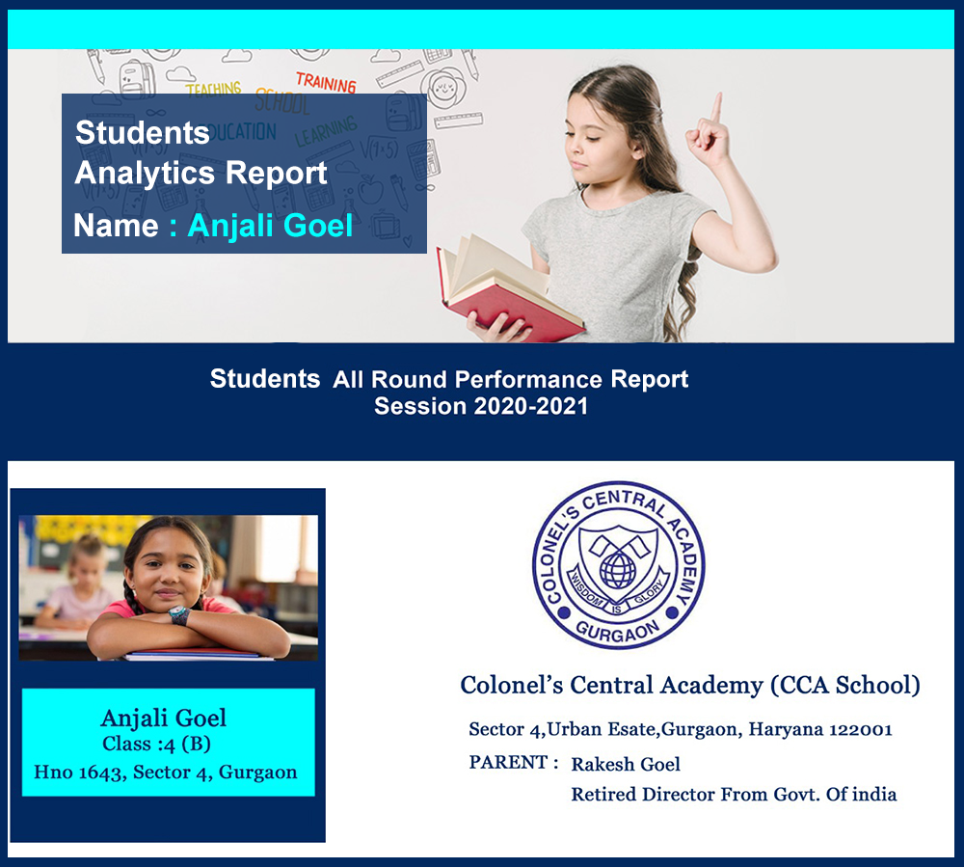
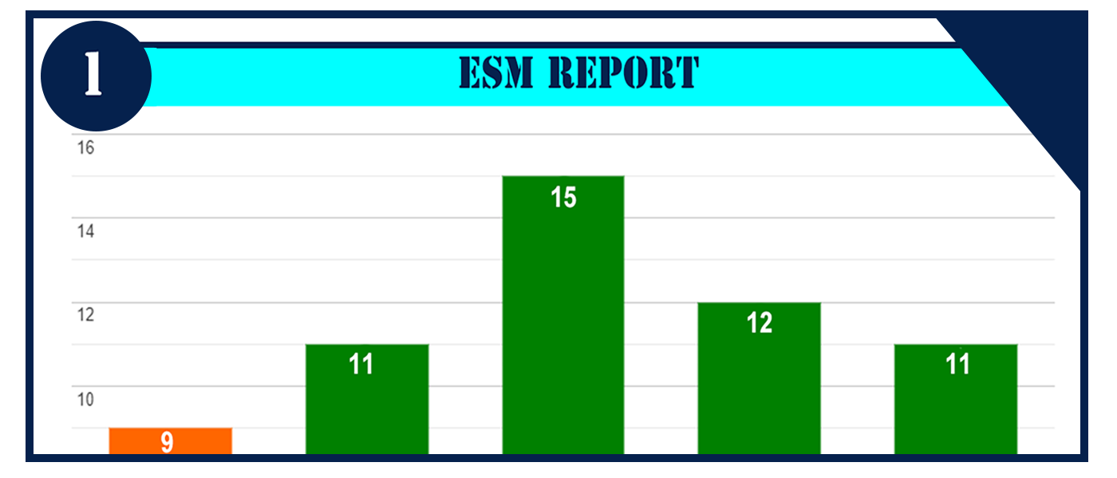
Student Analytics Report [1/5]

Slide 20
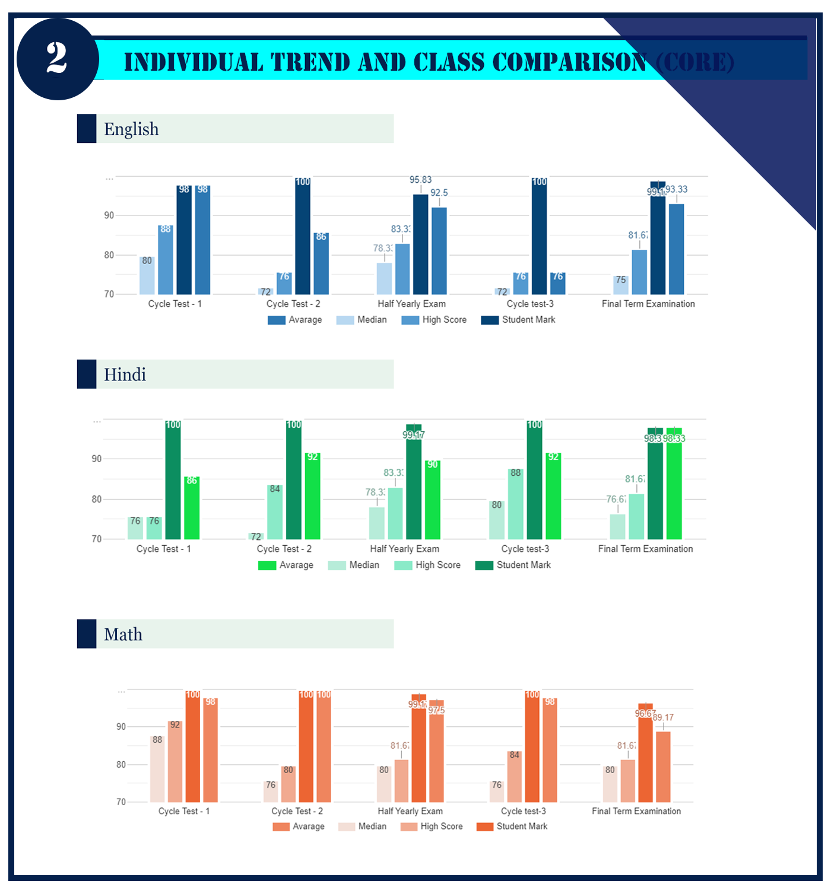
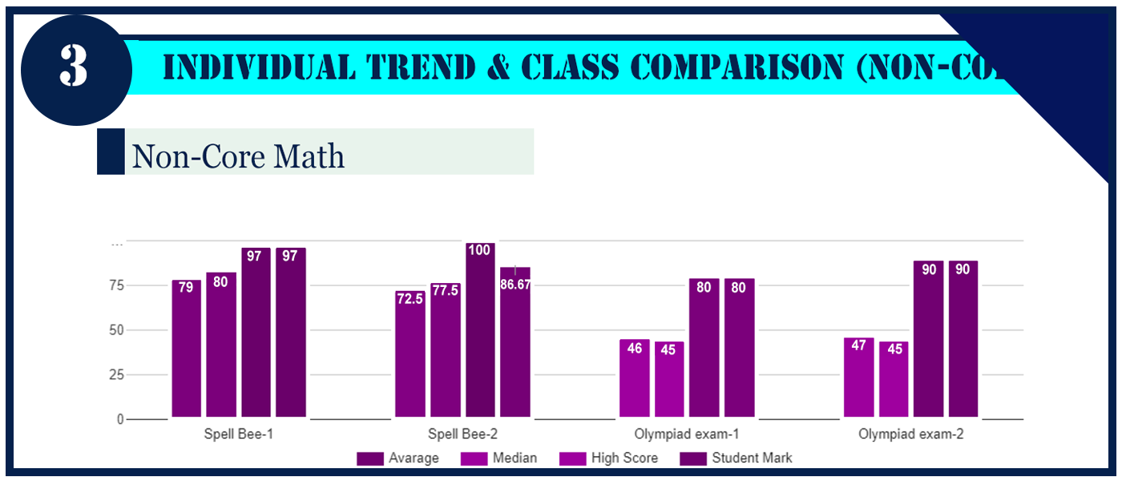
Student Analytics Report [2/5]

Slide 21
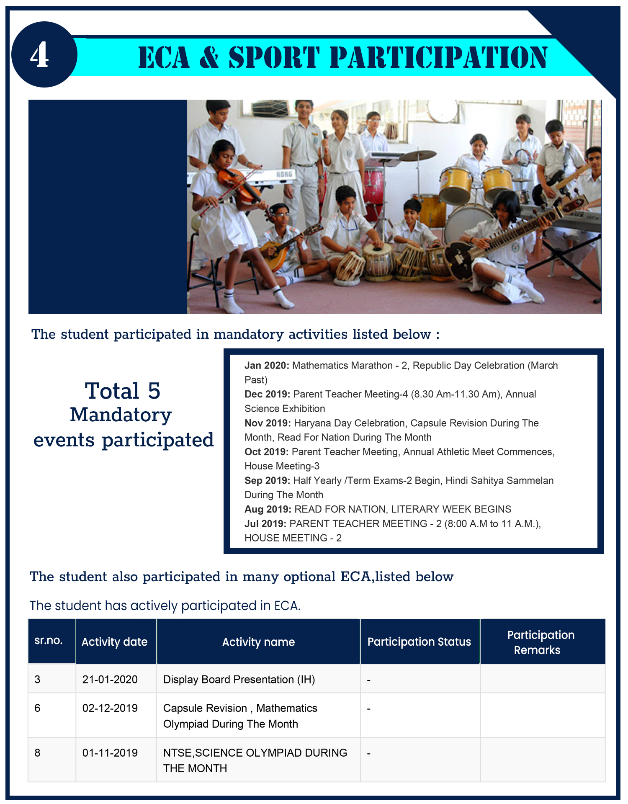
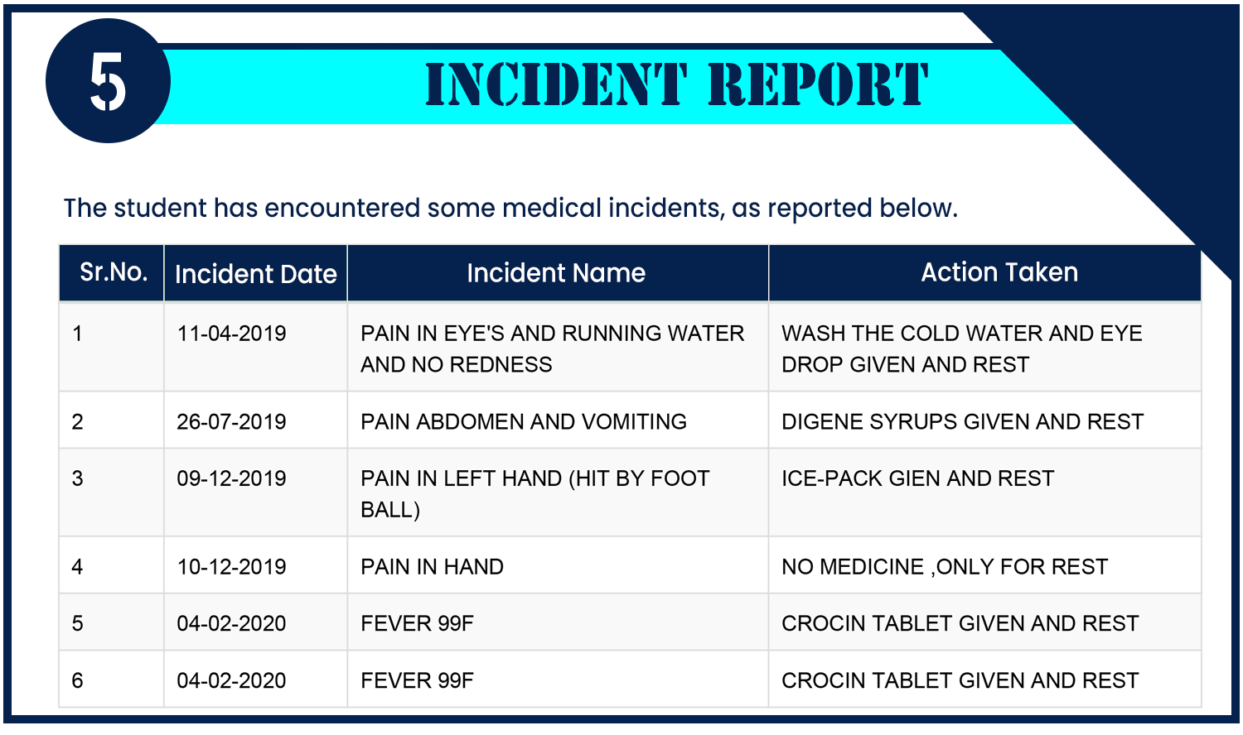
Student Analytics Report [3/5]

Slide 22
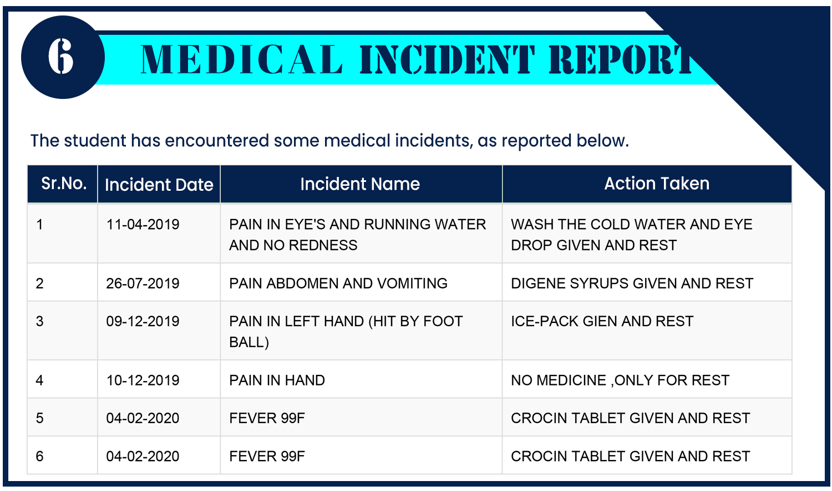
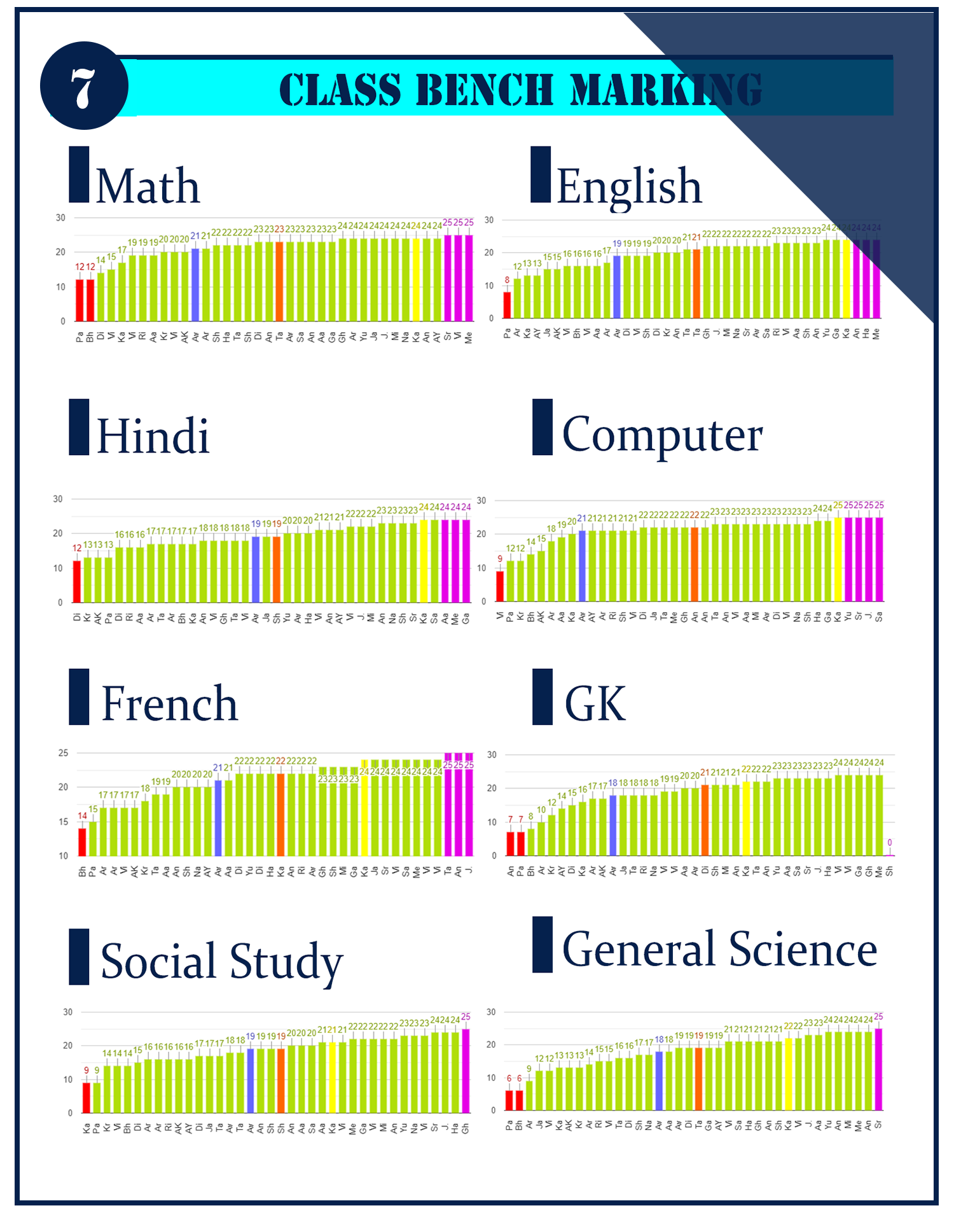
Student Analytics Report [4/5]

Slide 23
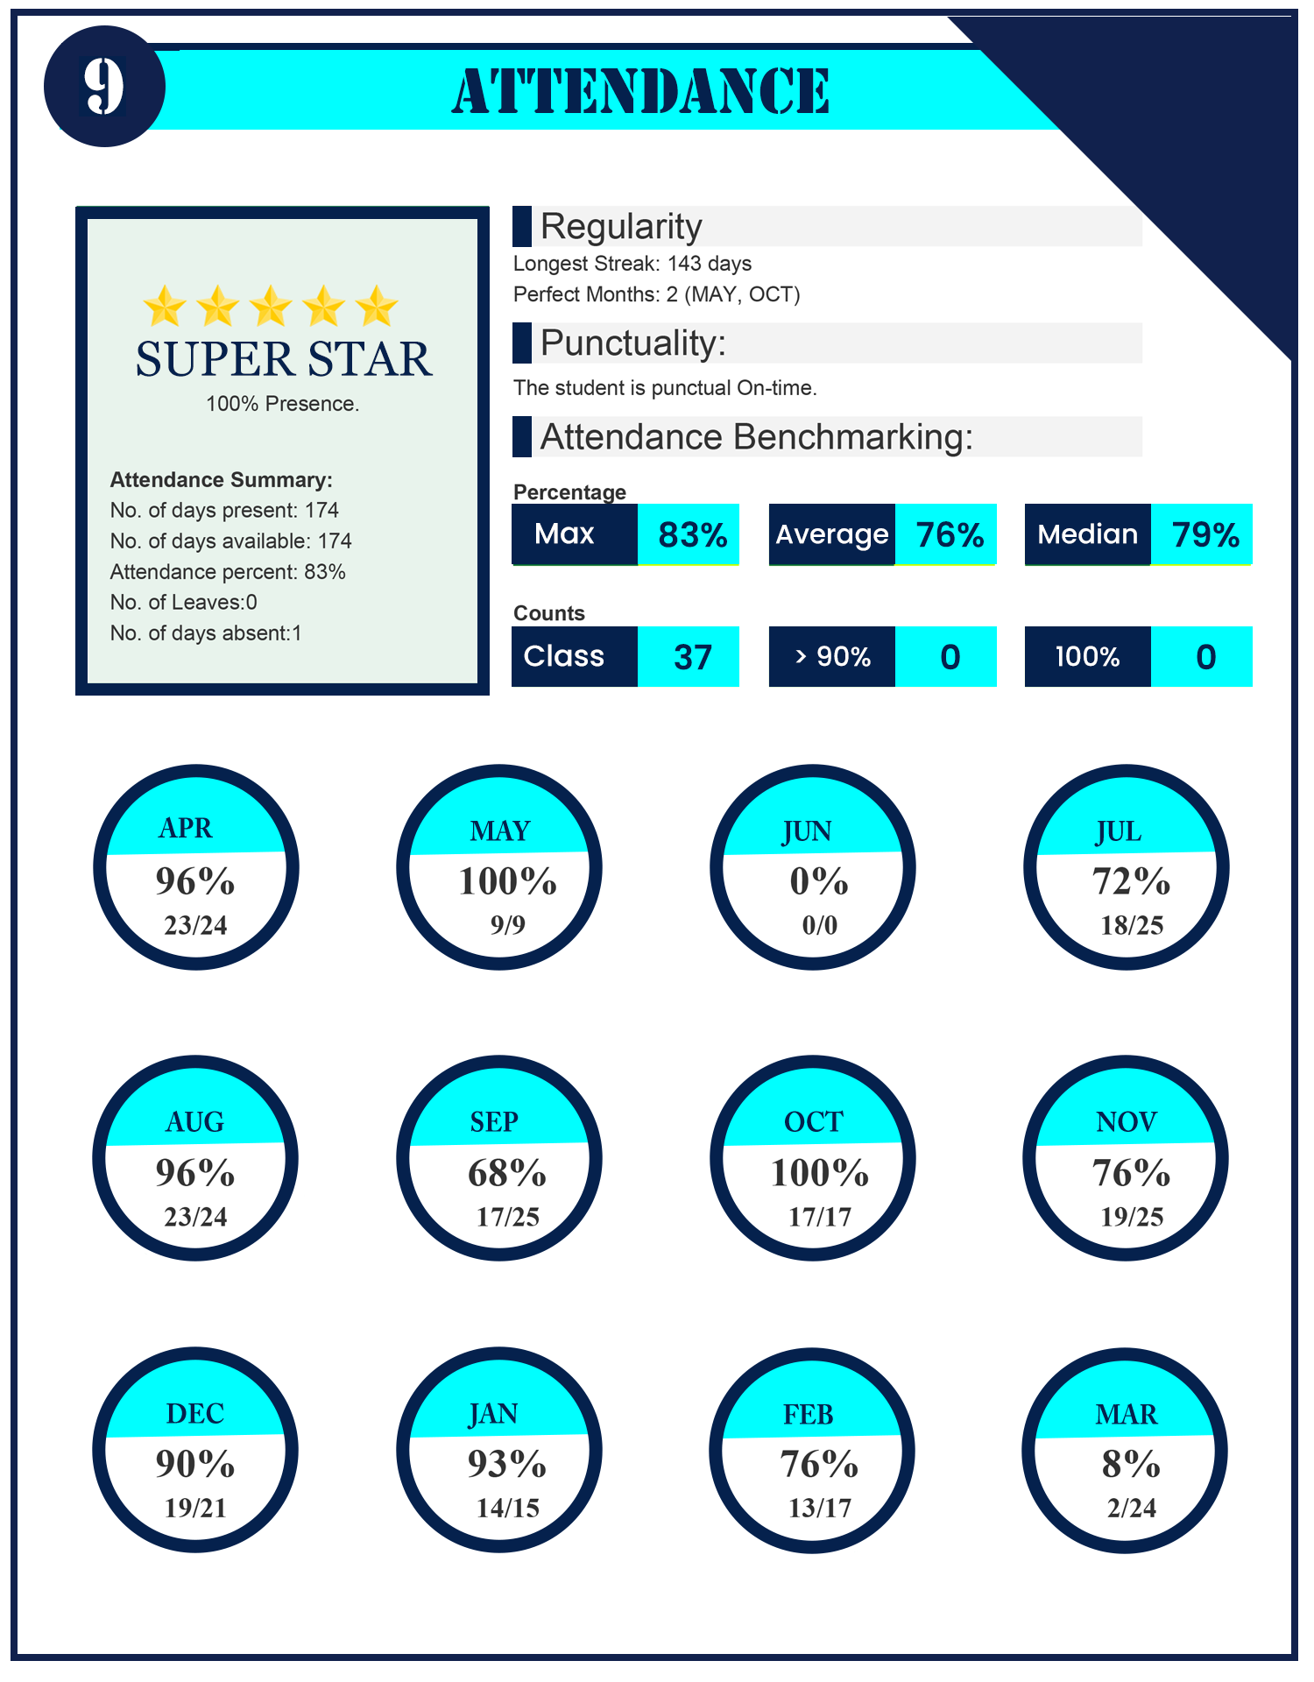
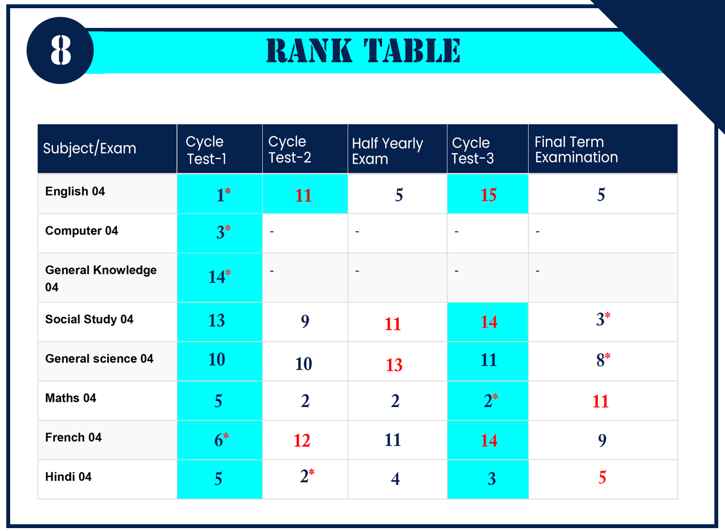
Student Analytics Report [5/5]

Slide 24
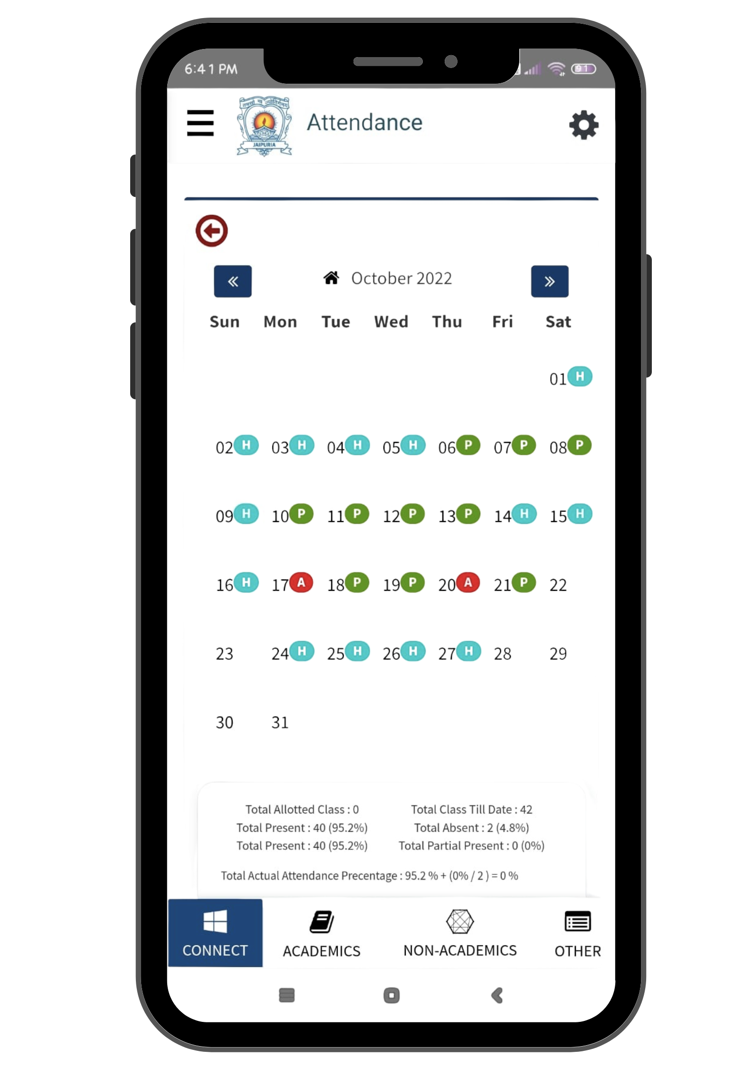
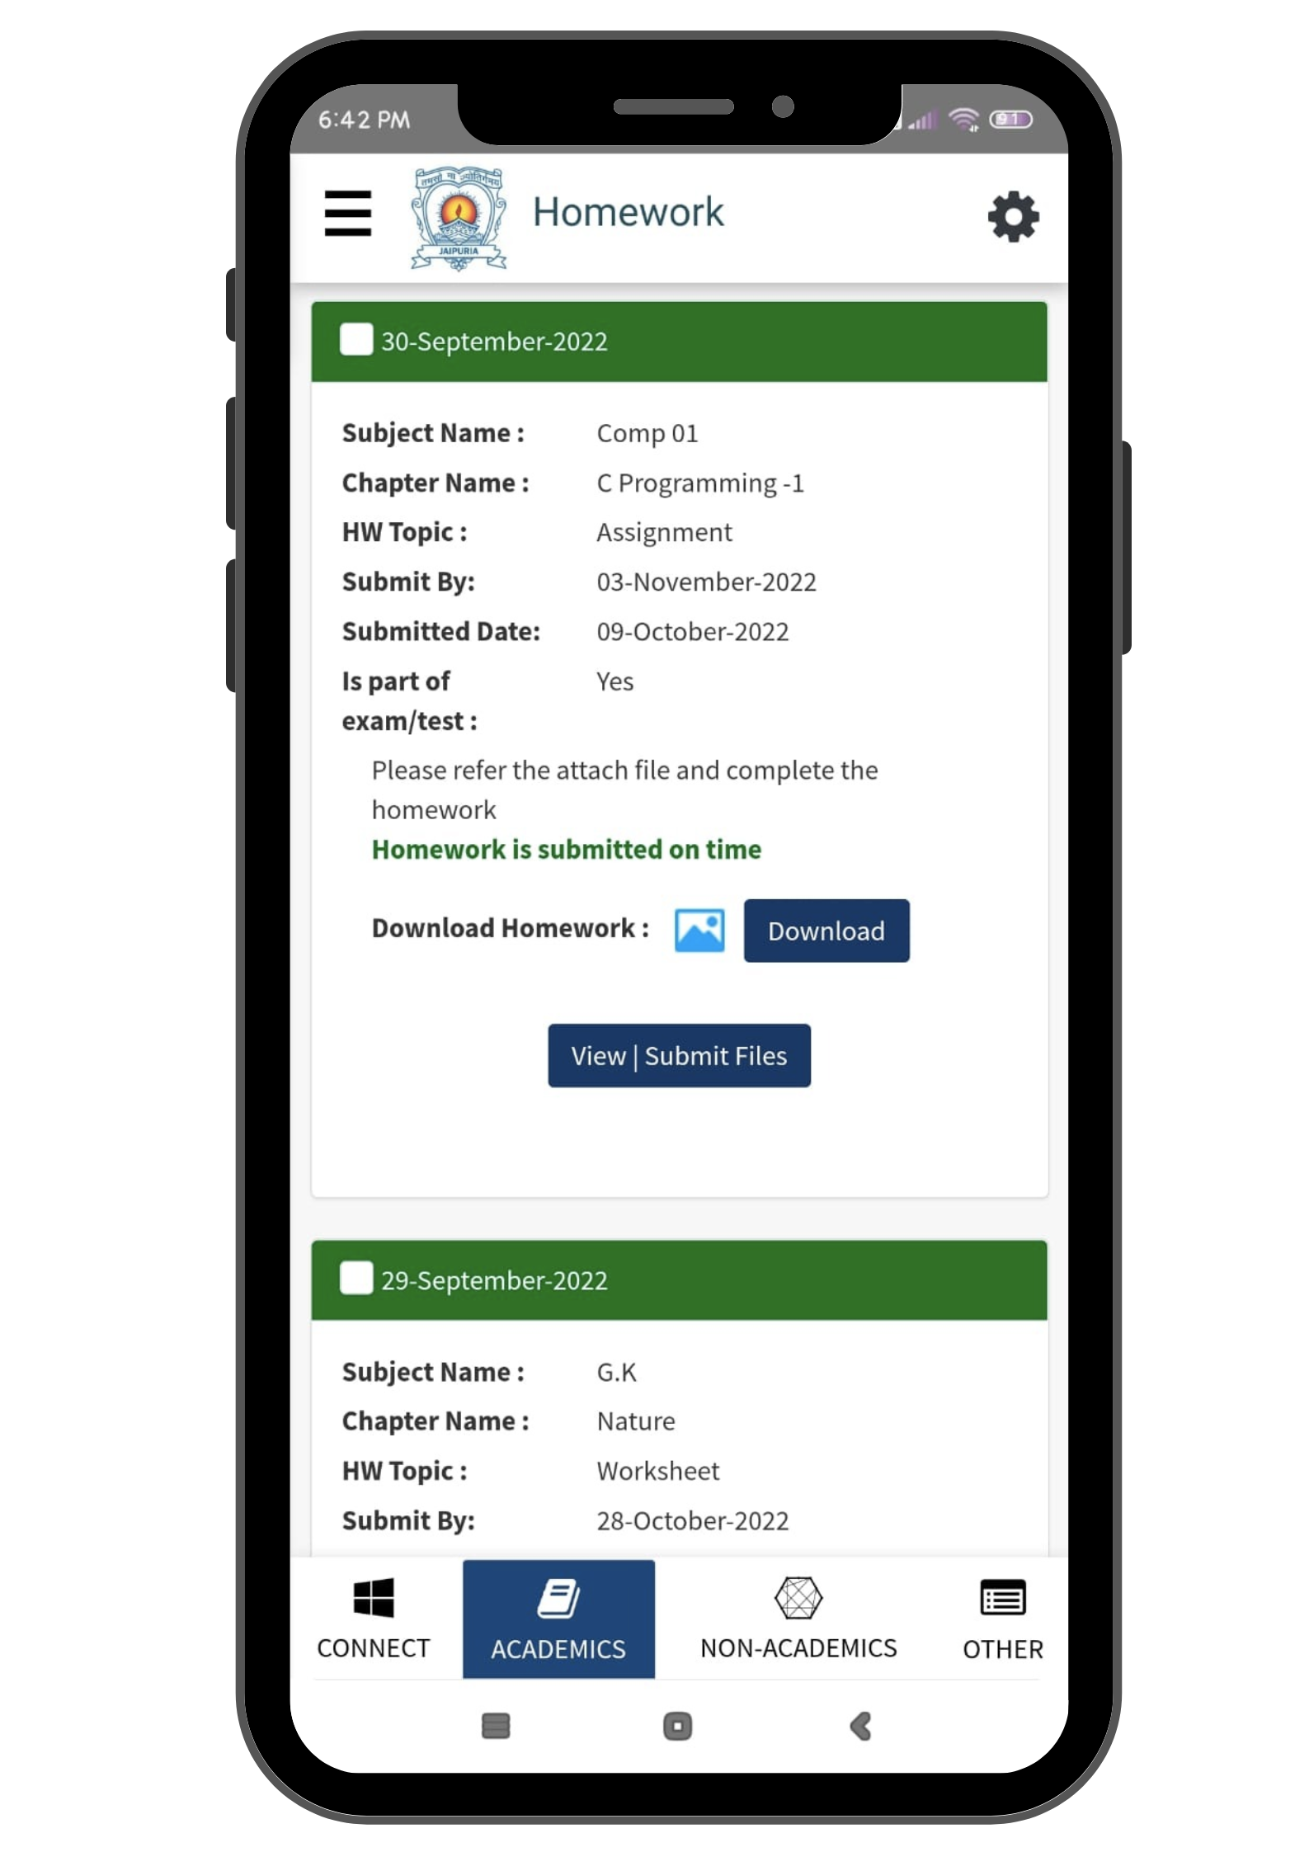
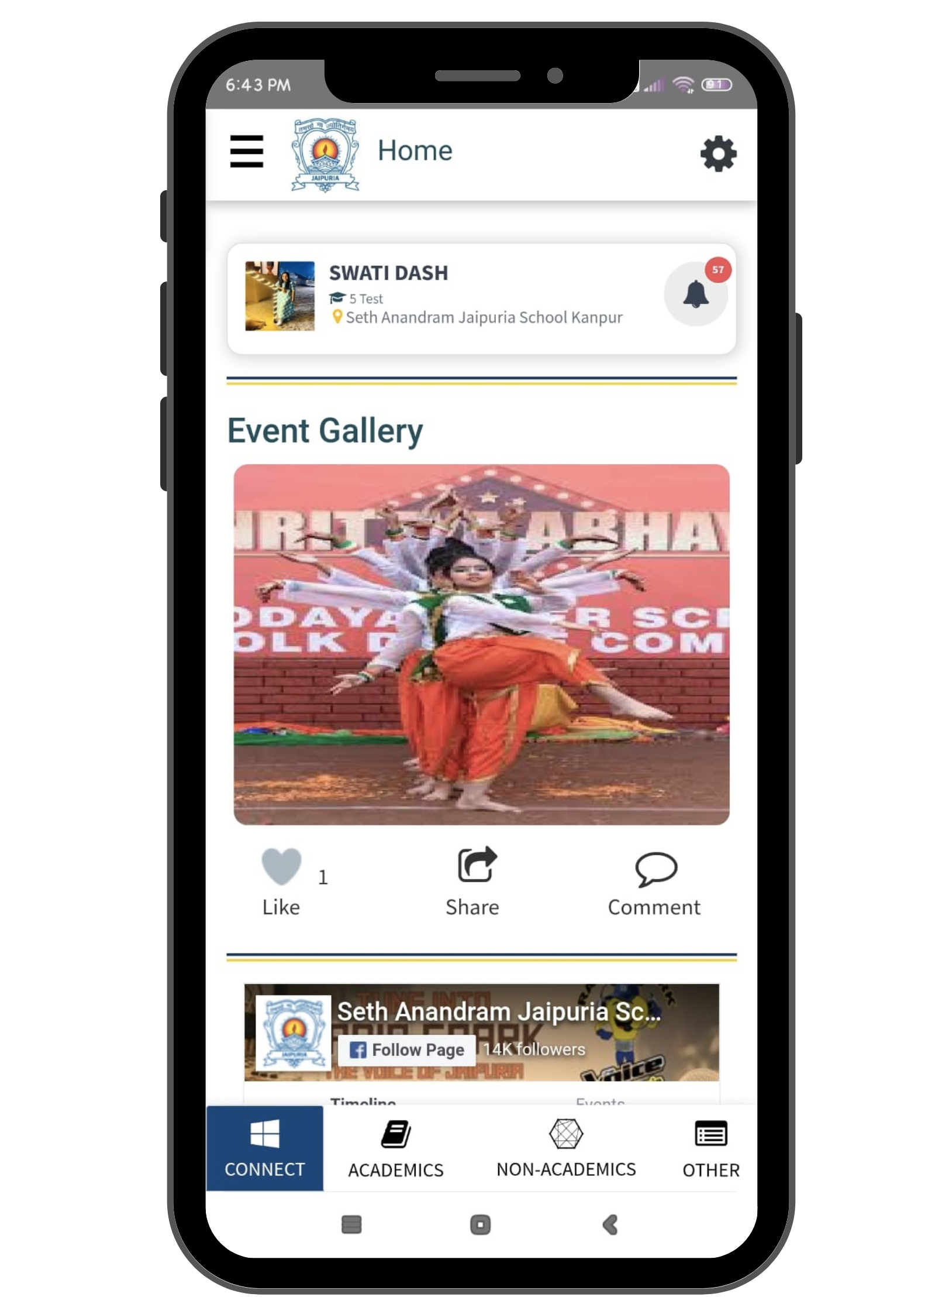
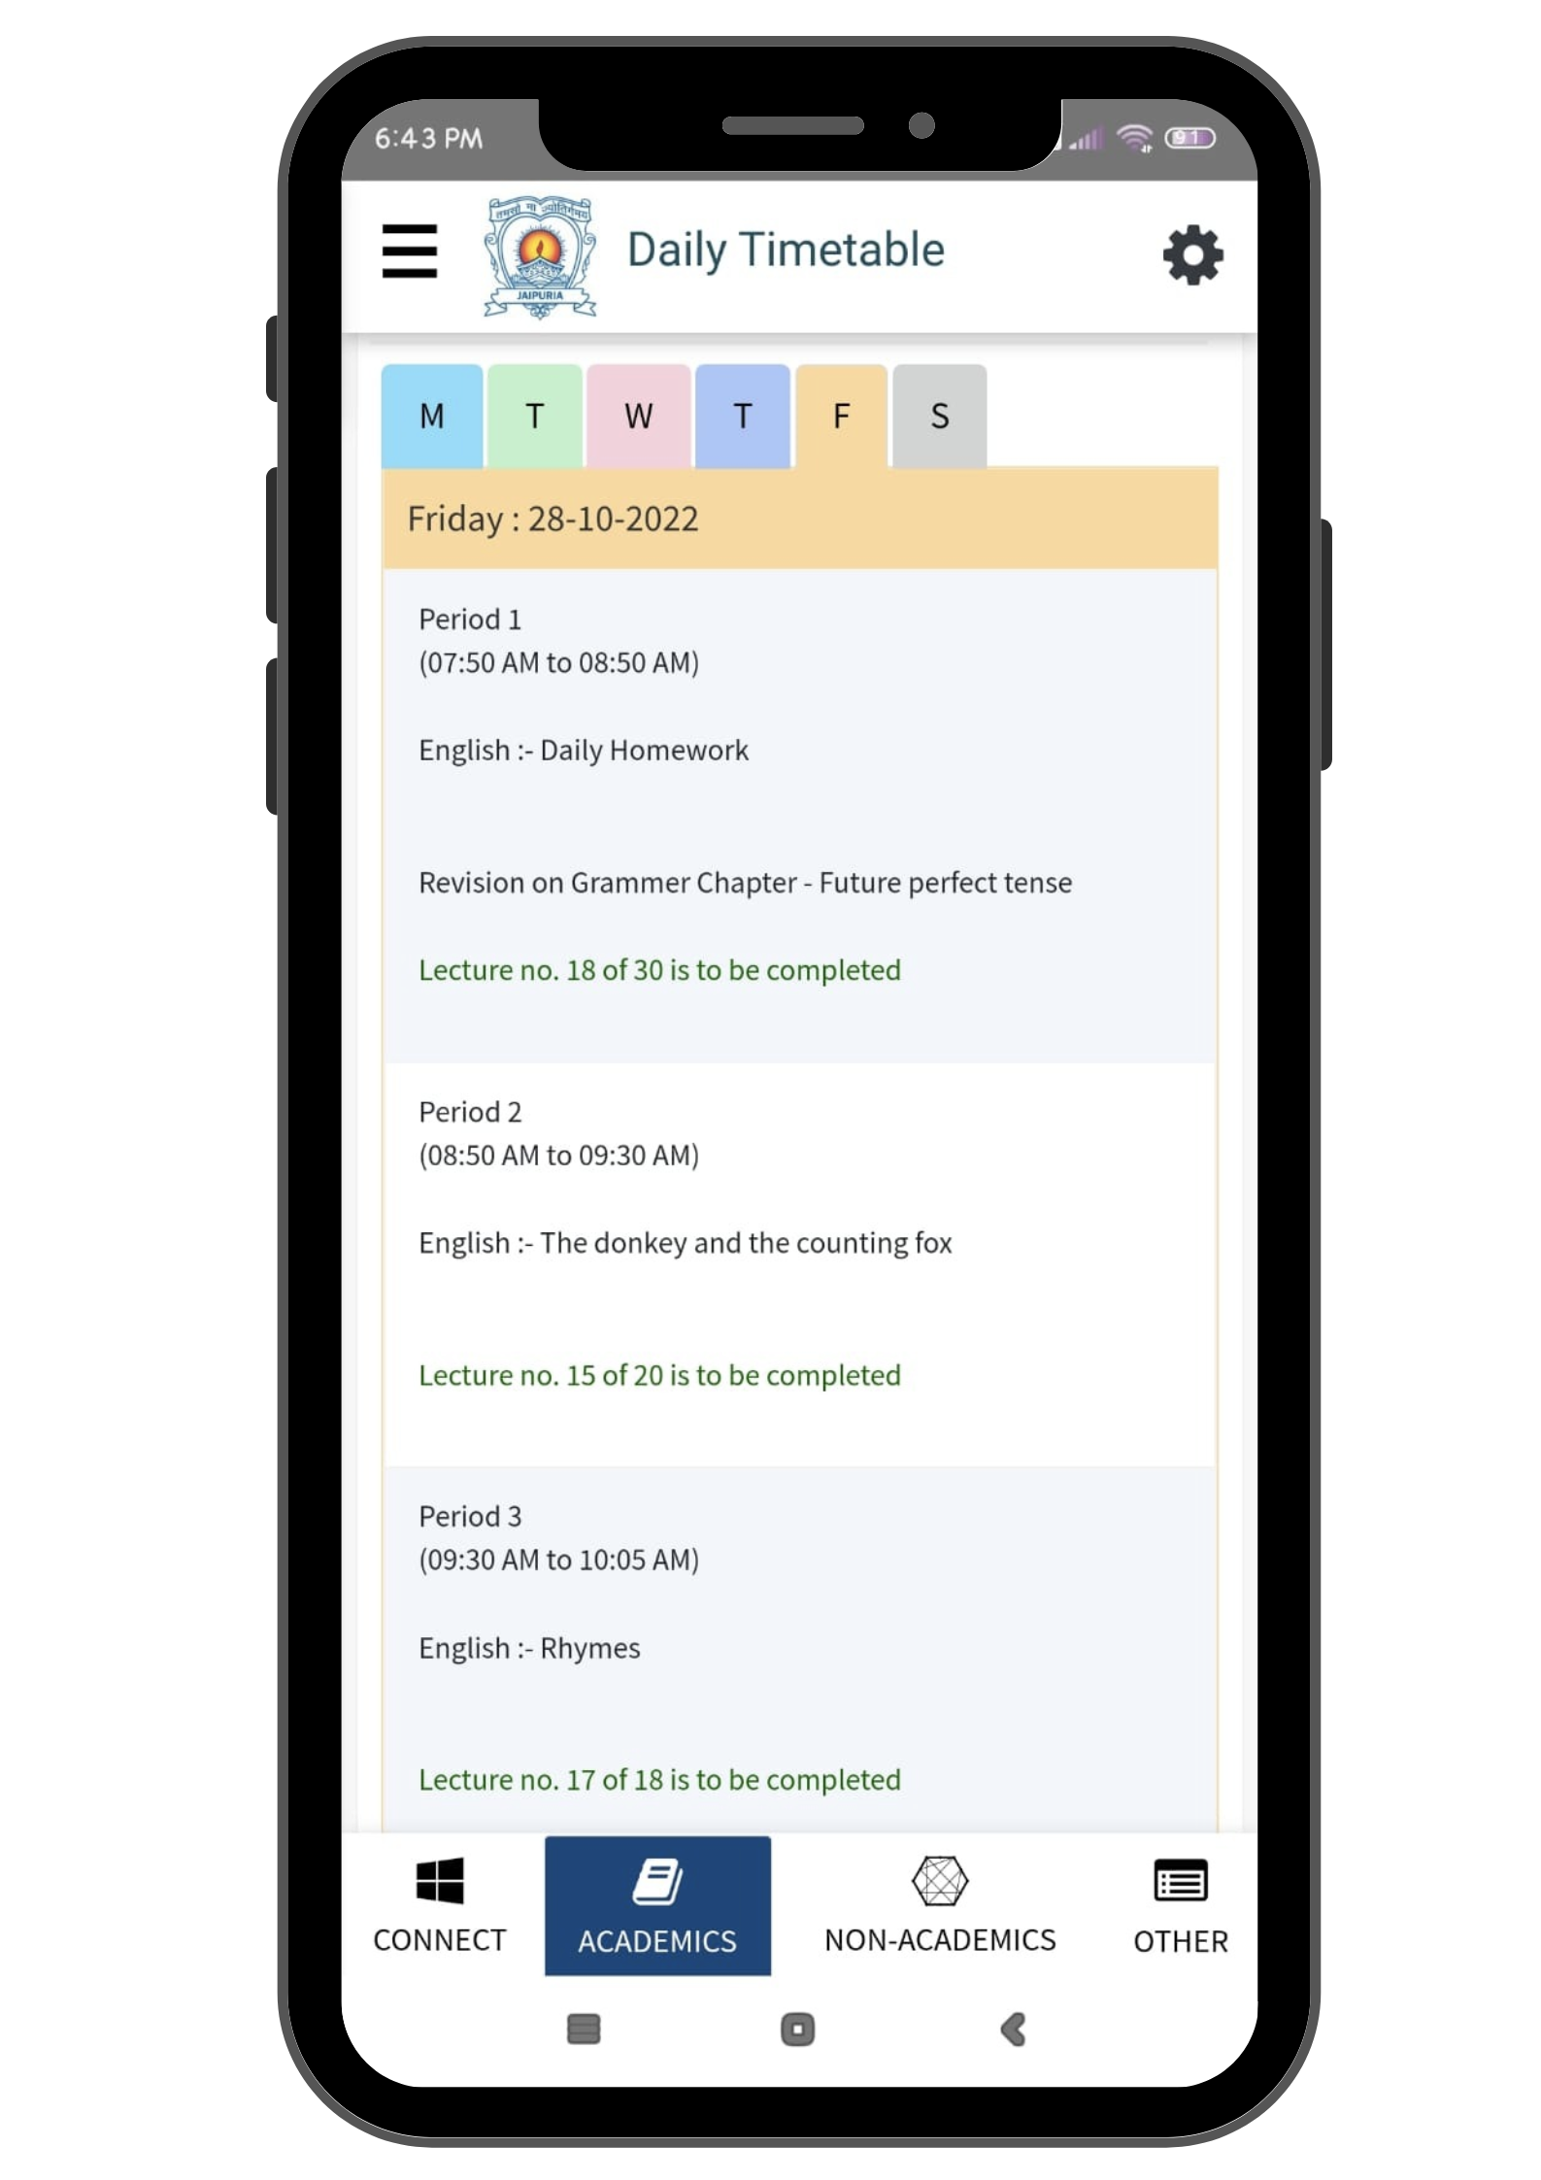
Mobile App Screens [1/3]

Slide 25
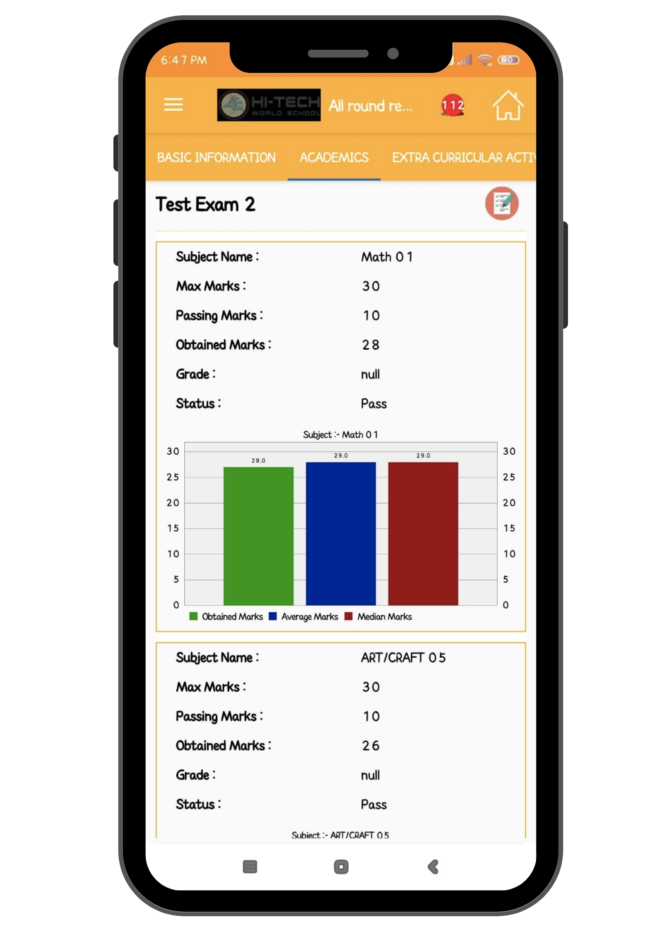
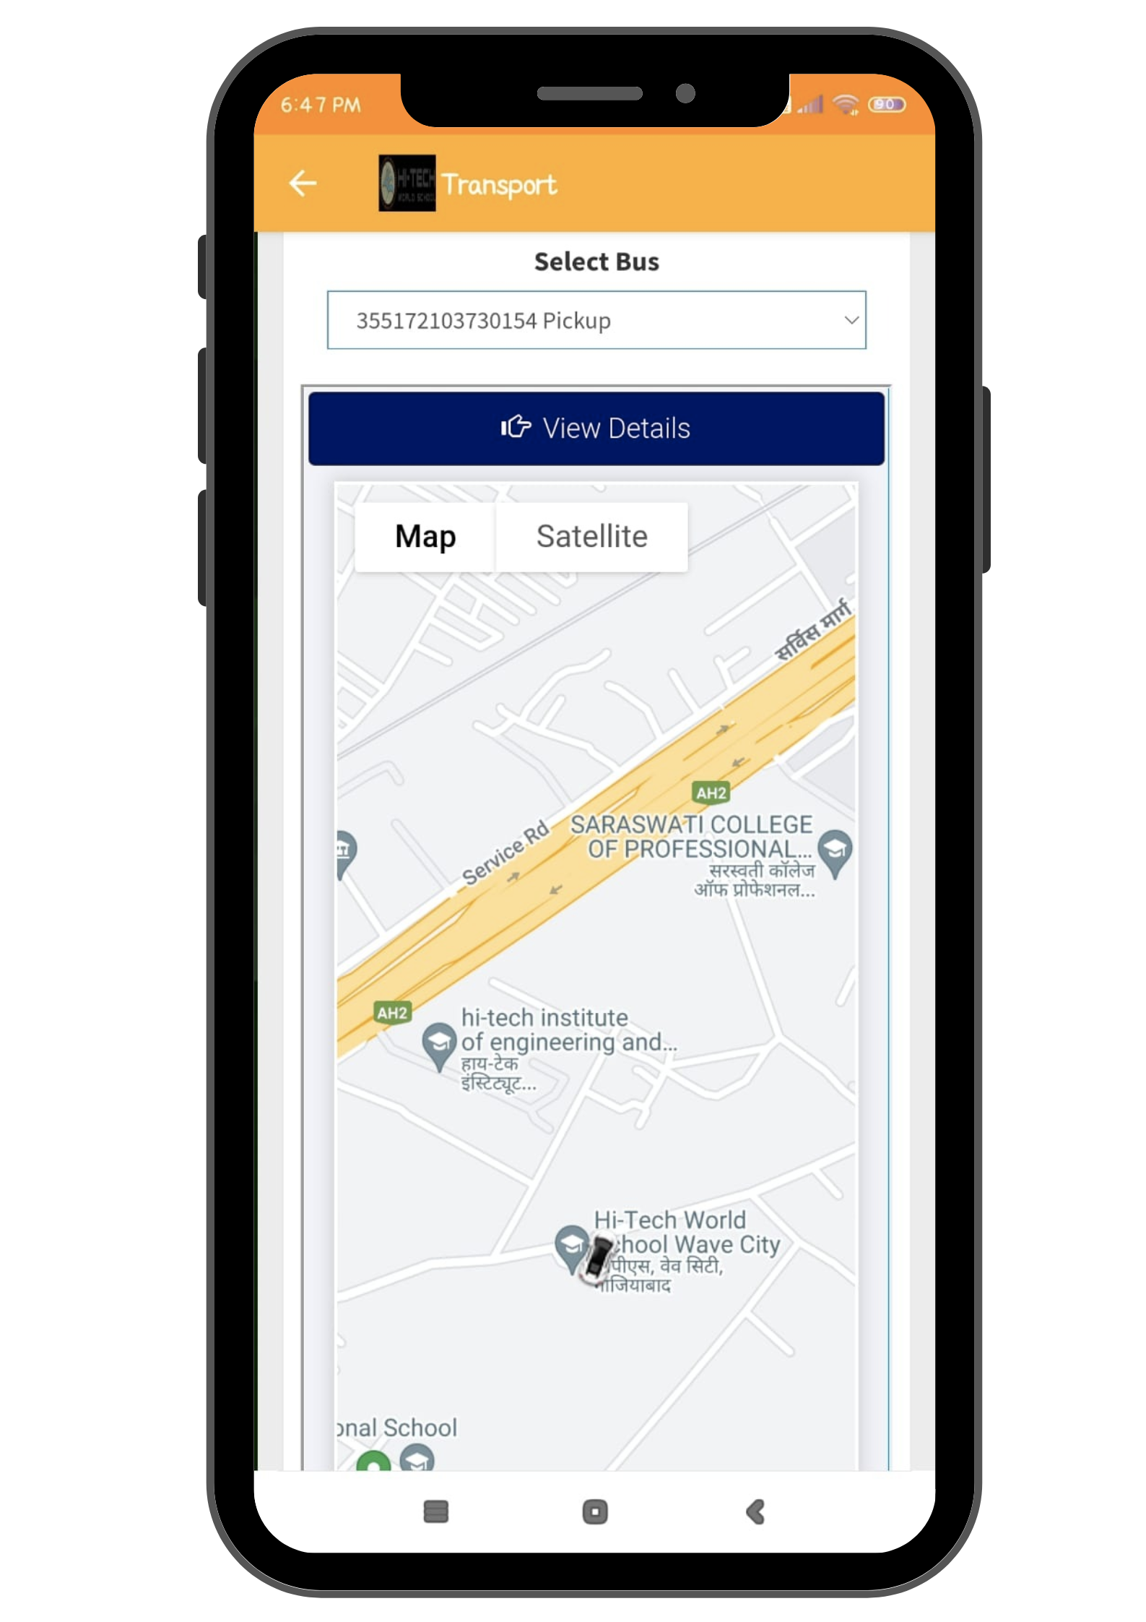
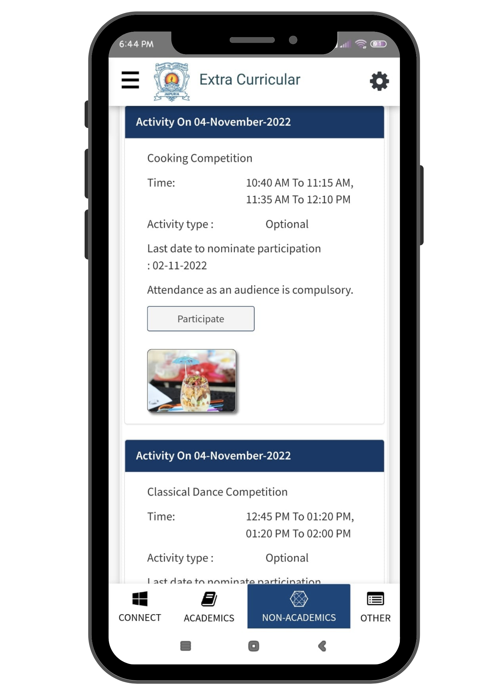
Mobile App Screens [2/3]

Slide 26
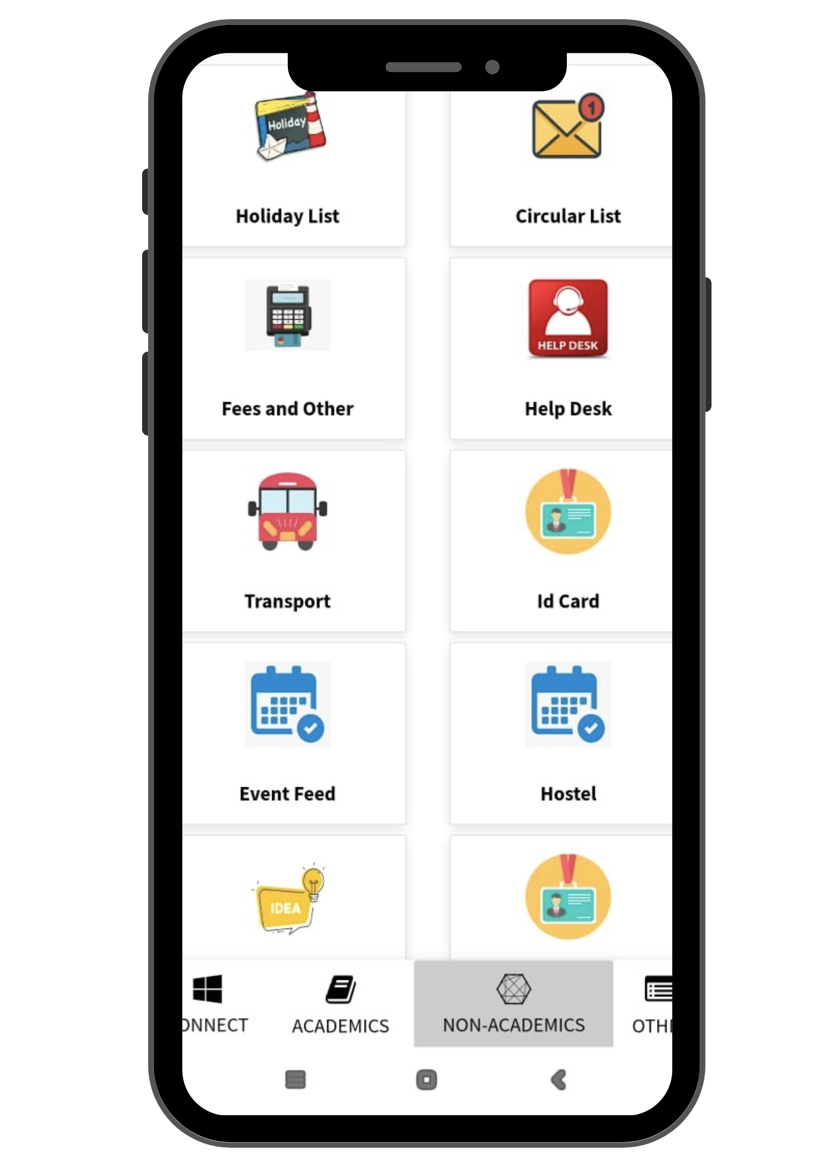
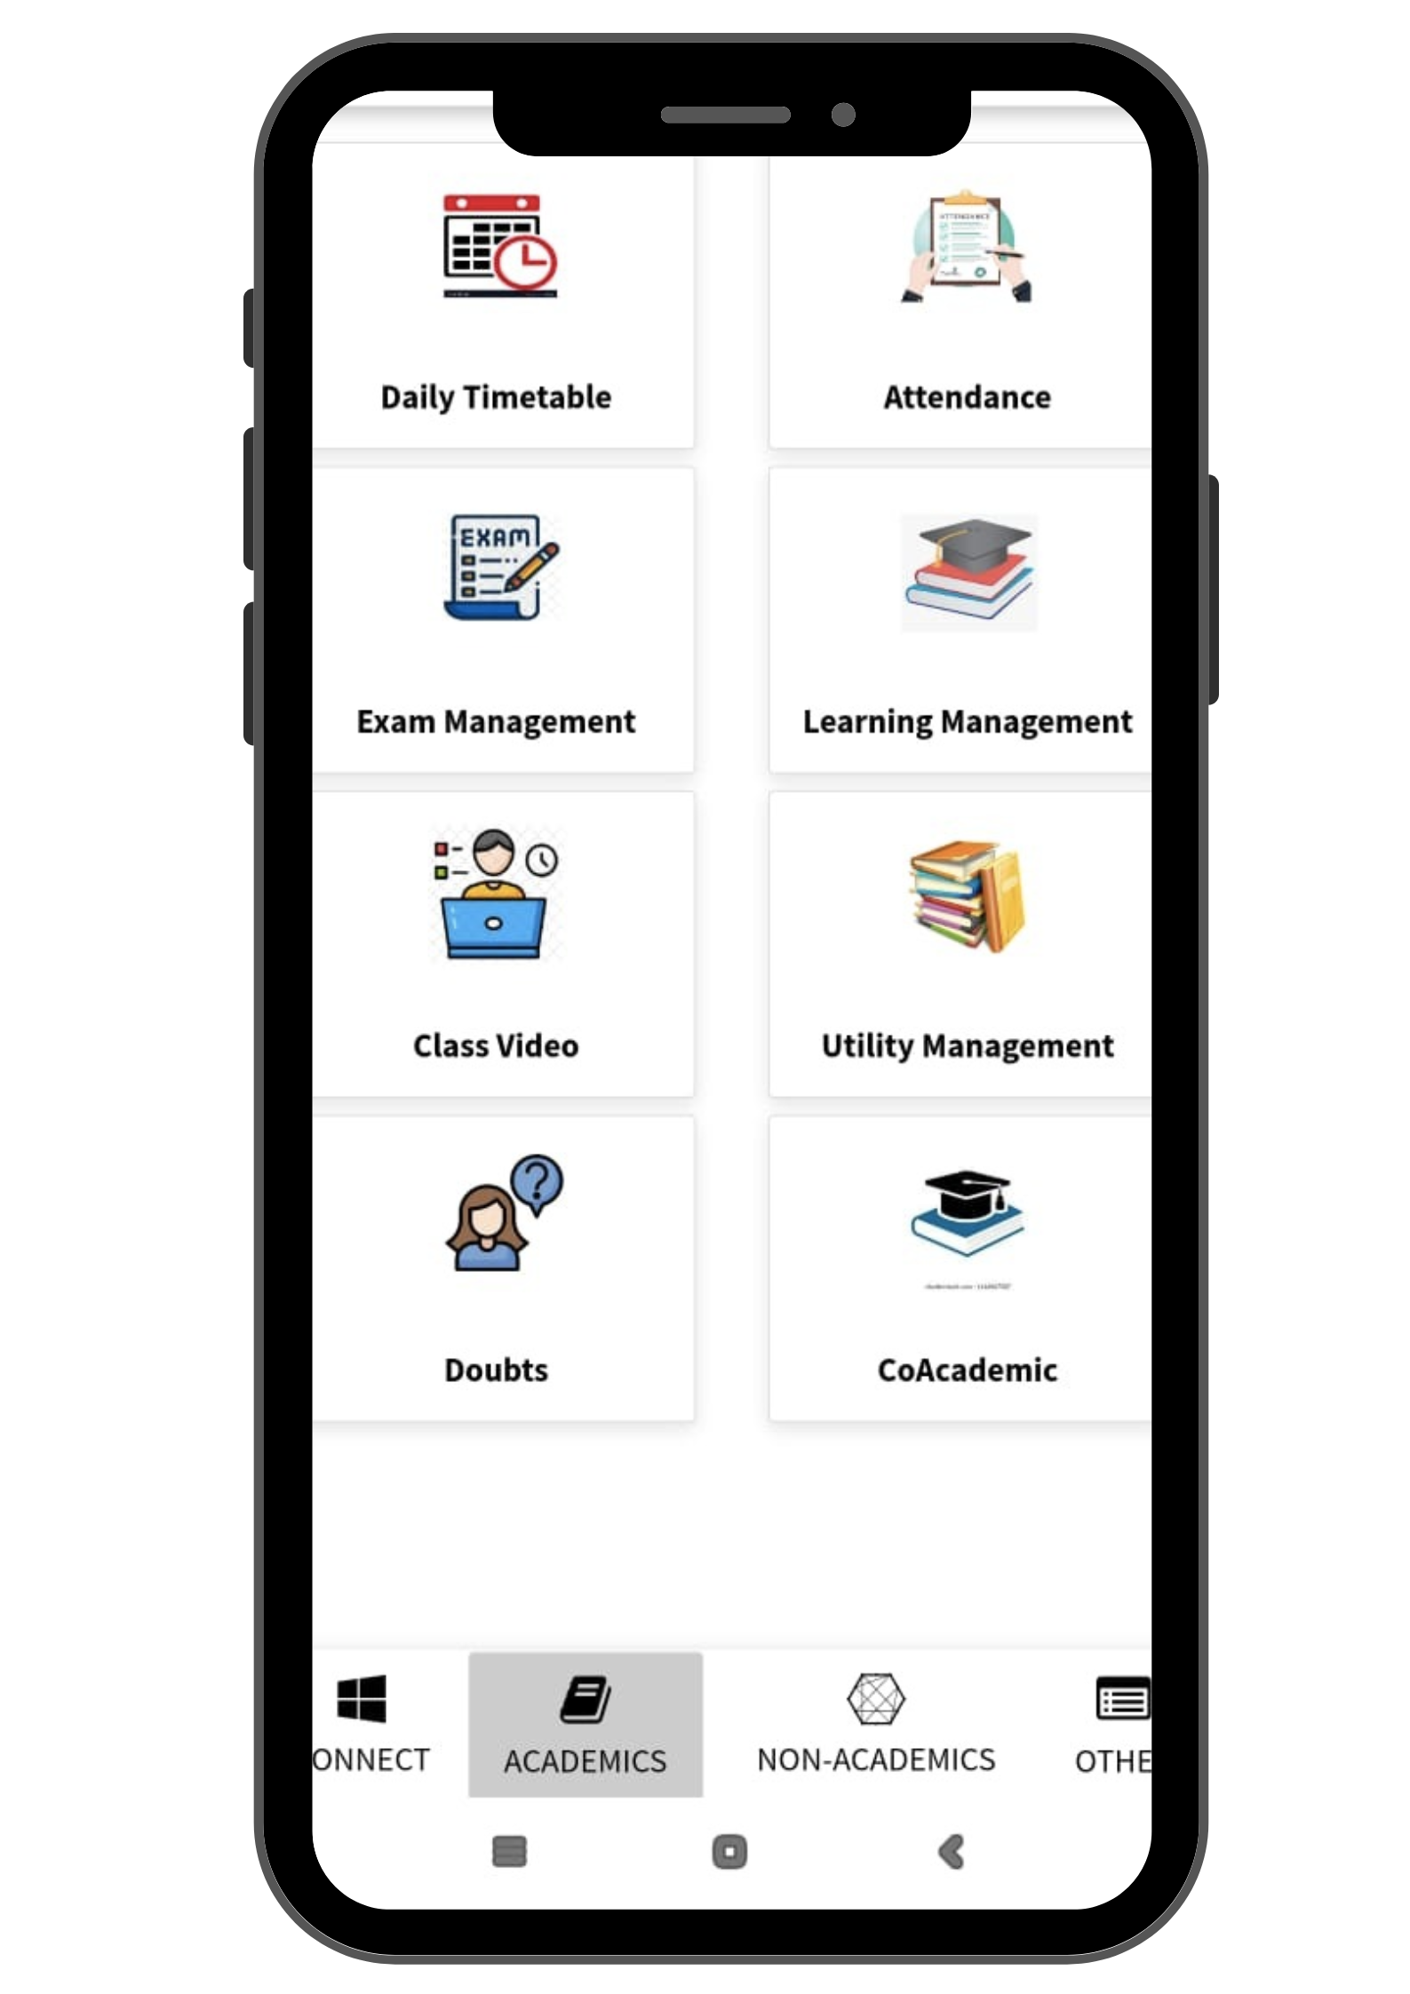
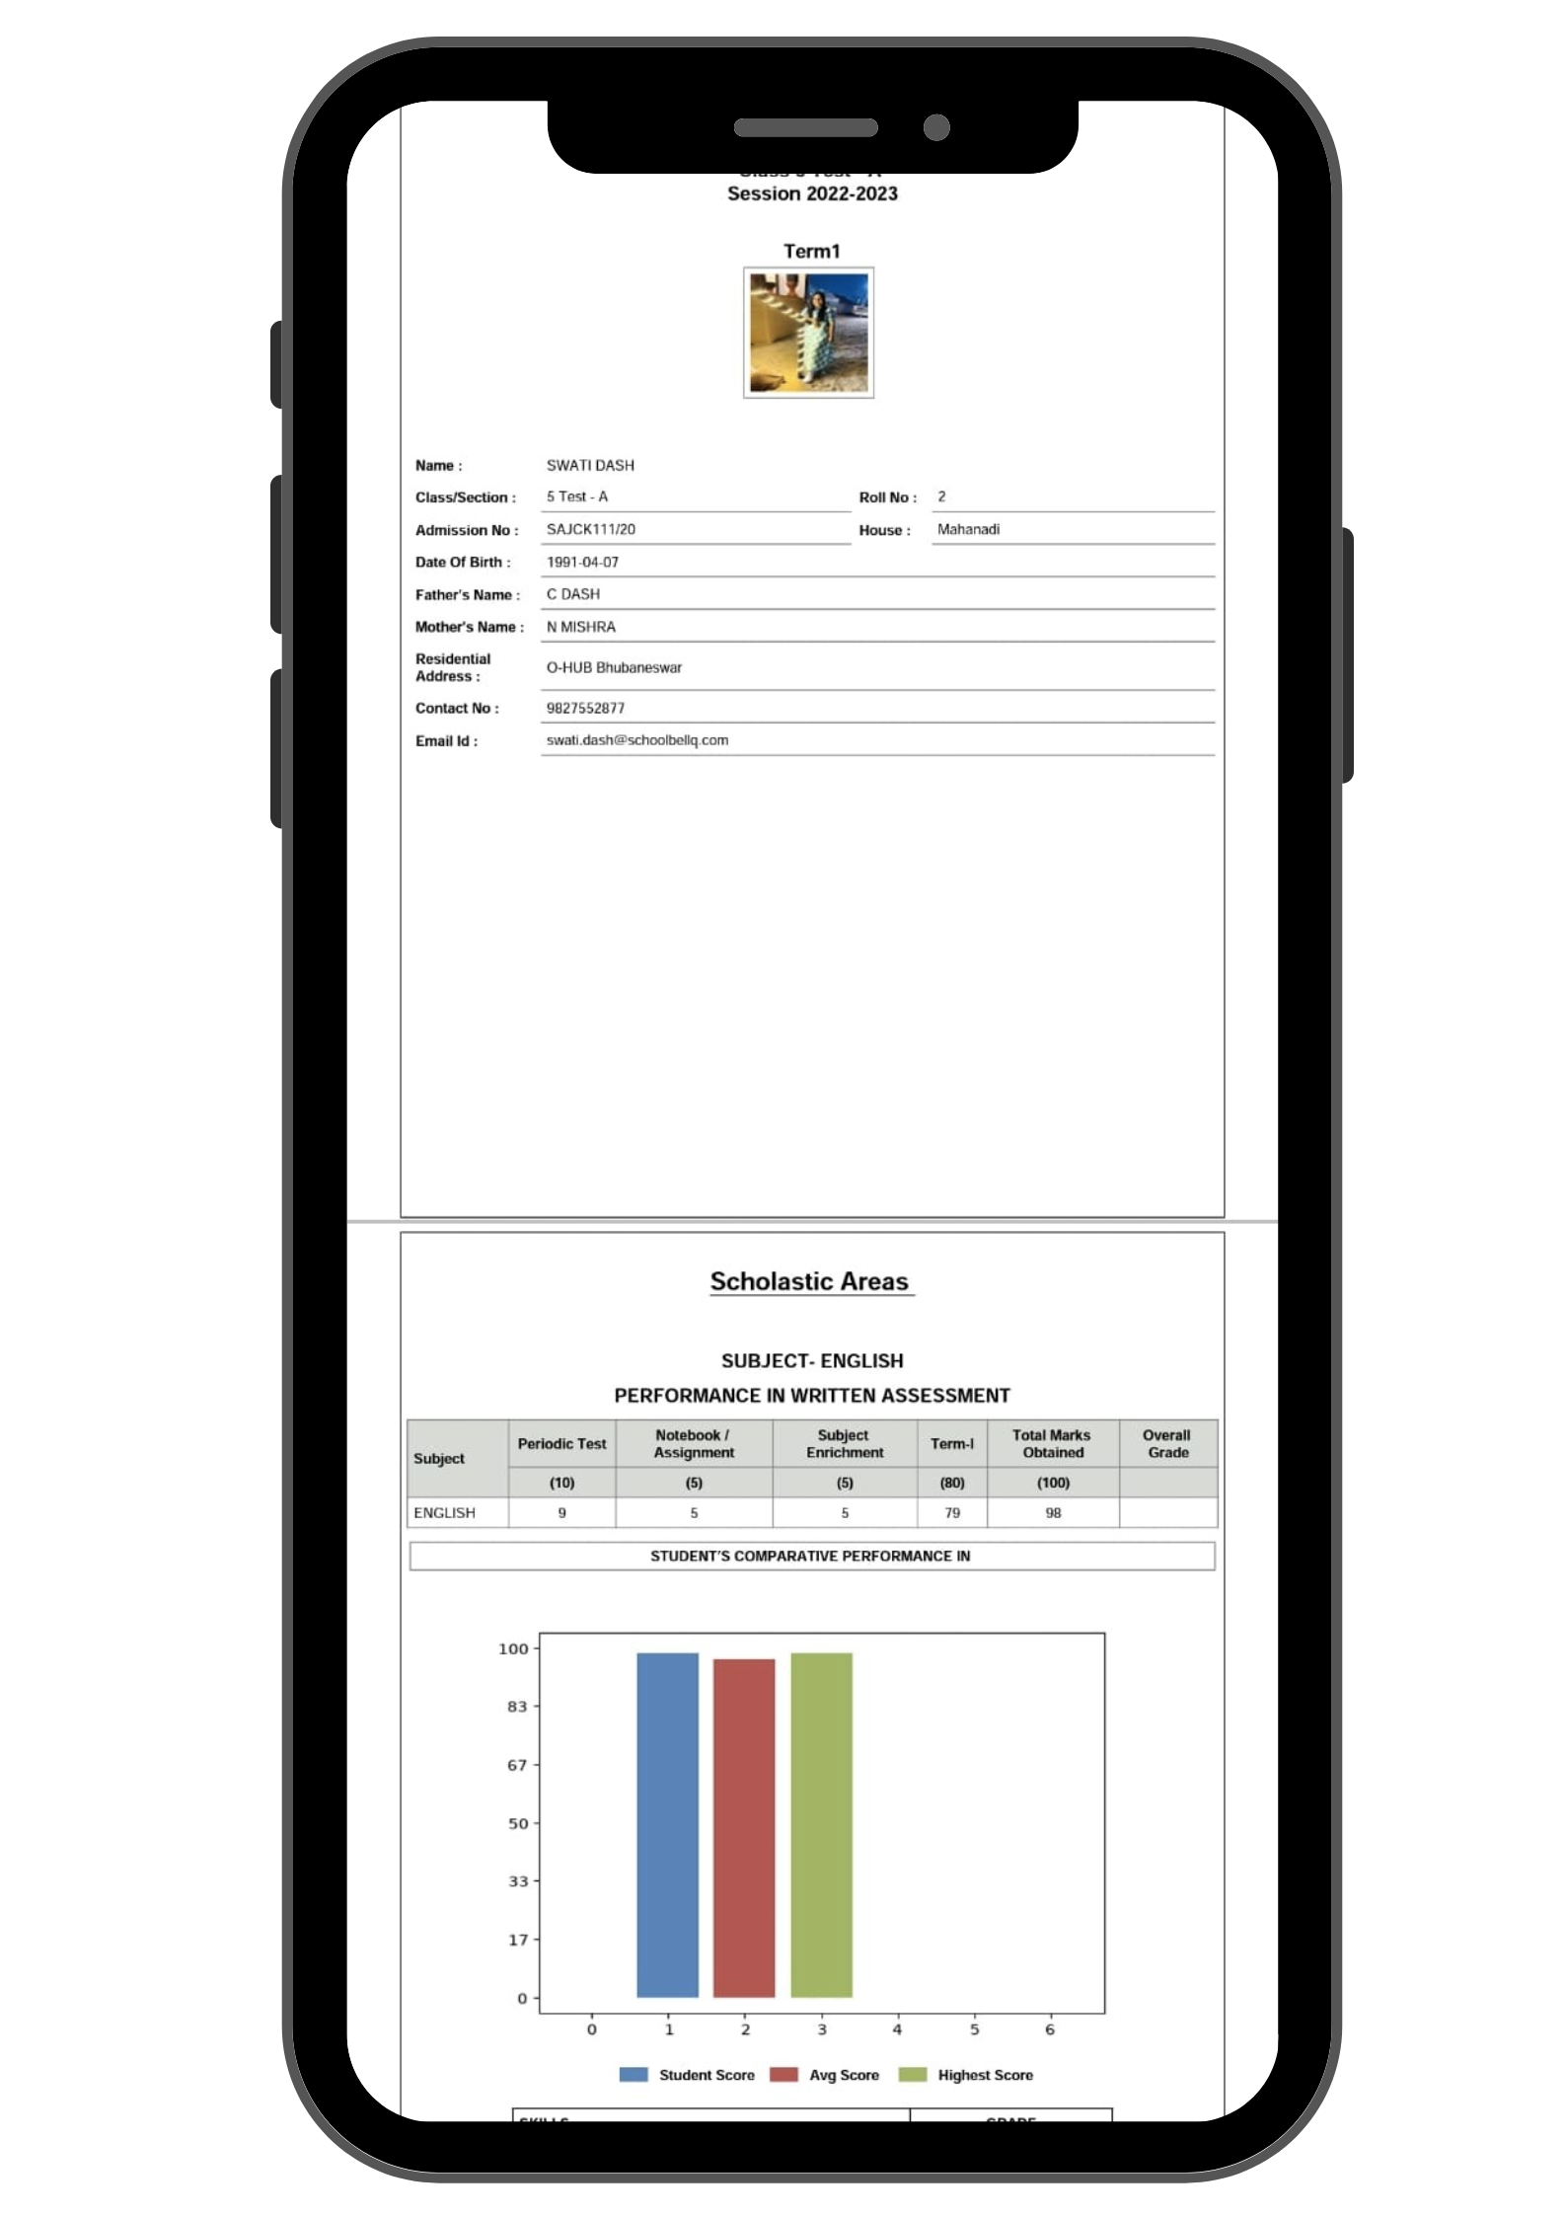
Mobile App Screens [3/3]

Slide 27


