Slide 1


21 March 2023
SCHOOLBELLQ
Admissions to Alumni

Slide 2

"It's not just about what we have,
but it's our ability to give what you want"

Slide 3




ABOUT US
Customer Empathy reflects in the following 3 critical attributes of our service
Service Edge
  On-premise School Associate
  Dedicated account manager
  24x7 customer care
Active Customisations in software to align with client's existing workflow.
Constant Upgrades, New Modules & developments, continuous infusion of latest Technologies.

Slide 4











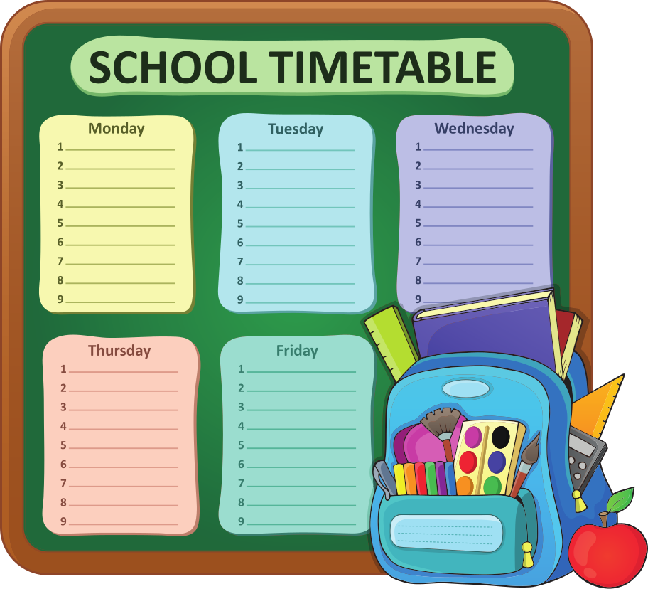






ADMIN OPERATIONS (Academics)
Manual &
Auto Attendance
Assign
Subjects
Manage Syllabus
II- Way Homework Evaluation
Gallery & Study
Material
ECA Nomination Option
Doubts
Management
Timetable Automation
Exam Management
Report Card Automation
Learning Mgt System (LMS)
Lesson Planning
Diary Module
AI Based Online Tests
Co- Scholastics Certificates
Voice Messages to parents
Student's
Communication
Zero-Code Report Cards

Slide 5




















ADMIN OPERATIONS (Non - Academics)
Lead Management & Digital Marketing
Pre- Admissions
Fee Management
Hostel
Management
Library
Management
Transport Management
IoT, GPS, RFID
cards deployment
EasyFee & Choice of Payment Gateway
Student Management
TC & Withdrawal Mgt
Teacher
Performance
Teacher
Management
Pharmacy Management
Happiness
Help Desk
Student Entry Exit & Leave Management
Utility Management
Student's Document
Student Vacancy Management
Discipline Management
Mgt Dashboards
& Reports
Handbook Management

Slide 6












BACK OFFICE OPS
Inventory
& Equipment
Employees &
Payroll
Incident Management
Visitors & Gate Pass Mgt
Recruitment Management & Appraisal
Attendance
& Leave
Parent Concern Management
Parent's Good idea Club
Circular Management
Surveys &
Feedback
Send
Notifications
General
Module

Slide 7


CUTTING EDGE FEATURES
Meeting the Gold Standard for Accounting Reports
Impeccable internal consistency in matching reports
Lightening Fast Reports
6 Million records populated in 2 minutes

Slide 8

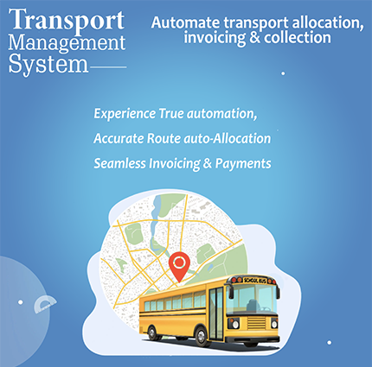
CUTTING EDGE FEATURES
Calibrated
Randomization
Not just sequence juggling but true randomization
Transport Invoice & Payment Automation
Auto Assign of routes & invoice generation instantly

Slide 9
TABLE OF CONTENTS
Chairman’s Dashboard Review
Lead Management, Pre admissions
Fees Management
Transport Automation
Class Management
LMS (Learning Management System)
Doubt Management
Inventory & Utility Management
Library Management
Student Analytics Report
Online tests
Student's Communication
Time Table Automation
Custom Report Card
Your App On Playstore
01
02
03
04
05
06
07
08
09
10
11
12
13
14
15

Slide 10

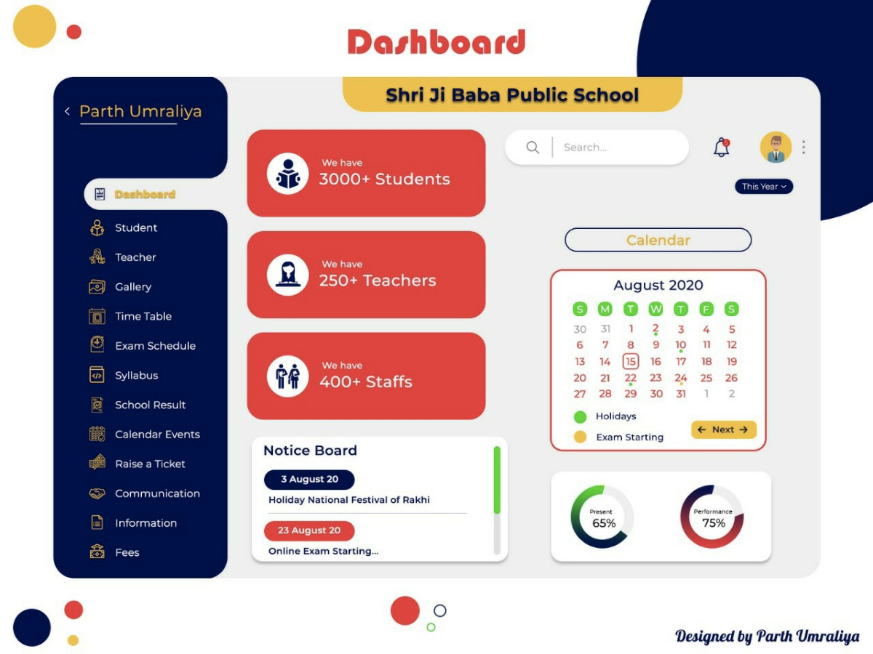
CHAIRMAN’S
DASHBOARD REVIEW
  Student Count - Reconciliation, daily admissions, TC and Net Increase in student strength in School.
  Operational Key data - Teacher's On Leave, Upcoming Exams & ECA Activity & Daily Student Attendance.
  Summary of homework & study materials assigned to students on daily basis with complete drill-down.
  Key daily performance parameters like Enquiries, lead Generation, Registration & Admissions.
  Quick Access to Notices posted in school, Pics of events in the school and quick links to key MIS reports that can be customised as per the user.
  Fee Defaulter summary for all quarters/months
  Complete Unpaid Invoice summary with deep drill-down feature on a single click
  Fees Concession summary with quick access to details.
02

Slide 11
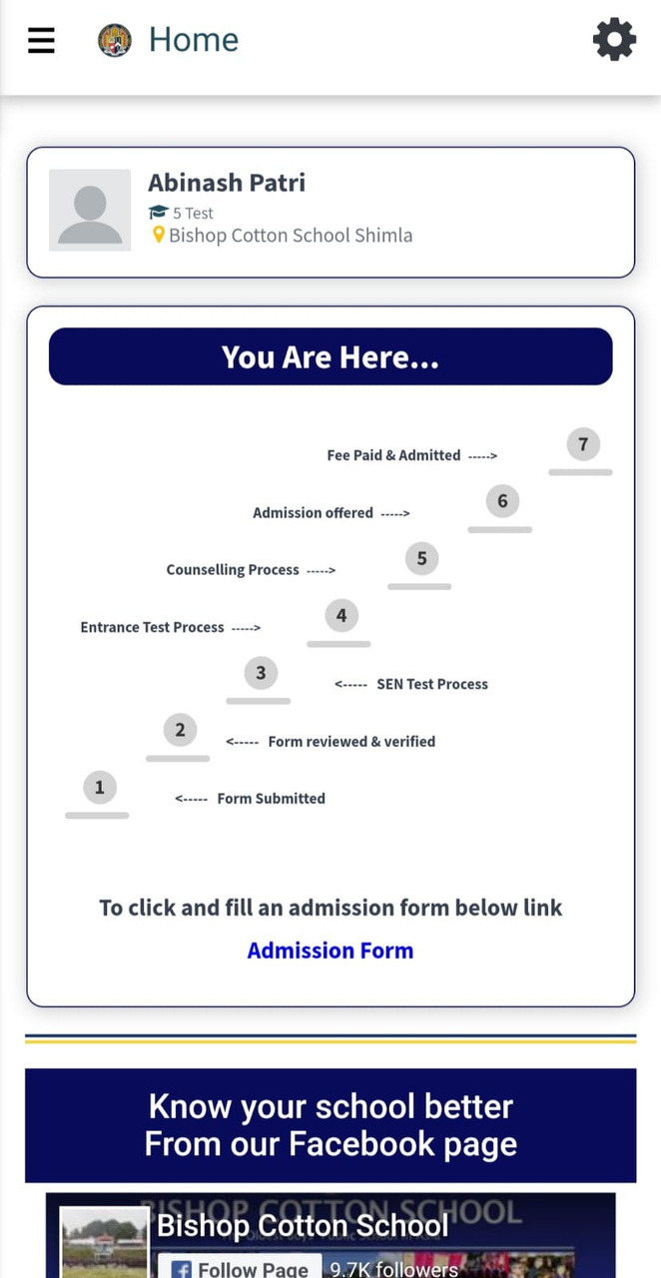










LEAD MANAGEMENT, PRE ADMISSIONS
  Pre-admission Module
  Admit Card ID Module
  Integrated Fee Management for New admissions
  Approval Mail Received by the Principal
  Invoice Concession approval
  Invoice for parent to pay
  Lead Generation Digital Marketing Campaign
  Lead Conversion with CRM
  Optimising digital marketing Performance
Lead Management Integrated Digital
Marketing with CRM
Pre-Addmissions, Admissions
  Create custom links
  Leads from multiple Sources
  Lower TAT between Lead generation & Closure
  Constant Connect with parents
  Counsellor Performance measurement
  Enquiry & Prospectus Module
  Automated Workflow for Admissions
  Ready to use tests available for online admissions
  Online proctoring, Auto- Evaluation, Varied question formats
  Admission Test Result Publication
Lead Management
Enquiry, Online Tests, Results
03

Slide 12
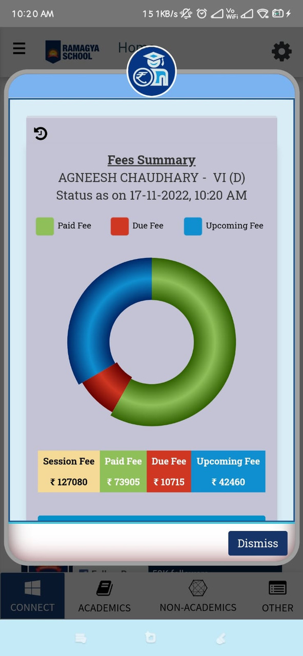
FEES MANAGEMENT
  Fee Dashboard
  Fee Management
  Tally Compliant & Integrated
  Discount & Online approval Functionality for Admission Fees payment
  Deferral or Partial Payment Online for Admission Fees
  Exhaustive Reports
  Fee Notifications
  Reporting & MIS
  Admin Platform - Easy Collection of Pending fees across sessions through Single Unified window
  Parent's App - Single Unified window in the SchoolBellQ* App for Payment of Pending fees across sessions
  Credit note
  Advance Fees Payment
  Speed prowess- 6 million fields report
  Accuracy prowess - 3 reports internal consistency matching ( student fee new report, daily fee collection, class wise MKS (matching with difference in 2 reports to arrive at daily collections report)
04

Slide 13
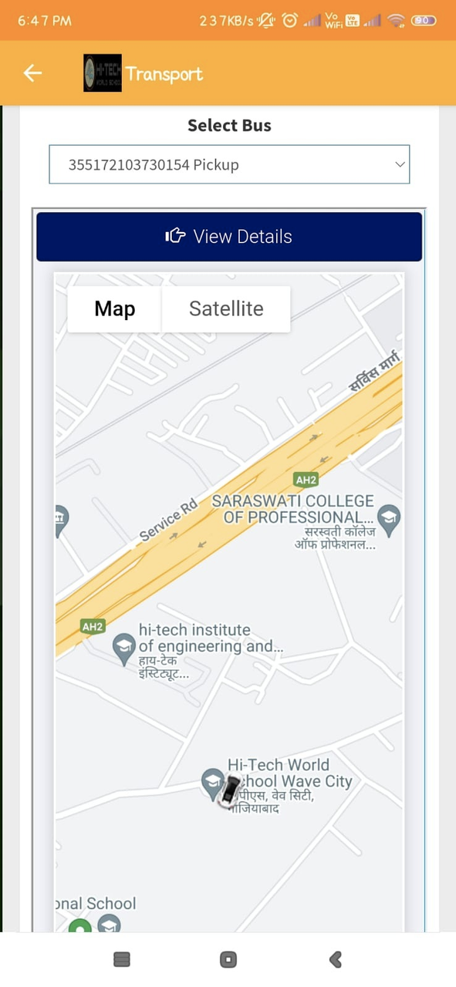
TRANSPORT AUTOMATION
  A holistic transport management module encompassing Bus, Fleet, Route and corresponding fees linked to the students.
  Complete details if the Bus including Driver details, Photo, contact details ad GPS Id etc with assigned route to ply
  Bus Routes can be composed by assigning multiple stops.Route staff like driver, helper & Guard can be allocated.
  Bus stops with the GPS location with precise lat-long and distances can be defined on the route and financial charges be assigned.
  Route & Stop Allocation with financial linking
  Auto Allocation of Transport - Parents can choose their stops for pickup & drop locations
  Auto Invoice generation & assignment
05

Slide 14
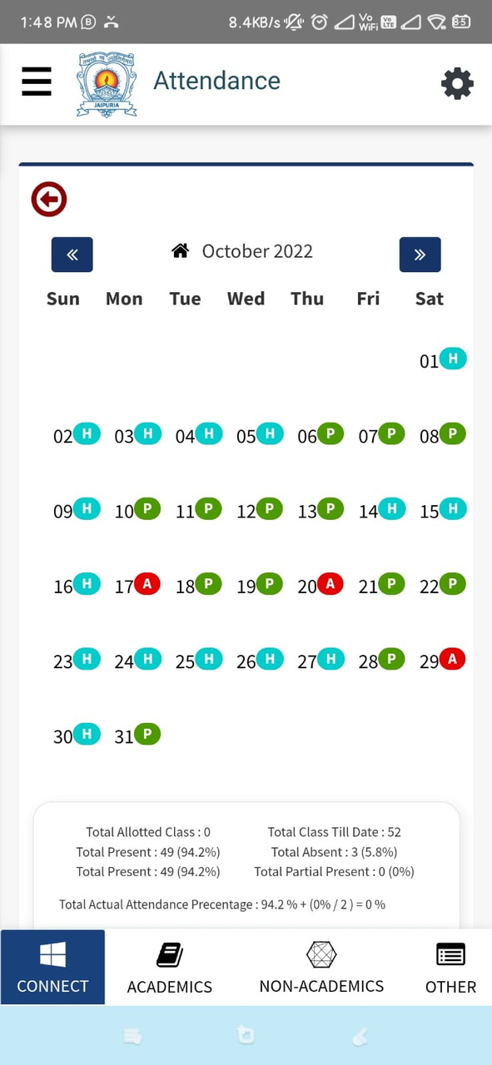
CLASS MANAGEMENT
  Assigning & Re-assigning Roll numbers
  Attendance Management
  Attendance Report Analysis
  Temporary ID Cards
  Gallery Management
  Student Teacher Chat
  Diary Management
  Extracurricular Activities Management
  Co-scholastic certificates
  Close looping Homework
  Syllabus Planning integrated with timetable
  Unit & Lesson Plan Management
  Report Card Automation
  Student Analytics Report
06

Slide 15
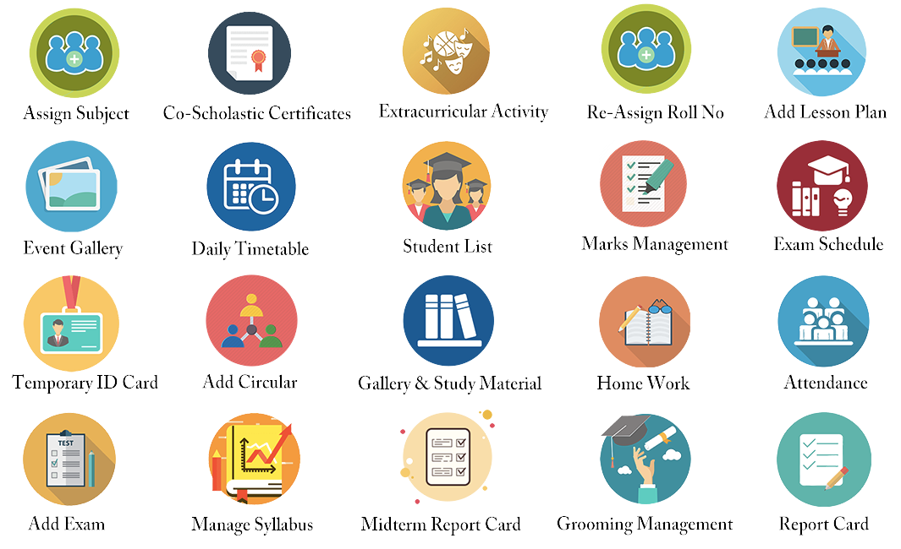


CLASS MANAGEMENT
Assign Subject
Co- Scholastics Certificates
Extra-Curricula Activity
Re-Assign Roll No
Lesson Planning
Event Gallery
Daily Timetable
Student List
Marks Management
Exam Schedule
Temporary ID Card
Circulars
Gallery & Study Material
Homework
Attendance
Add Exam
Manage Syllabus
Midterm Report Card
Grooming Report
Report Card

Slide 16
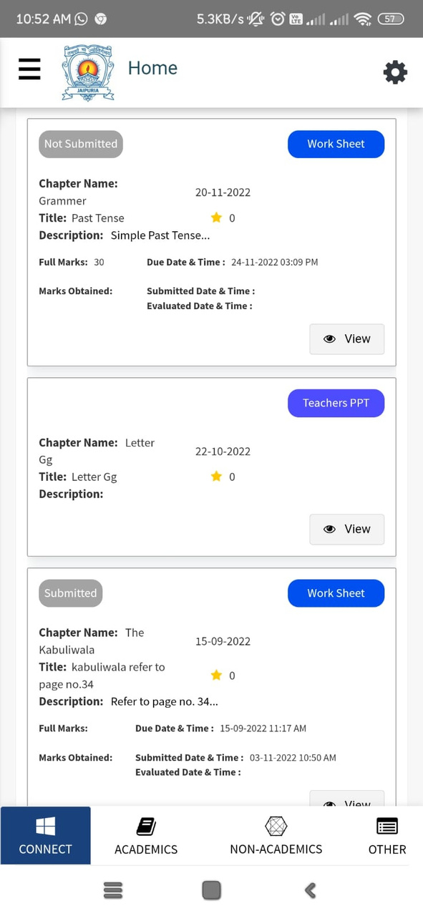
LEARNING MANAGEMENT SYSTEM
  Organize Learning resources to provide easy access to students
  Rich functionality that allows Actions like View, Evaluate, Reminders, Custom messages, Download each homework or worksheets.
  Annotate submissions without download feature
  Lucid & intuitive UI
  Easy Search Filters & Indexing
  Confidentiality of Proprietary material
  Multiple Formats & types
  Rating & Review by the students
  Exhaustive Reporting
07

Slide 17
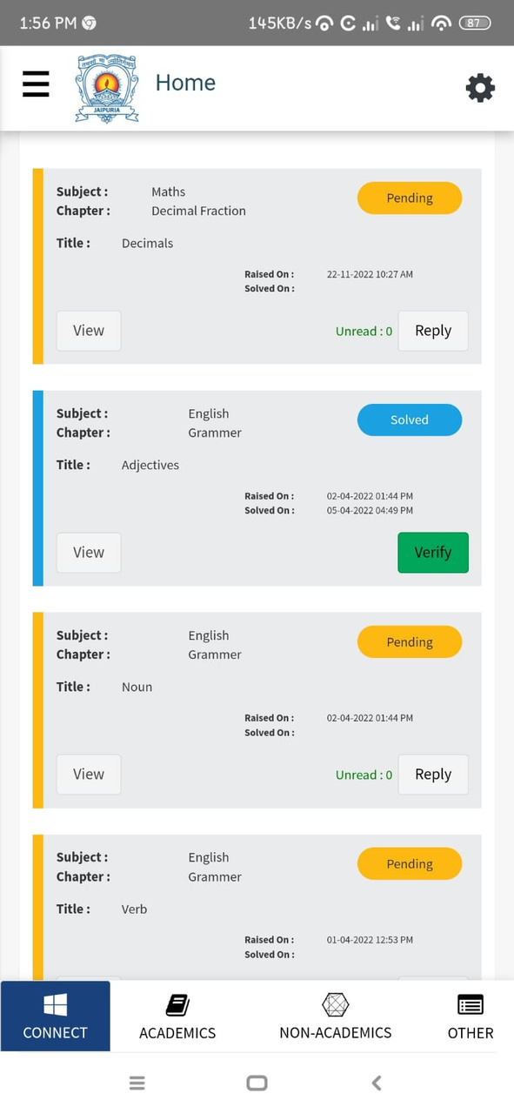
DOUBT MANAGEMENT
  Doubt List categories (Pending, Verified, Solved)
  Teachers can schedule doubt clearing meeting directly from our system.
  Close looping the communication through receiving a "verified" status once the student checks it.
  Support extended beyond classroom
  Increase Student - Teacher performance
08

Slide 18


INVENTORY & UTILITY MANAGEMENT
  Allows school to receive Uniform, Books etc. as Inventory item and issue them & receive payments
  Creation of multiple item type and define individual stock level.
  Critical feature like Inventory valuation at different price points for the same item
  Features like Re-ordering level and minimum balance concepts already built in to facilitate
  Fully functional Reporting module with multitude of reports , item-wise & Dept wise consumption, Stock arrival, Rejected items report etc
  Facilitates The Selling Of School Materials Online To The Parents
  Multiple Relevant Books & Stationery Sets With Various Subject Combinations For Each Class
  Automated fee collecting
  Defining Composition Of Packages And Mapping To Classes
  Offered For Sale To Parents Online
09

Slide 19
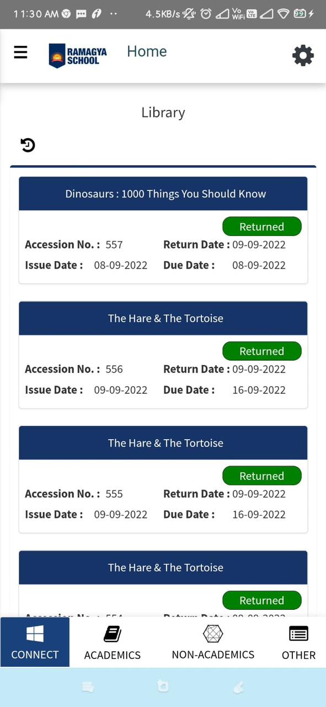
LIBRARY MANAGEMENT
  Comprehensive Library management module with intuitive and easy to use UI with no limit on the fields
  Books to be uploaded along with auto-FINE calculation and integration with main fees.
  Generating BAR code & Option to add books with BAR code
  Adding and maintaining newspaper register
  Status check of verified, unverified and discarded books list
  Book availability and issue reports.
10

Slide 20
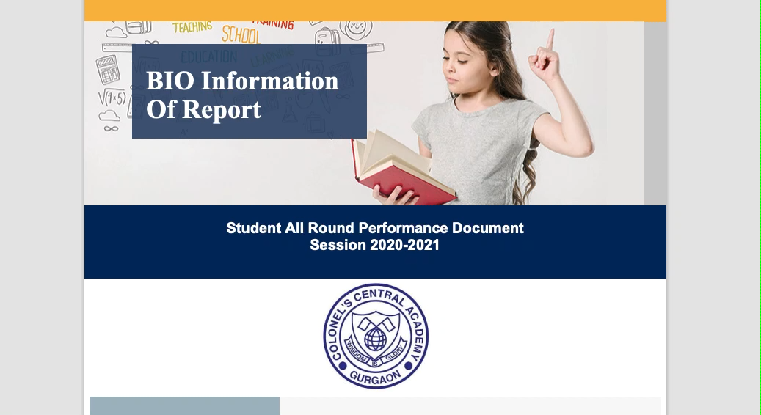
STUDENT
ANALYTICS
REPORT
  ESM REPORT
  Individual Trend And Class Comparison
  ECA & Sport Participation
  Medical Incident Report
  Medical Incident Report
  Class Bench Marking
  Rank Table
  Attendance
11

Slide 21
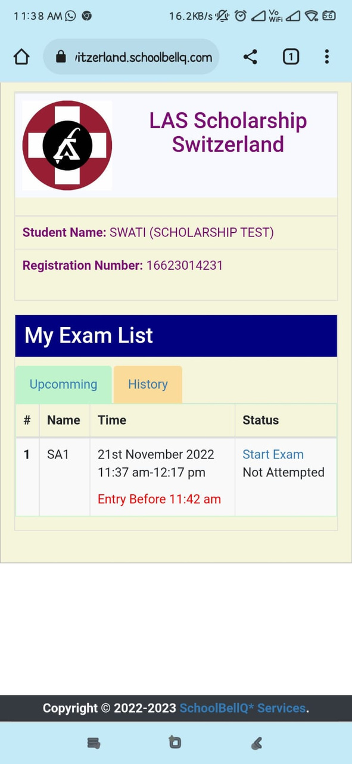
ONLINE TESTS
  Seamless, intuitive & easy-to-use platform for creating and administering timed weekly class tests.
  Provides support for the various modes of testing MCQs, descriptive & reading comprehension.
  Immediate evaluation based on pre-fed 'correct' answers along with features like screen-time & concept knowledge-level analysis.
  Tests reinforce & consolidate weekly learnings & induce higher engagement from students towards the subject matter.
  Online Question Repository
  Attribute Based analytics
  Post Test Analytics - Diagnostic Report
  Instant Result computation
  Screen Behaviour
12

Slide 22
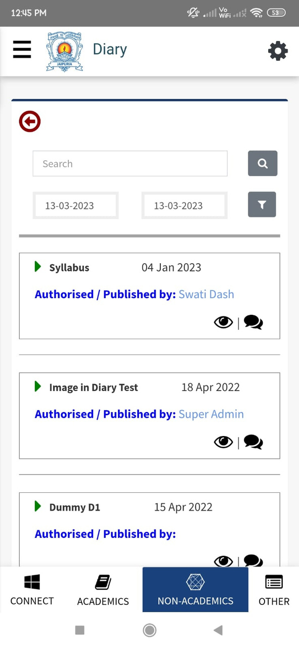




STUDENT'S COMMUNICATION
  Auto Alerts for circular publishing
  Manual Publishing/Scheduled Publishing.
  Multiple Circular Media Type Support
  Read-Receipt Feature.
  Unpublish feature
  Whatsapp Notification
  The notifications are fired through all three channels, namely SMS, Email & App Notifications.
  Three categories of Notifications - Regular/ Important/ Extreme Urgent
  Delivery Report.
  Single Click Trigger
  Auto-generated notifications
  Just like traditional diary teachers can update information about academics, extra-curricular and regular activities.
  Read receipt feature allows teachers to see which parents have read the diary.
  Multiple Media Type Support.
  Rich text features available in the editor
  Student - Teacher chat available
  Our system delivers personalised fees notifications that give a significantly better impact on payments
  The bulk sms notifications are personally marked with name, invoice number, student name, amount.
  Every Parent gets a personalized payment link enabling payment in a single click in mail or SMS.
14

Slide 23

TIMETABLE AUTOMATION
  Auto replicating takes care of absenteeism.
  Teacher availability reports or occupancy reports to help schools plan and schedule better.
  Gives instant access to all teacher’s details including Date of Joining, Retirement, Qualifications & allows to manage timetable.
  Teachers can apply leaves which get directly into the time table indicating the affected classes.
  Micro-scheduling in time table with the chapter & description of content planned to be covered.
  Combining' Class Feature (combine class to make up for a teacher shortage/Leave).
  Optional Subjects based time-table ensuring students see only the relevant optional subjects chosen by them.
  Reports based on Teacher Workload distribution.
16

Slide 24

CUSTOM REPORT CARD
  Amazing new feature that empowers the teacher to design report cards with simple drag & drop.
  Teachers can do as many iterations effortlessly to arrive at their perfect Report card, that too without the IT developers.
  Get Ready to Print files for Report Card - automatically for CBSE or any other board as per your requirements.
  Ability to take YOUR 'Detailed Report Card' online through our technically superior Coding team to deliver automated Report cards as pr CBSE specification.
17

Slide 25

YOUR APP ON PLAYSTORE
  We have developed a unique ability to make customised apps in your school's name, flaunting your name and boosting the school's brand.
  The school can choose the name and logo, and our team will launch the same in the App Store and the Google playstore.
  We will further back it up with complete branding support of the school's custom website for the app in their URL and the comprehensive back-end customer support for a password resolution.
18

Slide 26

THANK YOU
FOR YOUR ATTENTION

