Slide 1

SchoolBellQ* Services
Your one stop solution for Complete School Automation Services

Slide 2
Presentation Overview
Presentation Flow
This presentation has been broadly divided into 6 sections to help audience easily comprehend & navigate to various sections.
Section I: Unique Service Model: Learn how our services model ensures value add is delivered to schools
Section II: Maximize admissions: Combine our CRM with Digital Marketing to fill in more seats
Section III: Academic Ops: A peek in our superior tools that help you ace your academic operations
Section IV: School Admin Ops: Our Modules that offer tremendous convenience to manage your school
Section V: Back Office Ops: Manage your back offices like Inventory, HR etc. with user friendly modules
Section VI: Cutting Edge Technology: Latest advanced features & functionality to stand you ahead of competition
Your one stop solution for Complete School Automation

Slide 3
Section I
Unique Service Model

Slide 4
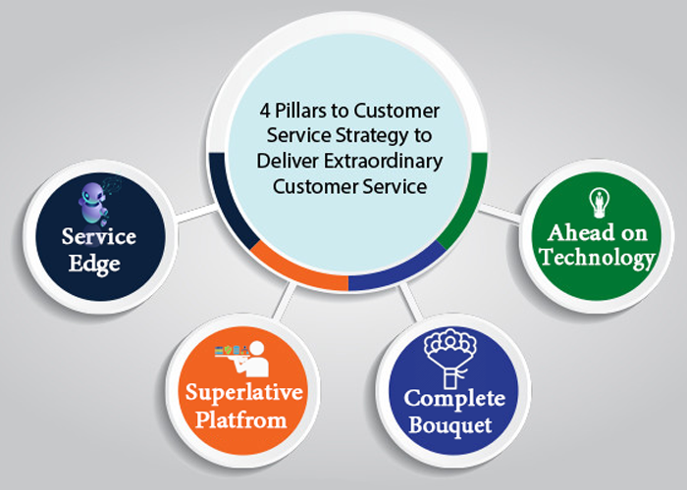
Unique Service Model
Section I
Section Overview:
Unique Service Model
Our unique service model is designed to facilitate the 'value add' delivery. Our value add delivery objective is accomplished by thoughtfully combining the four elements of
Service edge
Superlative platform
Complete Bouquet
Ahead on technology
Parent/student app
Apps for all [teacher and staff]

Slide 5
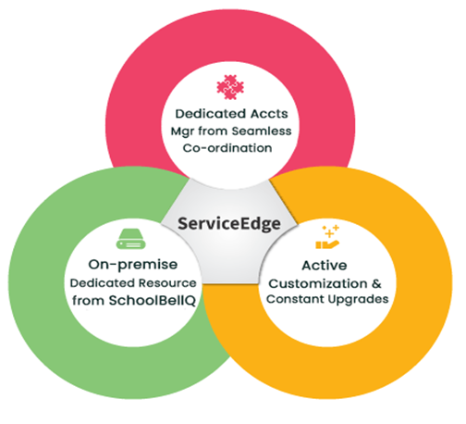
Service Edge
Section I
Service Edge essentially implies the human element of the Service that is critical to translate the Service from the software.
It is here that our Service Edge comes into play with our 'Managed Service model' that puts the onus on us to ensure that 'value add' is delivered fully.
We achieve it through On-premises Full time trained & dedicated school associates for training school staff, updating inputs, ensuring hassle-free usage.
A dedicated account manager supports the associates for troubleshooting and planning active customizations.
The customer care operates 24 x 7 to assist the parents with the app & fee issues directly

Slide 6

Superlative Platform
Section I
We have a Superior admin platform with a unified view of rich functionalities and features.
Insightful Visualization, drill-down dashboards for ease of navigation, Intuitive UI & UX for users.
Single click drill-down for easy navigation directly from deep-dive dashboards.
Powerful servers to handle complex functionalities & tasks like timetable scheduling with constraints.
We have the capability for High-volume Online exams for bulk testing for resource-intensive activities.
Multiple Intelligent Insights: automated analytics presented with graph-based Visualization and robust reporting
Use of best coding languages and latest coding frameworks to give you the best experience with the latest functionalities to keep you ahead on the technology curve

Slide 7

Complete Bouquet
Section I
Meeting school needs END to END on a single unified platform
From social media tracking to lead management combined with the power of digital marketing modules.
From Online Test modules with AI-based proctoring to advanced Result analytics to Random Question paper generation
From the essential staple for back offices like HR & Payroll & Inventory to Advanced Fee Modules & Time-table substitution module, we have everything to support our school partners and four apps for Staff, Teachers, Management.

Slide 8

Ahead on Technology
Section I
Continuous upgrades, embracing new technology proactively.
We keep you ahead on technology by incorporating new technology.
Be it AI (Artificial Intelligence) for proctoring your online exams or App-based facial recognition driven attendance, be it APIs integration with WhatsApp, Online Video apps like Zoom or Google Meet.
Be it the basic GPS for vehicle tracking, Active or Passive RFID cards or Beacon based ID card for attendance, Barcodes or Library management or a higher level integration like Tally integration, payment gateway integration, etcetera.

Slide 9
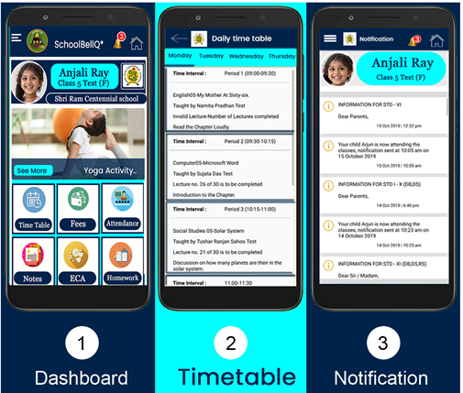
Parent/Student App
Section I
We have 2 absolutely awesome Apps both on Android & iOS platforms by the name of SchoolBellQ*
Excellent Ratings of 4.5 for our android app on Playstore is a testimony that we exceed expectations
Both the apps have accumulated user downloads of over to 50000

Slide 10
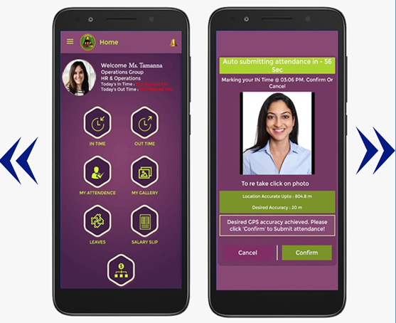
Apps for All (Teacher & Staff)
Section I
Employee App for HR Management
A world class app with daily attendance logs, history, leave balance, 'leave apply' feature, pay slip and employee notification and gallery
GPS based Attendance of employees
A Opt-in feature where the employee attendance is based on the GPS coordinates captured in the app.
Allows authorized fetching of GPS location during work hours.

Slide 11

Section II
Maximize Admissions

Slide 12

Maximize Admissions
Section II
Section Overview:
Maximize Admission
In the face of rising competition, get the edge. Get synergy from combining our Lead management CRM & Digital marketing to maximize the admissions and fill in the seats quick.
Contents:
Lead Management
Digital Marketing
Pre admission and inquiry
Integrated Online admission test
Vacancy Management for Admission

Slide 13
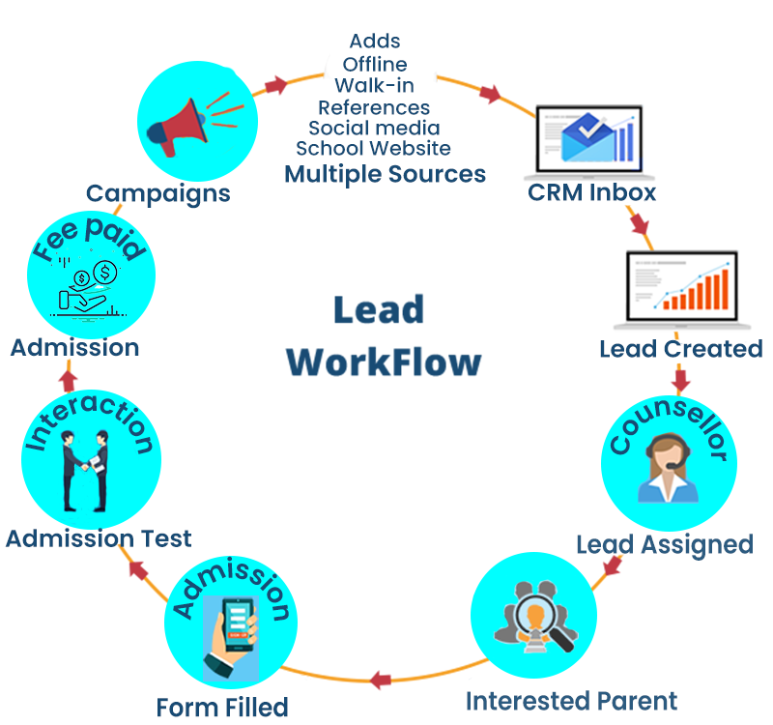
Lead Management
Section II
Create Custom Lead Links:
This feature empowers you to create the original links and post them on various social media channels, ad platforms. These links capture the leads and funnel them into your Leads repository.
Users can create unlimited links to cater to numerous marketing platforms and capture leads from offline sources.

Slide 14

Digital Marketing
Section II
Links Creation to capture leads from Social Media
This feature empowers you to create the original links and post them on various social media channels, ad platforms.
These links capture the leads and funnel them into your Leads repository.
Users can create unlimited links to cater to innumerable marketing platforms..
Links Unique to each Counsellor:
Further, schools can generate links specific to each counsellor. This signature link is unique to each counsellor and is shared with parents that come through offline mediums like calling or walk-ins.
Unified View of all leads sources:
The counsellors have a unified view of all the leads captured and the platform source where the lead originated.
These are the critical feature helps lead source attribution.

Slide 15

Pre-Admissions & Enquiry
Section II
Pre-admission Module
Allows schools to accept online and offline admission registration Requests with the facility to receive admission from charges both online and offline.
Allows school to manage and coordinate the applicants to be scheduled for interview/admission tests with integrated communications platform.
Admit Card ID Module
Allows applicants to be issued ID card that can be printed and used for school access and identification at the entrance for Entrance Test/Interview conducted by the school for various classes.

Slide 16

Integrated Online Admission Test
Section II
Ready to use tests available for online admissions:
Online admission tests are integrated as part of the Pre-admissions workflow.
The school can choose from the repository of tests already available in the system at no extra cost.
Ability to customize tests (each class)
All features of Online Tests can be used as below:
Online proctoring
Varied question formats, including text-based answers or image-based response
Auto-evaluation for objective part
Manual Evaluation for subjective responses

Slide 17
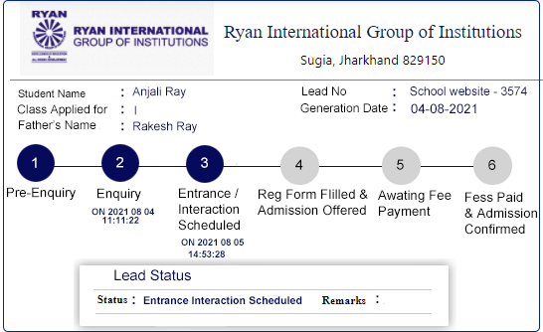
Vacancy Management For Admissions
Section II
This particular module helps schools manage vacancies for the schools with higher demand & face the problem of plenty.
This module enables tracking the ongoing admissions count against the allocated vacancy (calculated as Vacancy= Class Capacity determined by the school - (Current student count + Confirmed New admissions).
The counselors get real-time alerts when the prospects for admissions exceed the vacancy.
Most importantly, it allows the schools to follow cum first serve principle, especially where school seats are scarce

Slide 18
Section III
Academic Ops

Slide 19
Academic Ops
Section III
Section Overview:
This section details the various modules involved in academic administration
Contents:
Class Management Ops
  Class Admin Functions
  Class Co-scholastic Functions
  Class Academic Functions
Syllabus Planning
Unit & Lesson Plan Management
Report Card Automation
Online Testing & Analytics
Student Analytics Report
7. Teacher Management
Time Table Automation
Teacher Performance Appraisal, CRO, Teacher Academic Results Performance
10. Learning Management Solution
11. Doubt Management
The best testament to our exceptionally superior services is that we have churned the well-entrenched industry stalwarts from many of the schools, which helps re-affirm faith in our extraordinary abilities.

Slide 20

Class Management Ops
Section III
The Class Management Module allows teachers to carry out all the class's day-to-day routine responsibilities. Broadly, there are three categories Academic functions, Co-scholastics and Admin responsibilities.
Class management functions involves 3 categories
Class Admin Functions
Class Co-scholastic Functions
Class Academic Functions

Slide 21
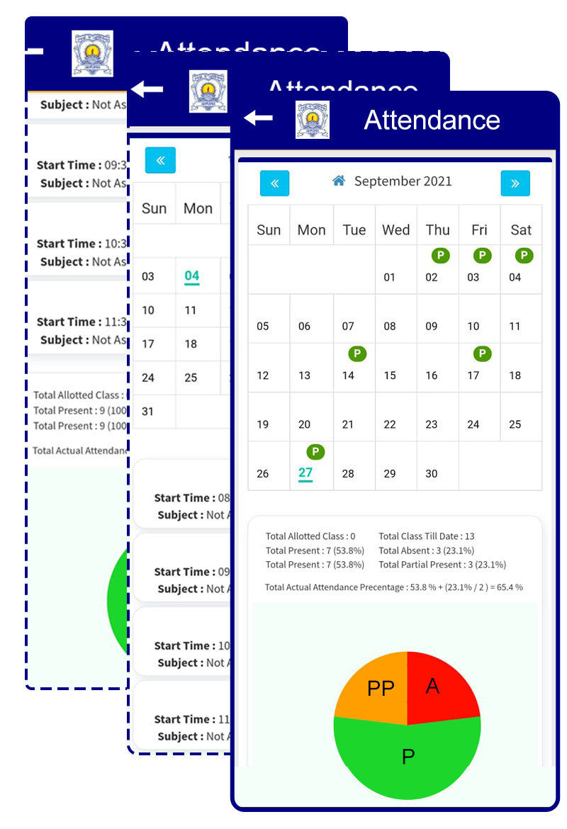
Class Admin Functions(1/3)
Section III
Assigning & Re-assigning Roll numbers:
Roll number re-alignments is always a problem as the students keep getting added or churned.
Attendance Management:
An advance attendance management feature or module that allows every form of attendance
Manual Attendance:
Teachers can mark attendance through the admin app or the SchoolbellQ* admin website.
Auto Attendance:
Feature linking attendance with biometric devices or online classes imparts tremendous convenience and flexibility in our attendance modules.

Slide 22
Class Admin Functions(2/3)
Section III
Day-wise Attendance :
Ability to provide attendance status as a single entry for the entire day
Class/Period wise attendance
Our system also supports the scenario where the attendance for the students is marked for each period attended individually.
Multiple statuses in attendance
Present, Partial Present, Absent & Leave
Integration with Report Cards & Student Analytics Report
The Data points from the attendance module form the inputs for report cards & student analytics reports.
Attendance Reports
Reports for the month, year for attendance at class or student level and a multitude of other insightful reports and analyses on attendance data

Slide 23
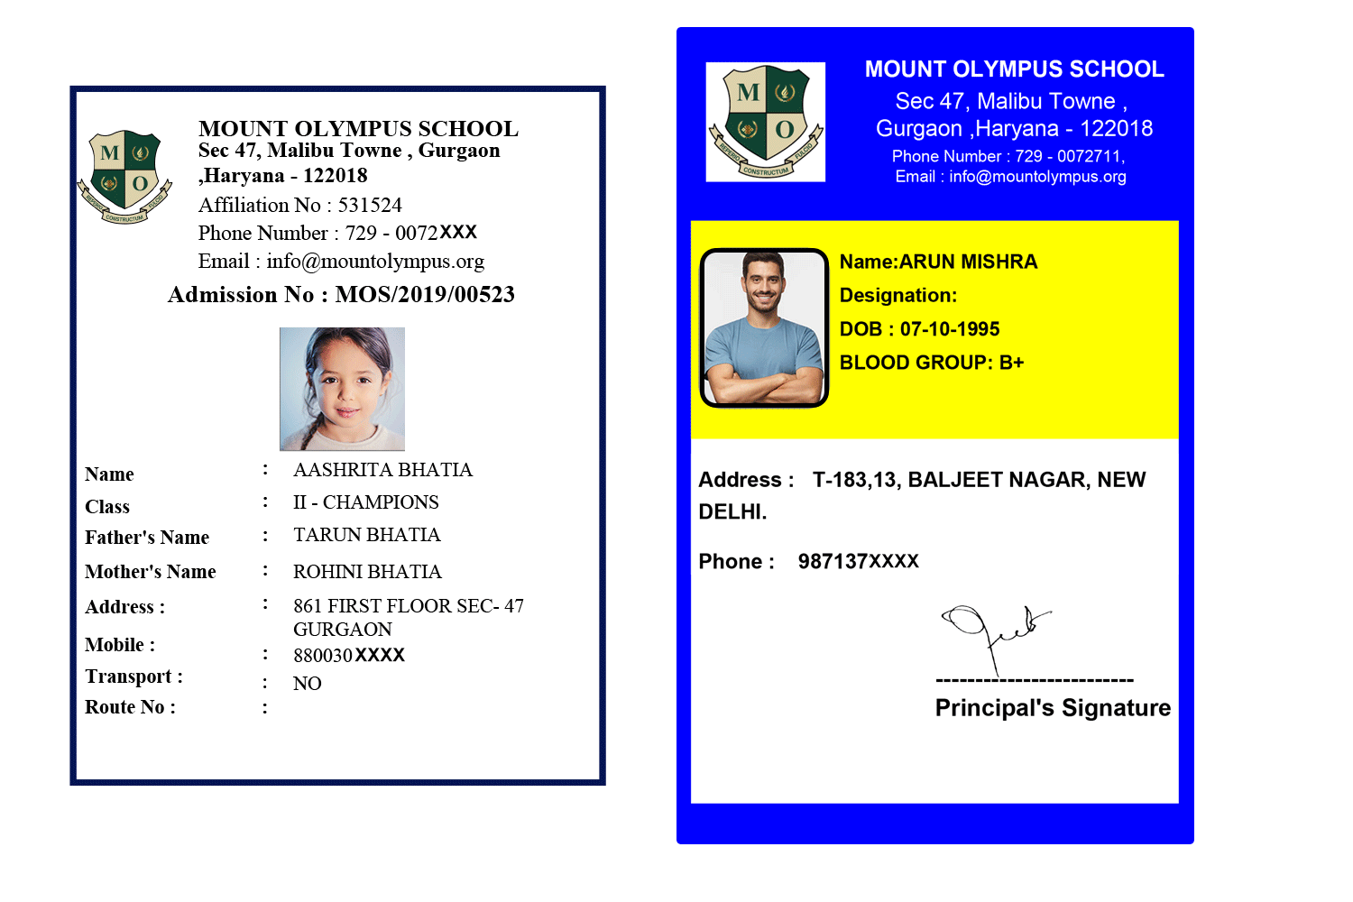
Class Admin Functions(3/3)
Section III
Temporary ID Cards:
This feature allows the school to issue temporary ID cards precisely like the proper ID cards based on the school's approved formats, designs & color scheme.
Gallery Management:
Feature to update events pictures in the gallery visible to parents in the app and Admin.
Rich features like presenting gallery images as Event albums with topic, description and timestamps for each image.

Slide 24

Class Co-scholastic Functions
Section III
Extracurricular Activities Management:
Planning and scheduling extracurricular activities
Participate Option: Providing option for parents to nominate their child for participation in the ECA from the app itself
Co-scholastic certificates:
Easy to create, customize, modify, print and distribute Co-scholastic certificates in this module offers tremendous speed and convenience to the teachers

Slide 25

Class Academic Functions
Section III
Close looping Homework
Initiating Loop 1: School assigns, uploads homework on our platform with submission date
Closing Loop 2: Student downloads the homework, completes it, submits it by uploading it through App
The teachers can access files submitted and uploaded by the students.
Students can view the evaluated contents and the scores & grading of the homework done by the teacher

Slide 26
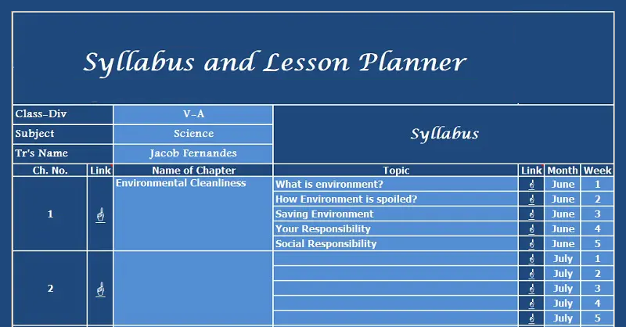
Syllabus Planning
Section III
A thoughtfully designed module that helps school teachers plan.
And to complete their syllabus for each class while management has access to their progress to review, evaluate & rate them.
Syllabus planning allows the teachers to break down the entire curriculum into the number of lectures for each chapter or content.

Slide 27
Unit & Lesson Planning
Section III
The Unit and lesson planning form the bedrock of syllabus planning. The lesson planning aggregated up to form the syllabus plan for the year.
Meticulous & Rigorous:
Our system provides rigorous and detailed Unit & lesson planning to be drawn by teachers by filling up objective data points and crisp, taut instructional objectives, actual teaching Outcomes vs the planned teaching goals for each topic/chapter.
Defined timelines:
The timelines and dates are defined to complete instructional objectives, making them time-bound and effective.
Follow-up Alerts & Reminders
The follow-up alerts and reminders can be inbuilt as a custom requirement for the school.
Multi-level review
The multi-level review & monitoring (by Coordinator, Subject HOD and Principal) of each teacher's lesson planning and execution renders this process even more productive.

Slide 28

Report Card Automation
Section III
Get Ready to Print files for Report Card - automatically for CBSE or any other board as per your requirements
Ability to take your 'Detailed Report Card' online through our technically superior Coding team to deliver automated Report cards as per CBSE specification

Slide 29

Online Testing & Analytics(1/3)
Section III
There are numerous compelling reasons for the best school to partner with us and taste our services first hand. Some of the most promising premises to engage with us are categorized under 4 broad heads as below:
Online Testing
Seamless, intuitive & easy-to-use platform for creating and administering timed weekly class tests.
Provides support for the various modes of testing MCQs,descriptive & reading comprehension.
Evaluation & Grading
Immediate evaluation based on pre-fed 'correct' answers along with features like screen-time & concept knowledge-level analysis.
Tests reinforce & consolidate weekly learnings & induce higher engagement from students towards the subject matter.

Slide 30
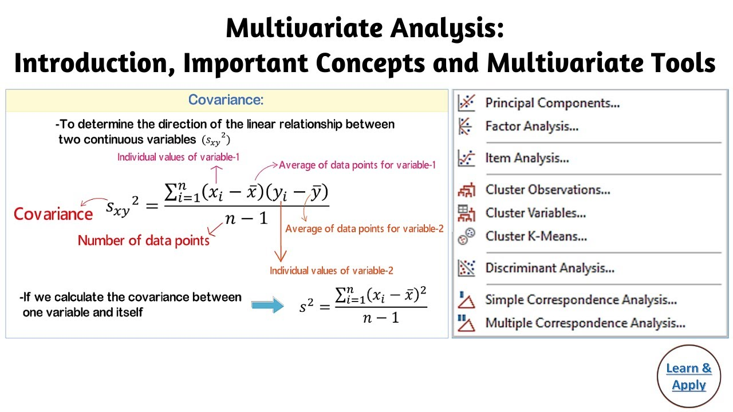
Online Testing & Analytics(2/3)
Section III
Analytics Multivariate Analysis
Online Question Repository
Rich, powerful and useful compilation of question repository that can be supplemented with locate teacher inputs
Multivariate Attributes of questions
Ability to assign multiple question attributes to a single question like; subject category, numerical, descriptive, conceptual
Question Type
Ability to add multiple question types - Fill in the blanks, Match the following, choose the righty option, multiple selection etc.
Attribute Based analytics
Our algorithm combines the attributes with exam performance variables like accuracy, time spent, exam fatigue etc. to give rich insights

Slide 31

Online Testing & Analytics(3/3)
Section III
Randomization of test questions
Post Test Analytics - Diagnostic Report
Actionable insights from Cross-tabbing, based on the performance diagnosed in the test and precise areas of improvement identified
Screen Behaviour
Candidate Behaviour on screen while answering questions can be identified for deeper insights, time spent on question (screen), to & from movement over question
Instant Result computation
Instant Results with drill down options enables quick devision making . Descriptive reports with actionable insights

Slide 32
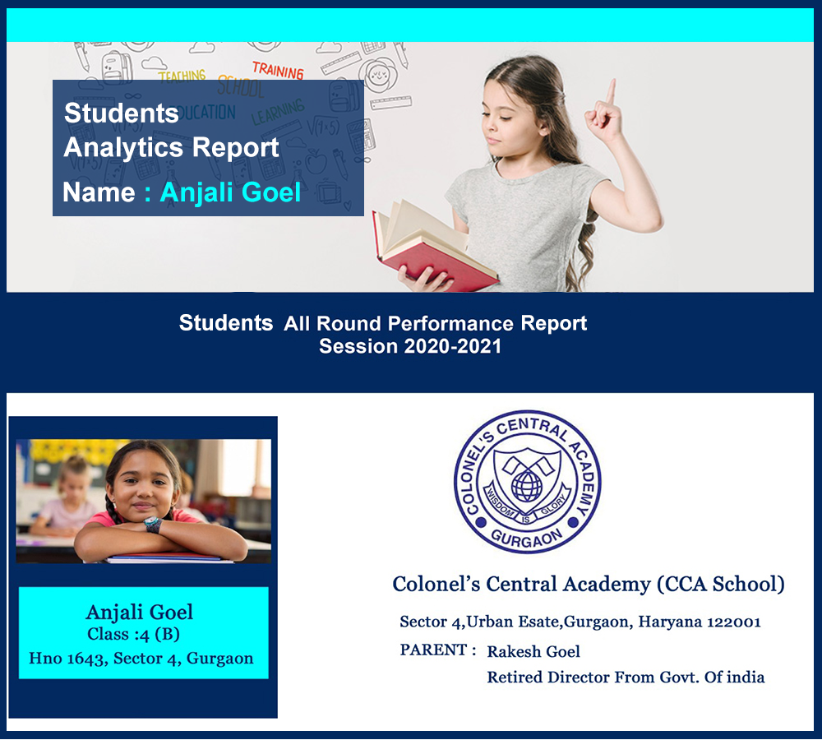
Student Analytics Report
Section III
The section mainly showcases the Students All Round Performance Report of his/her academic performance in crucial subjects.
Class comparisons in core subjects analyses the improvement to be done in future endeavors.

Slide 33
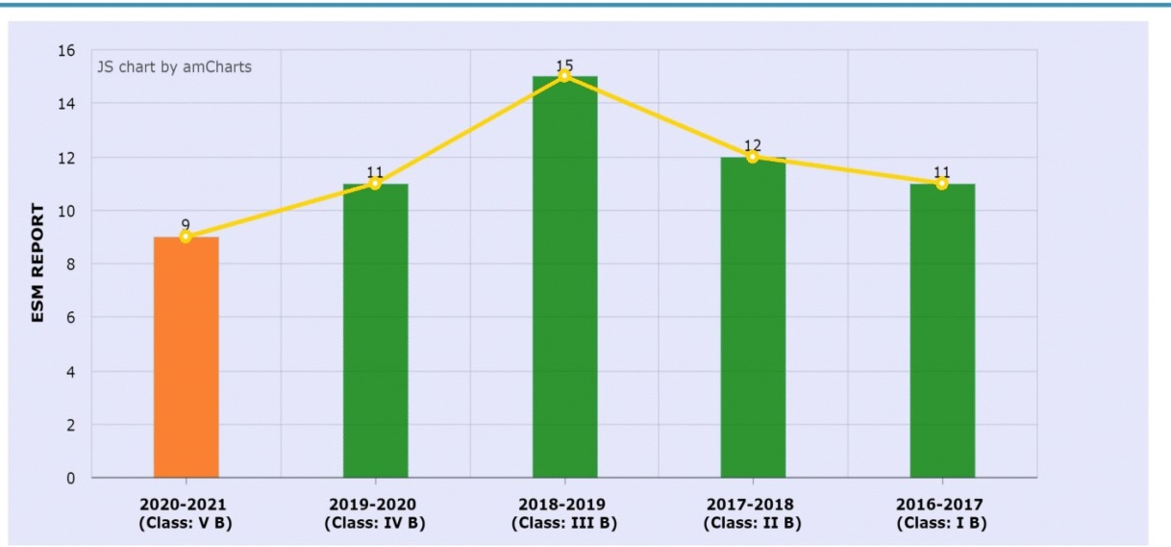
Student Analytics Report(1/9)
Section III
1
ESM REPORT
This section captures the student's long-term - Inter-academic year performance in crucial subjects of English, Science & Maths.
Besides capturing the long-term performance of the child, it evaluates his aptitude in scientific and mathematical subjects.
cell shows her improvements in marks of crucial subjects
Like English, Maths & Science (class & year wise).
Numbers on the bars of the graph indicates the ranks in the subjects.

Slide 34
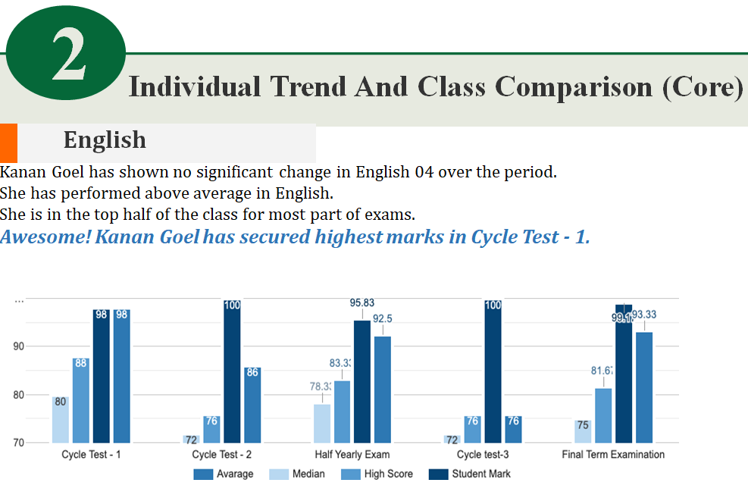
Student Analytics Report(2.1/9)
Section III
This section captures the student's mark trend in the same year and a rising trend is captured in blue color in the graph. Currently the 6% increase in marks defines the threshold for registering the graph in blue.

Slide 35
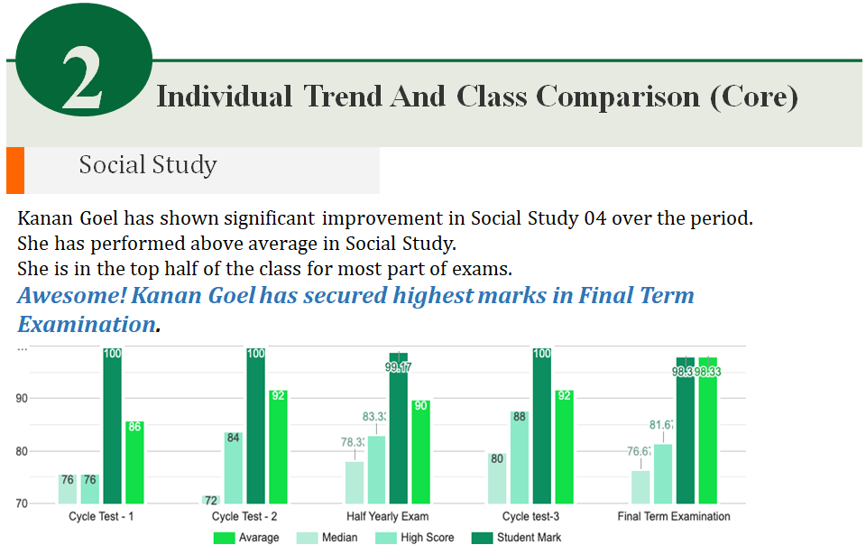
Student Analytics Report(2.2/9)
Section III
This section captures the marks trends across exams in the same year and a rising trend is captured in green color of the graph. Currently the top performance is defined as the threshold for registering the graph in green color as in the graph above.

Slide 36
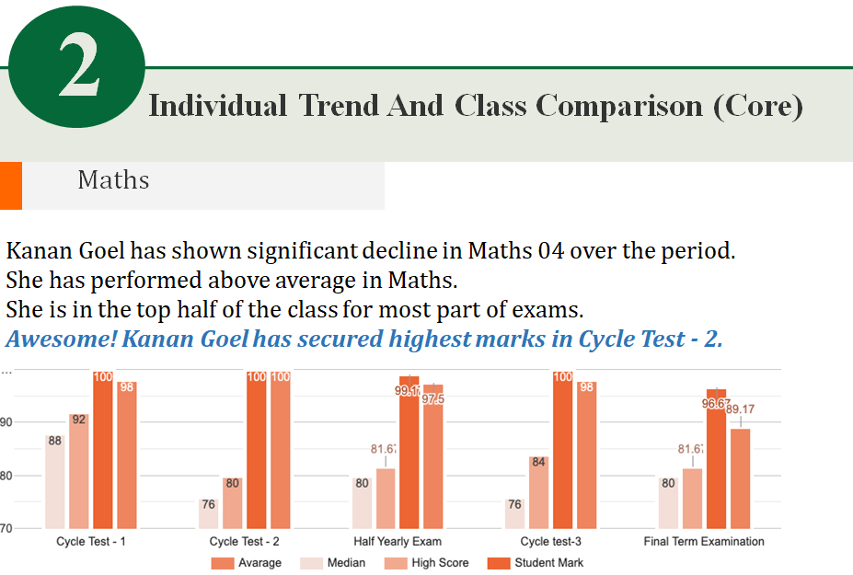
6/11-Student Analytics Report(2.3/9)
Section III
This section captures the marks trends across exams in the same year and a decline trend is captured in the red color of the graph. Currently the 5% drop is defined as the threshold for registering the graph in red color as in the graph above.

Slide 37
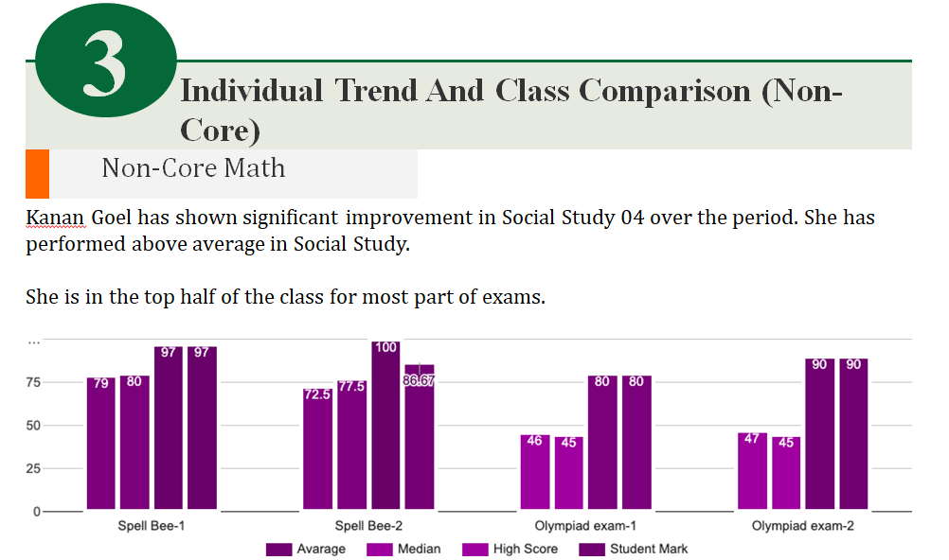
Student Analytics Report(3/9)
Section III
This section captures the marks trends across exams in the same year and a increase trend is captured in the purple color of the graph. Currently the 4% rise is defined as the threshold for registering the graph in purple color as in the graph above.

Slide 38
Student Analytics Report(4/9)
Section III
4. ECA & Sport Participation
The student participated in mandatory activities listed below.
Jan 2020: Mathematics Marathon - 2, Republic Day Celebration (March Past)
Dec 2019: Parent Teacher Meeting-4 (8.30 Am-11.30 Am), Annual Science Exhibition
Nov 2019: Haryana Day Celebration, Capsule Revision During The
Aug 2019: READ FOR NATION, LITERARY WEEK BEGINS
Jul 2019: PARENT TEACHER MEETING - 2 (8:00 A.M to 11 A.M.), HOUSE MEETING - 2
Apr 2019: PARENT TEACHER MEETING - 1(8:00 A.M to 11 A.M.), HOUSE MEETING – 1
The student also participated in many optional ECA, listed below
The student has actively participated in ECA.
Sr. No. | Activity Date | Activity Name | Participation Status | Participation Remarks
3 | 21-01-2020 | Display Board Presentation (IH) | -
6 | 02-12-2019 | Capsule Revision , Mathematics Olympiad During The Month | -
8 | 01-11-2019 | NTSE,SCIENCE OLYMPIAD DURING THE MONTH | -

Slide 39
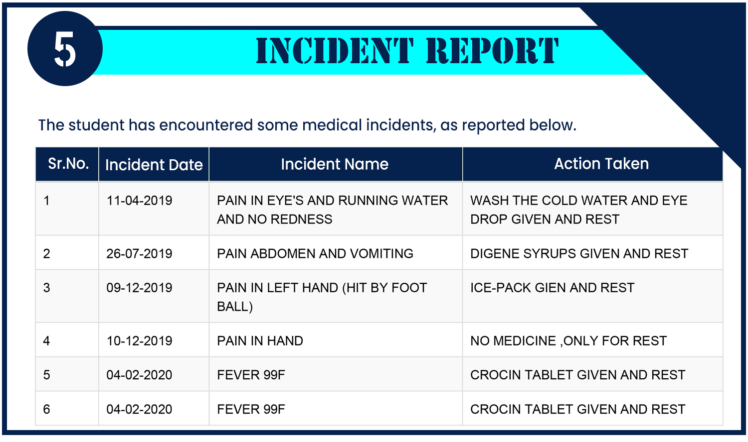
Student Analytics Report(5/9)
Section III
5. Medical Incident Report
The student has encountered some medical incidents, as reported below.
It's genuinely empowering when the parents can not only see a list of ECA but also nominate their child for them.
Of course, the school reserves the right to accept the nomination.

Slide 40
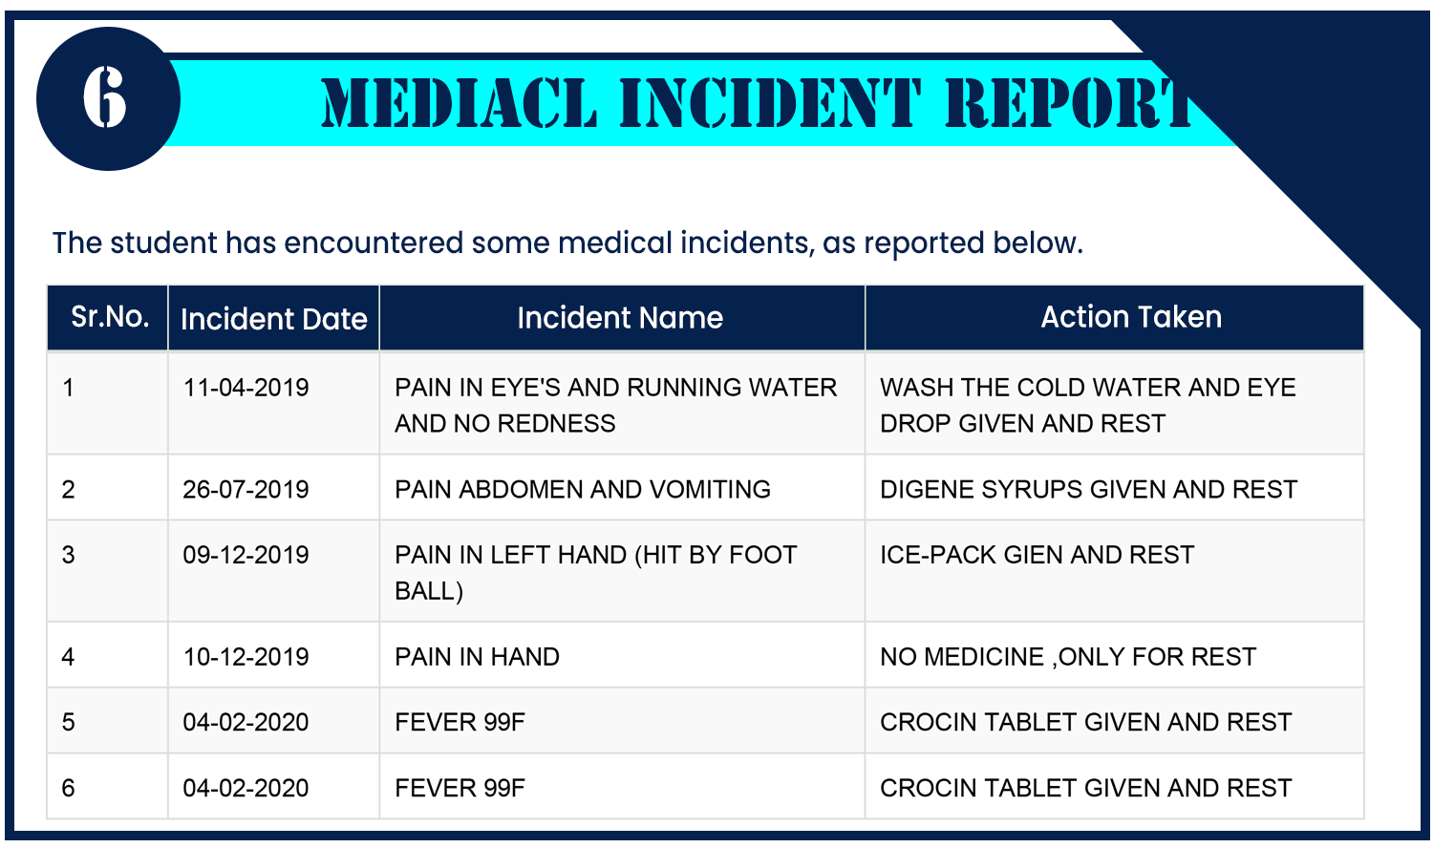
Student Analytics Report(6/9)
Section III
6. Medical Incident Report
The student has encountered some medical incidents, as reported below.
It's genuinely empowering when the parents can not only see a list of ECA but also nominate their child for them.
Of course, the school reserves the right to accept the nomination.

Slide 41
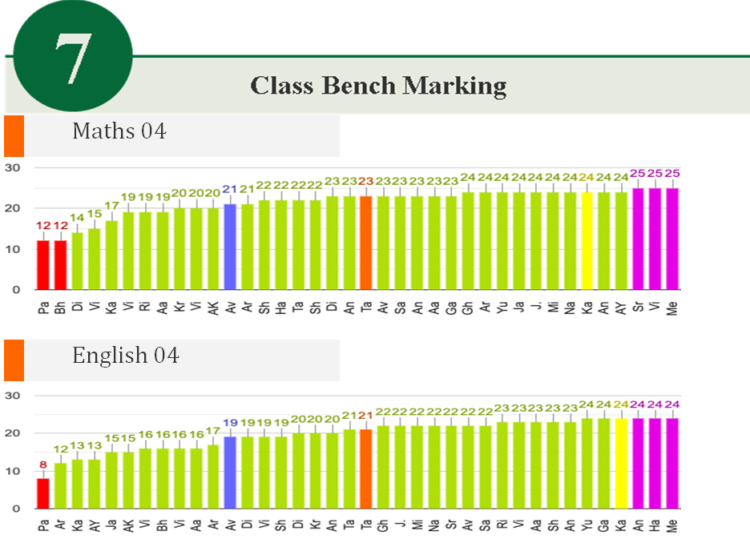
Student Analytics Report(7/9)
Section III
Class Bench Marking shows the measurable standards are set for learning. The median (orange) of marks in subjects of the student & the student’s marks(yellow) indicates the student have higher marks than the median of the class.

Slide 42

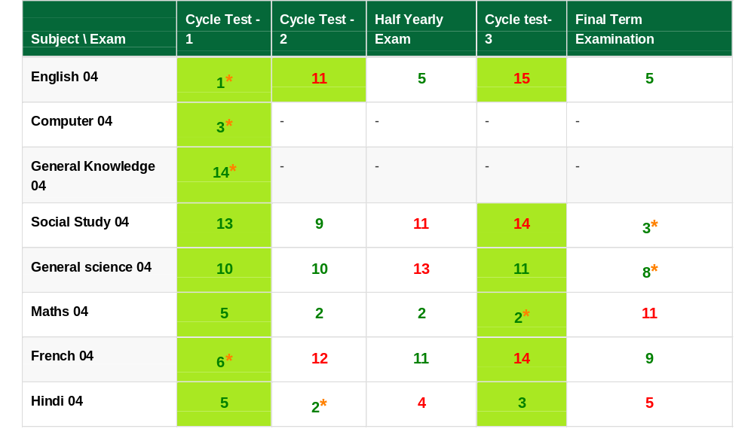
Student Analytics Report(8/9)
Section III
2x2 Matrix for Absolute Performance Vs. Comparative /Relative Performance:
This section captures the absolute vs. the relative performance of the student in crucial subjects.
As shown in the rank table the student has improved marks in comparison to ranks in English, social studies, French but the ranks gradually reduces.
In maths the performance remains best up to cycle test 1 to 3 but in Final term the mark and rank both decreased.
Explanation of above table:
Green cell indicates increase in marks & white cell is opposite.
Green font indicates increase in ranks & red font is opposite.

Slide 43
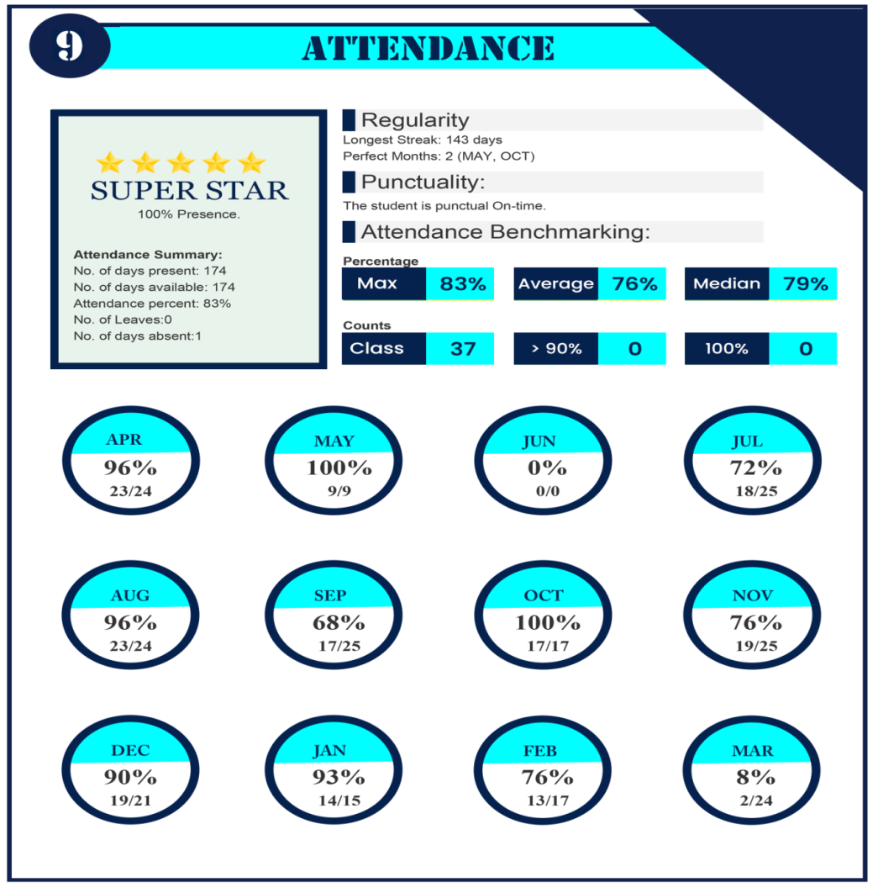
Student Analytics Report(9/9)
Section III
9. Attendance
This section captures the total attendance summary of the student of the academic year & also puts emphasis on the attendance benchmarking.
As shown in the table the student is punctual & in may and oct she has 100% attendance.
She has the lowest attendance in the month of march.
The attendance benchmarking shows she has average percentage of 76% and median of 79%.

Slide 44
Teacher Management
Section III
Our Teacher management empowers you in many ways that can be divided into two broad categories of:
1-Teaching Operations
2 -Teachers Performance Management
Teacher management essentially combines teaching operations with our Teacher's appraisal system to provide holistic teacher management.
While the former is the functional part of the Teacher's role, the latter deals with the softer traits that impact the former.
So, in a way, both are intertwined and would yield rich dividends if they are used in conjunction.
While the teaching operations helps manage the resources efficiently, the teacher performance management makes them more effective by working on the resource competence.

Slide 45

Time Table Automation(1/3)
Section III
1-Teaching Operations
Time-table
Time table once created becomes Auto replicating takes care of absenteeism
Teacher’s Data
It allows Teacher availability reports or occupancy reports to help schools plan and schedule better.
Gives instant access to all teacher’s details including Date of Joining, Retirement, Qualifications & allows to manage timetable.
Teacher leave management
Teachers can apply leaves which get directly into the time table indicating the affected classes.
Automation of time-table
Time table once created becomes Auto replicating takes care of absenteeism
Time table scheduling for absent teacher
Teachers can manage get directly into the time table indicating the affected classes.

Slide 46
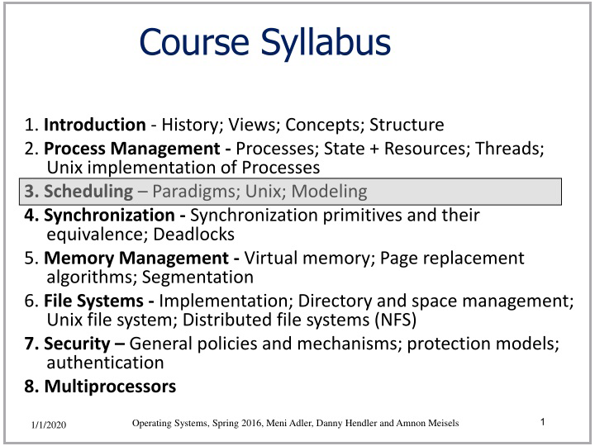
Time Table Automation(2/3)
Section III
Scheduling

Slide 47
Time Table Automation(3/3)
Section III
Superior Time-Table Features
Micro-scheduling :
Micro-scheduling in time table with the chapter & description of content planned to be covered
Scheduling & Work Distribution :
Scheduling & Work Distribution among teachers for efficient work load distribution
Teacher substitution:
Teacher substitution at the last moment due to unplanned teacher absence owing to some exigency at teacher's end
Combining Class:
Combining' Class Feature (combine class to make up for a teacher shortage/Leave)
Optional Subjects based time-table:
Optional Subjects based time-table ensuring students see only the relevant optional subjects chosen by them
Reports based on Teacher Workload distribution
Exam timetable features:
Optional Subjects based EXAM time-table ensuring students see only the relevant optional subjects chosen by them in the Exam Date sheet

Slide 48
Teacher Performance Analysis(1/7)
Section III
1-Teachers Performance Analysis
This is a crucial tool for recording & measuring various aspects of the Teacher's performance in the classroom and pre-classroom that impact her deliverables.
It has two components given below:
1-Class Room Performance
2-Teacher Goal Sheet
2. Teacher's Self Appraisal & Goal sheet
Our appraisal system allows management to assign appropriate weights to the self-appraisal to consolidate it with the other appraisal components.
Teachers can input their assessment and assign ratings to their performance on the parameters identified in the CRP.
Also, they can fill the subjective part of the Teacher's goal sheet and give a descriptive assessment of their performance.
1. Teacher Performance Analysis
Multiple Instances of evaluation by the school through thoughtfully designed scientific forms of CRP (Class Room Performance
Teacher Performance Appraisal, Multiple self-evaluation forms, Multi-layered Supervisory evaluation
Weightage based consolidation of results, Class Room Observation Form-based evaluation
Easy to establish a correlation between Teacher's efforts vs. Results(Linking to chapters taught vs. Academic performance).

Slide 49
Teacher Performance Analysis(2/7)
Section III
Part-1
CRP (Class Room Performance form):
This is a crucial tool for recording & measuring various aspects of the Teacher's performance in the classroom and pre-classroom that impact her deliverables.
The form is very scientifically designed to capture all the attributes impacting teacher performance and contains objective parameters very thoughtfully conjured.
Teacher's Appraisal thru domain experts, supervisors
CRO - Scientifically Designed CRO captures the vital input
Custom design of periodivty, frequency of appraisals
Ability of school to customize all the variable options like questions, format, frequency of the appraisal and weight the components makes the system extremely adaptive besides being flexible and practicable

Slide 50
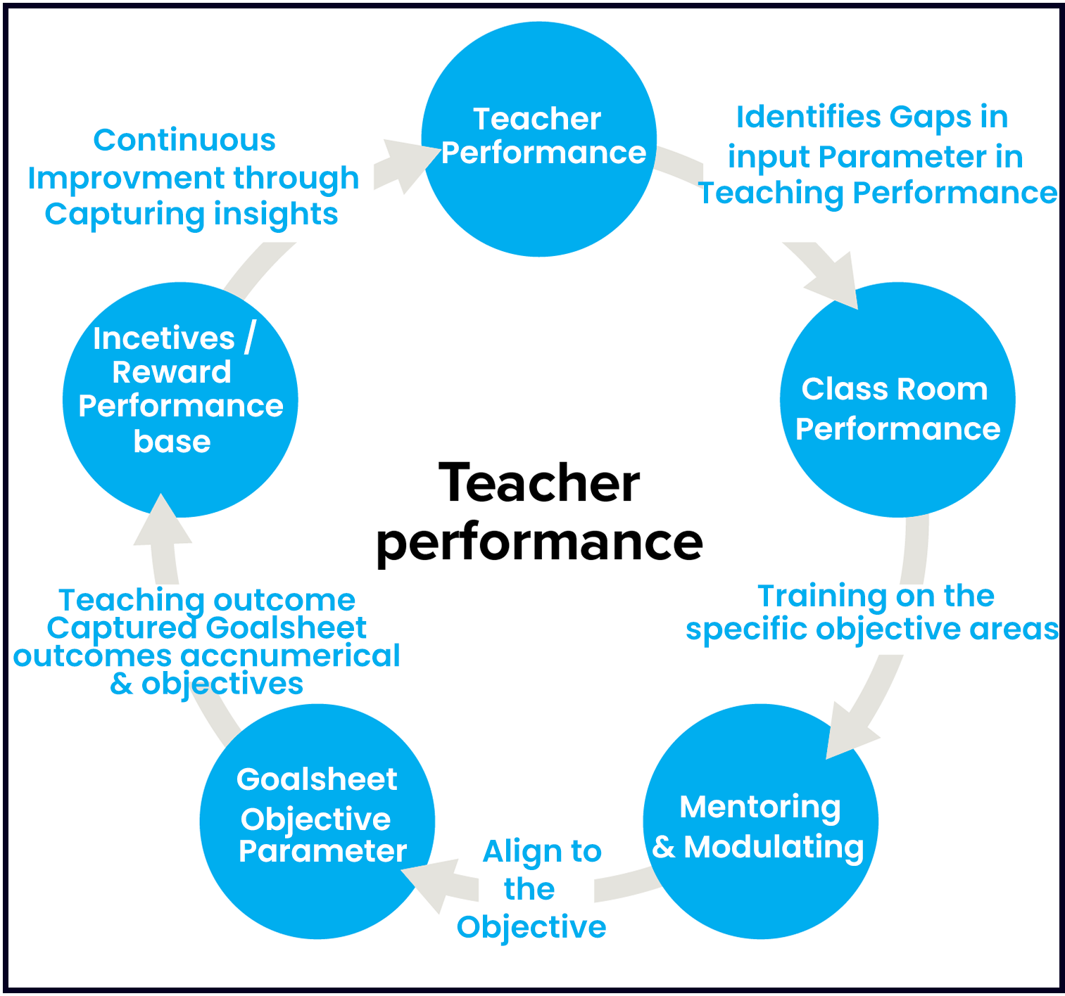
Teacher Performance Analysis(3/7)
Section III
Teacher Performance
This section captures the overall performance of the teachers including class room performance, mentoring & modulating, goal sheet objective parameter and incentives/reward performance base.

Slide 51
Teacher Performance Analysis0(4/7)
Section III
Sample CRP:
A look at below sample form few questions will help you appreciate or underscore its importance.
Its profound impact is inescapable.
Multiple authorized users mapped to fill the CRP:
Further, this form is filled through direct classroom observation practice by a senior faculty member, head of the department, vice-Principal, or Principal.
The Incredible CRP - Class Room Performance form:
The incredible power of this form lies in the meticulous in minute detail it can capture and articulate
The Incredible CRP - Class Room Performance form:
The incredible power of this form lies in the meticulous in minute detail it can capture and articulate.
CRP - A source of inputs for Mentoring & Modulating:
The outcome of the CRP is usually the inputs to modulating the Teacher's style and other behavioral aspects of her teaching in the class.
Follow-up CRPs based on Progress:
More CRPs are carried out to evaluate the outcome of existing training interventions besides the original one.

Slide 52
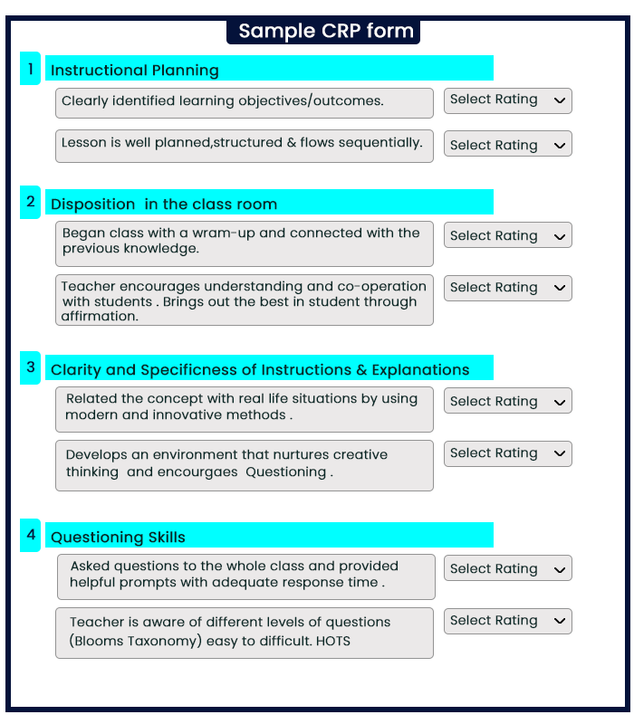
Teacher Performance Analysis(5/7)
Section III
They are called Progress CRPs and are available in our Teacher's appraisal module.

Slide 53
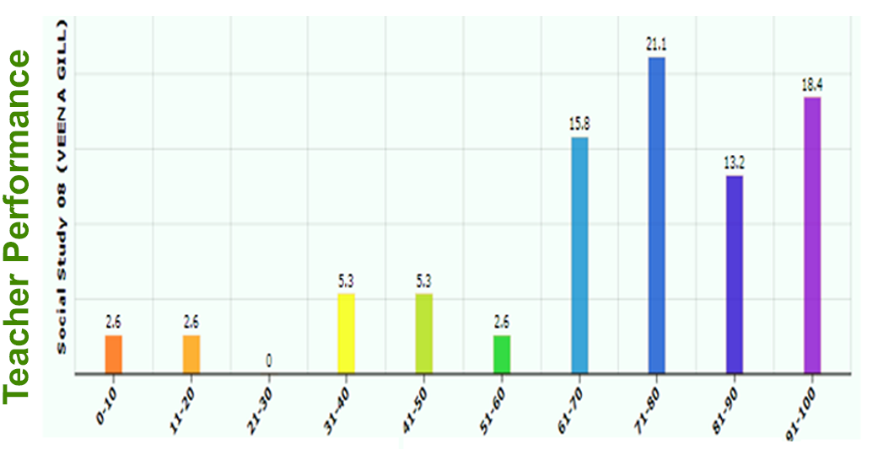
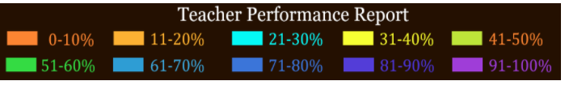
Teacher Performance Analysis(6/7)
Section III
Part-2
Teacher's Goal-sheet - Objectively measuring class performance
The outcome of these training inputs will impact the class performance and are captured in Teacher's Goal Sheet.
This Goal sheet has all objective parameters reflecting the academic performance of the students.
Teacher Goal Sheet output 10 Percentile.
Explanation of the above diagram:
Indicates 21.1% students have got mark between 71-80%.
Indicates 0% students have got mark between 21-30%.

Slide 54
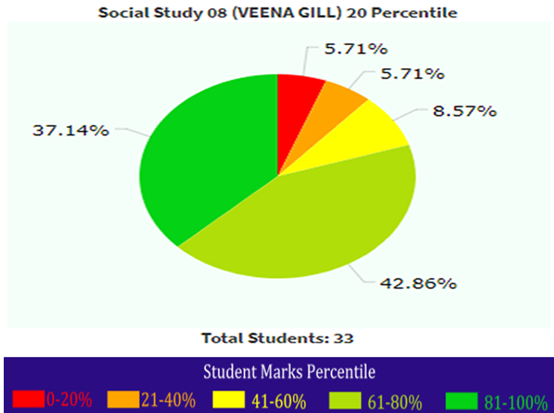
Teacher Performance Analysis(7/7)
Section III
Teacher Goal sheet output 20 Percentile.
Explanation of the above diagram:
Indicates 37.14% students have got mark between 81-100%.
Indicates 5.71% students have got mark between 0-20%.

Slide 55
Teacher Appraisal
Section III
The Final Performance Appraisal: A balanced blend
The final performance assessment is the blended outcome of the above two essential exercises.
The weights assigned to the CRP or CRPs (in case of multiple CRPs) and Target Goal-sheet at an appraisal level form the basis of final appraisal are input parameters for each user.
The custom weights feature tremendously helps in customizing the appraisal process and weaving in more nuance based on each user's unique circumstances.
For instance, the Teacher's Goal sheet carries more weight for higher classes where academic performance is held sacrosanct.
Consolidation of Reviews, appraisals
Calculating score based on weights assigned to self , supervisor, reviewer appraisal along with discretionary scores with Principal. The weights can be assigned to multi-period reviews held at custom frequency
Objective Inputs from Academics performance
The analytics of the marks secured by the students for the subjects attributable to specific teachers forms a strong and objective basis of rating system

Slide 56

Learning Management Solution
Section III
This section focuses to plan, implement and assess a specific learning process, which includes daily curriculum planning, documentation of data, assessment of learning resources for students material types & clear doubts.
Daily curriculum planning: lessons to teach, ideas to engage students, homework to give for the day
Documentation: Keeping a tab on study materials, systematically managing the data.
Access learning resources for students material type & academic structure.

Slide 57

Doubt management
Section III
There are different doubts on the operations of the academics of the school which needs to be taken care of. This section mainly focuses on these queries/doubts.
Doubts on fees structure of schools are solved through transparent & sophisticated information systems.
Academic administration have lots of functionalities which may create a doubt on minds of teachers as well as the management like the

Slide 58
Section IV
School Admin Ops

Slide 59
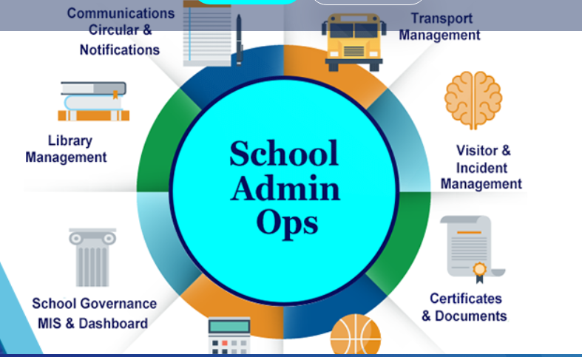
School Admin Ops
Section IV
Section Overview:
There are numerous compelling reasons for the best school to partner with us and taste our services first hand. Some of the most promising premises to engage with us are categorized under 4 broad heads as below:
Contents:
Chairman’s Dashboard
Fees Management
Student Management
Communication, Circular, Notification
Parent concern management
Student Documents
Incident Management
Library Management
Transport Management
Visitors Management

Slide 60
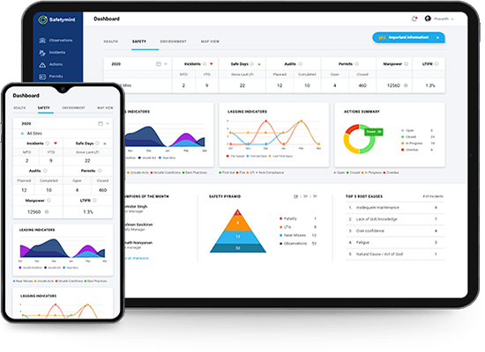
Chairman's Dashboard
Section IV
Fee Defaulter summary for all quarters/months - Complete Unpaid Invoice summary with deep drill-down feature on a single click, Fees Concession summary with quick access to details
Rich, informative and useful compilation of most important metrics of the school
Student Count - Reconciliation, daily admissions, TC and Net Increase in student strength in School
Operational Key data - Teacher's On Leave, Upcoming Exams & ECA Activity & Daily Student Attendance %
Summary of homework & study materials assigned to students on daily basis with complete drill-down
Key daily performance parameters like Enquiries, lead Generation, Registration.
Quick Access to Notices posted in school, Pics of events in the school and quick links to key MIS reports that can be customized as per the user

Slide 61
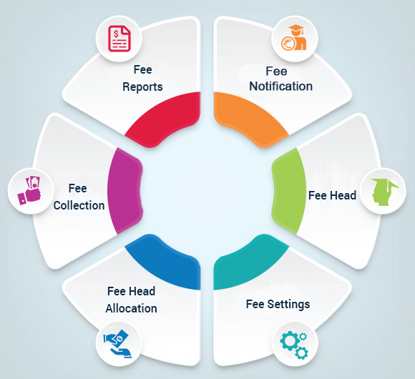
Fee Management(1/4)
Section IV
Fee Dashboard
Fee related information like Daily collections, Fee Due list, Concessions, Scholarships, discount etc. accessed in a single click on an intuitive dashboard.
Micro-detailing available in deep drill down in sequential clicks
Management
Schools can customize fee components, frequency & plans
Tally Compliant & Integrated
All our Fee modules can be integrated with the accounting software 'Tally" through XML files generated by our system
Admin Platform - Easy Collection of Pending fees across sessions through Single Unified window:
For Ease of fees Collection for School Admin, we have developed a function to show all pending invoices of previous academic sessions in the Current session UI.

Slide 62
Fee Management(2/4)
Section IV
As a result, the school admin doesn't have to toggle between the academic sessions to check the previous pending due.
All the invoices are presented on the same screen, and importantly, they can be directly settled from the current session itself.
To maintain distinct accounts of both academic sessions separately, we have ensured that the previous session invoice is settled in the database of the previous session.
This Functionality adds tremendous convenience to the admin, especially during fee collection. It saves time by obviating the need to toggle between the sessions to check the pending fees for the parent.
Parent's App - Single Unified window in the SchoolBellQ* App for Payment of Pending fees across sessions:
With the new Functionality for the Fees in the parent's app, now the parents will find it satisfying as;
They can now conveniently view all pending invoices in their Fee payment section in the app in the current session (2021-22)

Slide 63
Fee Management(3/4)
Section IV
The invoices of the previous academic sessions (2020-21) will also be visible on the same screen.
They can view and pay all pending invoices from both the sessions (2020-21 & 2021-22) on the same screen.
This feature facilitates parents in assessing their previous session dues conveniently and clearing them.
Discount & Online approval Functionality for Admission Fees payment:
Based on the School's process flow, we had already developed the Functionality whereby:
The admission counsellors can assign fee plans at the time of admission.
The admissions counsellors can seek discount approval from the principal (or any other authorized personnel) online or offline.
And upon approval from the principal, it automatically sends the discounted invoice to the parents online for payment.
This process has been working smoothly and is already integrated into multiple Schools for quite some time.

Slide 64
Fee Management(4/4)
Section IV
Deferral or Partial Payment Online for Admission Fees:
The above process illustrated for most parents may not be viable for few parents with difficult current financial situations owing to the COVID battered economy:
Being the specific requirement of allowing users to make the part payment towards the admission fees, we have developed a different functionality that enables the School to generate the invoice for partial amounts that can be paid online & offline both.
The invoices can be generated and settled both online and offline.
This feature will allow the School to collect the part-payment towards the admissions online, especially helpful during the pandemic, thus locking in a larger number of admissions.
Exhaustive Reports
Fee Notifications
Customized Fee notifications sent to parents with details like child name, fee amount, admission number, due date - can be sent AFTER of BEFORE DUE Date.
Reports
Multitude of reports for internal requirement and external statutory compliance are readily available.
Reporting & MIS
Multitude of Reports like student-wise, Route-wise, Bus-wise or Bus Related details or charging summary for the route assigned can be extracted to
Online Fee integration with school account
Regular reconciliation report for fee payment
Customized fee notification
Tally integration

Slide 65

Student Management(1/3)
Section IV
This section displays the overall management of the student from attendance to transport management and activities in school academics.

Slide 66
Student Management(2/3)
Section IV
Including Personal details
Manage Student's personal like the name, Birthdate, Blood group, Info on the parents, their occupation, address, etc., and the profile pictures for students.
School-related info
Access and update school info for any student like admission & roll number, RFID card details, transport, schoolhouse, shift, class, section etc.
Academic Info
Manage critical function like assigning subjects -compulsory & optional- which can be set in this section by the class teacher .
Update Profile links:
Functionality to send links to parents to update their data points like pictures, addresses and other important personal details to keep the data as current and updated as possible.
Individual Parent communication
Functionality to send details like passwords & account login for the web & school apps, adding, modifying emails & mobile numbers.

Slide 67
Student Management(3/3)
Section IV
Manage student Anecdotes:
This functionality helps chronicle the child's school life by recording significant events and observations about a student through a teacher's perspective. These anecdotes constitute the input for the Student Analytics Report.
Entire Student Data available in a class wise format along with student pic, details of Transfer, Character and Bonafide Certificate can be generated instantly.
Manage Student Status
like active, in-active, TC issued etc.
Generate Documents
Issue TC, Bonafide/Character certificates etc.
We encourage schools to add More customized formats based on the school's workflow.
Birthday Notifications:
A feature designed to provide manual & auto-notifications for birthdays to students, which can also be pre-scheduled and customized by student name .
Download
Student data with custom field selection through excel & PDF etc.

Slide 68
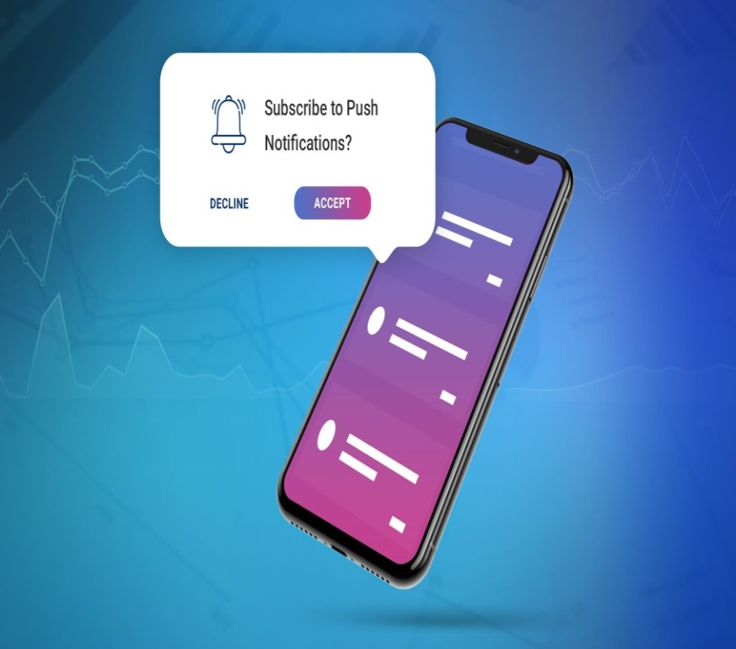
Communication, Circular,
Notification(1/4)
Section IV
Notifications
Notification Channels:
The notifications are fired through all three channels, namely SMS, Email & App Notifications.
Notification Category:
Based on the notification channel deployed, there are three categories of Notifications:
Regular Notifications: Channels deployed - App Notifications & Emails
Important Notifications: Channels deployed - App Notifications & Emails & SMS. (Text message is triggered when the recipient doesn't open the app notification in a threshold time. The threshold time is admin user-determined and helps conserve SMS by sending only to recipients who haven't opened app notification even after the lapse of the threshold time.)
Extreme Urgent Notifications: All three channels are deployed simultaneously (App, Emails & SMS)

Slide 69

Communication, Circular,
Notification(2/4)
Section IV
Delivery Report:
Delivery Report for all the above 3 channels can be made available to the admin users.
Single Click Trigger:
A single Click can fire the notifications through all three channels instantly
Auto-generated notifications:
The template with customizable fields for routine activities like Fees Invoice generation, Fee Payment Receipt Notifications Or Daily attendance notifications is auto-generated etc.
The users can determine the notifications channel in the settings.
Custom Notifications:
Admin can send customized notification content to their parents across the communication channels.
The admin can determine the notifications channel in the settings.

Slide 70
Communication, Circular,
Notification(3/4)
Section IV
Circulars
Auto Alerts for circular publishing:
Publishing Circular generates auto-notifications alerts informing recipient users about the publication.
The admin also has the choice to disable auto alerts in the settings.
Manual Publishing:
The admin has to click publish manually for the circulars to be posted and visible to all parents and stakeholders.
Scheduled Publishing:
The admin can pre-determine the time for publishing, and the circular publication is auto executed at the pre-scheduled time.
The publishing can be with or without auto alerts depending upon the admin user-defined settings

Slide 71

Communication, Circular,
Notification(4/4)
Section IV
Multiple Circular Media Type Support:
Circulars Support multiple formats like Word, PDF, Image (JPEG, PNG and other image types), video links etc. The school can choose any format to upload in the circular and publish
Read-Receipt Feature:
The read-notifications are essentially the acknowledgement of the messages or circulars that are read or opened. The system provides reports on various users read receipt status.
Unpublish feature:
One of the technology's key advantages is that it enables us to recant or retract a circular published carrying some inadvertent errors.
The circular unpublishing feature will delete the circular from the parent's view in the app. There are no time restrictions for unpublishing the circular.
Whatsapp Notification:
Integration with WhatsApp is also technically established and follows different commercials as charged by WhatsApp based on the usage.

Slide 72

Parent Concern Management(1/2)
Section IV
Happiness Help Desk
Our Happiness Help-desk delivers a structured framework through our software module to capture, report, and resolve these issues effectively and efficiently.
Typical issues include some clarification of Fees Invoices (Fee department) or Changes in the school bus pick-up point (Transport Department), ERP password issue (ERP department) or address update (Admin Department) or student medical.
All these issues can be resolved efficiently provided they are reported to the concerned departments on time.
Our Happiness Help-desk delivers a structured framework through our software module to capture, report, and resolve these issues effectively and efficiently.
Multi-department:
The parent can choose departments they seek intervention or support from by checking relevant boxes. The parent can assign a topic and describe the issue in detail.

Slide 73
Parent Concern Management(2/2)
Section IV
Relevant Stakeholders Real-time access:
This feature ensures that the relevant stakeholders or department heads in real-time access the issues raised and respond quickly through required intervention.
Action Taken Report:
This report helps the school administration track the relevant departments that responded to the issues raised and the resolution provided.
Time-bound response & Escalation Matrix:
The timestamp and the logs help assess the time taken against each issue.
Analytics for Issues raised:
The overall summary report helps the school authorities identify the broad patterns of the reported issues and take policy-level intervention to take steps.
Higher Satisfaction Scores:
Schools using Parent concern or happiness helpdesk have reported higher satisfaction amongst the parents and better fee compliance.

Slide 74

6/10-Student Documents
Section IV
Student Documents:
Issued Documents: TC, Bonafide certificate, Report Cards etc.
Received Documents: Birth Certificate, Aadhar & incoming TC, and other documents can be conveniently uploaded and stored at the time of admissions.

Slide 75
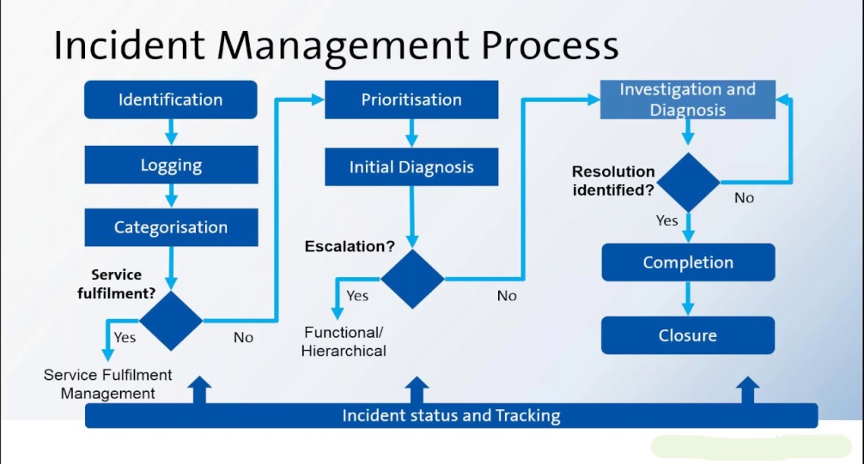

Incident Management &
Library Management
Section IV
Incident Management
A reporting tool for school authorities to record, report and intimate authorities of all incidents taking place in the college or outside involving students.
Library Management
Comprehensive Library management module with intuitive and easy to use UI with no limit on the fields
Books to be uploaded along with auto-FINE calculation and integration with main fees.

Slide 76

Transport Management
Section IV
Transport Management
A holistic transport management module encompassing Bus, Fleet, Route and corresponding fees linked to the students
Bus Management
Complete details if the Bus including Driver details, Photo, contact details ad GPS Id etc. with assigned route to ply
Route Planning
Bus Routes can be composed by assigning multiple stops. Same bus stop can be present in multiple routes incase of overload. Route Stop Management
Bus stops with the GPS location with precise lat-long and distances can be defined on the route and financial charges be assigned
Route & Stop Allocation with financial linking

Slide 77
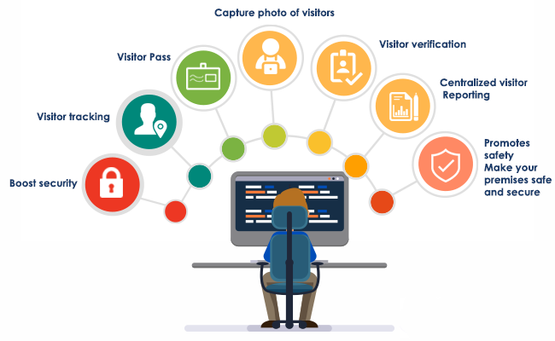
Visitors Management
Section IV
Visitor management
An online interface that allows parents/visitors visiting campus to submit quick feedback that flows to management through mails and excel reports, SMS integrated to Welcome Visitors
VisitorQ is a complete visitor management solution, features with :
Capture & verify incoming visitor photograph
Accurate & Complete Records
OTP based authentication
Building & Syncing of database of visitors
Optional Approval from the visited person
Storage & Retrieval of Records

Slide 78
Section V
Back Office Ops

Slide 79

Back Office Ops
Section V
Section Overview:
There are numerous compelling reasons for the best school to partner with us and taste our services first hand. Some of the most promising premises to engage with us are categorized under 4 broad heads as below:
Contents:
Payroll
Inventory
Surveys & Feedback Management
Equipment Management
Recruitment Management
HR & Attendance Management

Slide 80
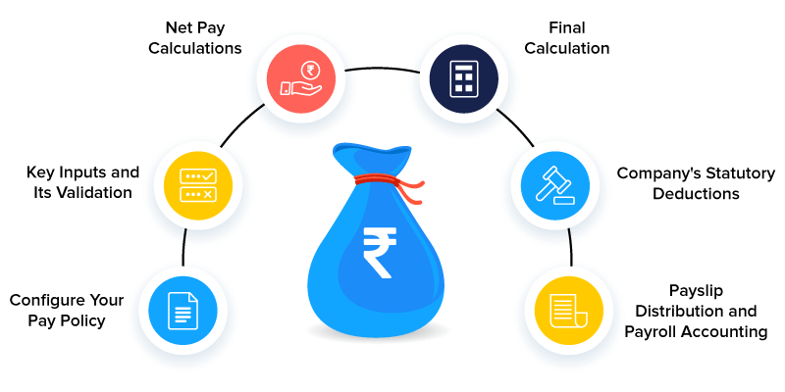
Payroll
Section V
A comprehensive payroll management module integrated with the attendance module & hardware; allows pay slips and payroll to be generated.
Advance features for PF, ESIC, Loan Advance related deductions.

Slide 81
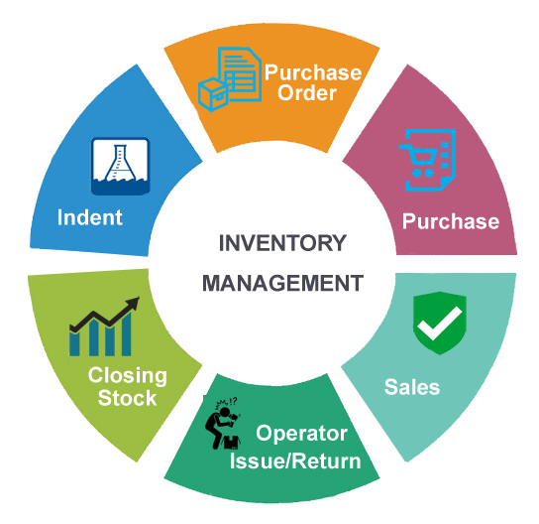
Inventory
Section V
Re-ordering level triggers
Allows school to receive Uniform, Books etc. as Inventory item and issue them & receive payments
Creation of multiple item type and define individual stock level. Critical feature like Inventory valuation at different price points for the same item
Features like Re-ordering level and minimum balance concepts already built in to facilitate
Fully functional Reporting module with multitude of reports , item-wise & Dept wise consumption, Stock arrival, Rejected items report etc.

Slide 82

HR & Attendance Management
Section V
There are numerous compelling reasons for the best school to partner with us and taste our services first hand. Some of the most promising premises to engage with us are categorized under 4 broad heads as below:
Consolidation of Reviews, appraisals
Calculating score based on weights assigned to self , supervisor, reviewer appraisal along with discretionary scores with Principal.
The weights can be assigned to multi-period reviews held at custom frequency
Objective Inputs from Academics performance
The analytics of the marks secured by the students for the subjects attributable to specific teachers forms a strong and objective basis of a rating systems
Custom design of periodicity, frequency of appraisals
Ability of school to customize all the variable options like questions, format, frequency of the appraisal

Slide 83
Section VI
Cutting Edge Features

Slide 84
Cutting Edge Features
Section VI
Section Overview:
There are numerous compelling reasons for the best school to partner with us and taste our services first hand. Some of the most promising premises to engage with us.
Contents:
Easy fee
Homework
Intelligent SMS
Online Auditorium
Zero-Code Report Cards
Extra-Curricular Activity
Homework Evaluation
Report cards & Result Analysis All Round Performance
Voice Messages to parents
Online tests supporting large volume
AI-based proctoring Online tests for large volume
Randomized Question Paper Generation
13. Online tests supporting All Question & Answer formats
14. Custom Fees Notification
15. Online Class Integrated with zoom
16. Auto-Attendance Capture for Online classes
17. Period-wise attendance for Offline & Online Classes
18. Staff for GPS & Face-recognition based Attendance
19. Students GPS & Face-recognition based attendance
20. Anecdotes Recording and compiling into student annual report
21. Choice of Payment Gateways for parents to fees payment
22. loT, GPS, RFID cards deployed in school

Slide 85
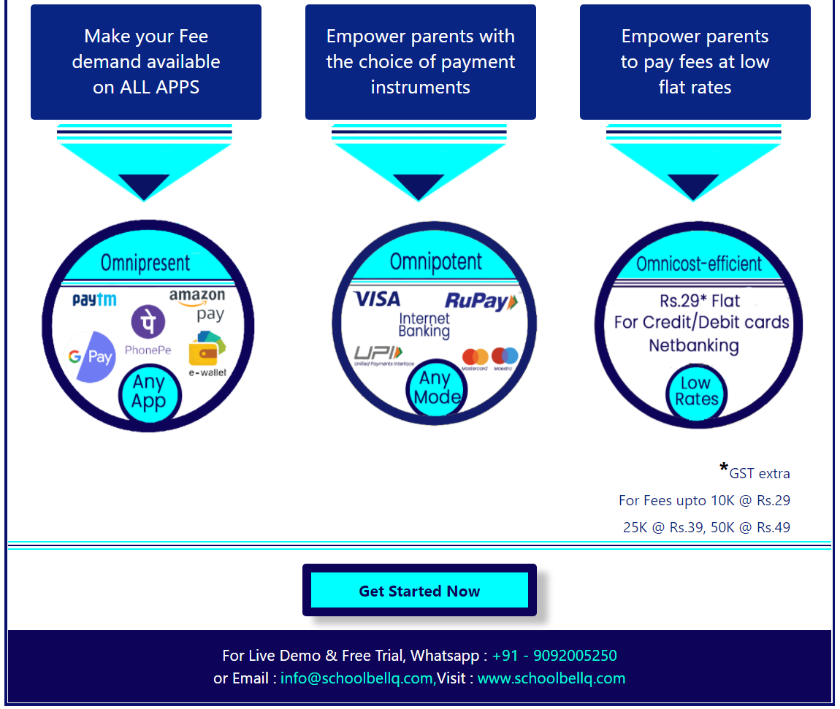

Easy Fee
Section VI
Ways to Increase fee collection, with our easy fee solution you can
Make your fee demand available on all apps
Empower parents with the choice of payment instruments
Empower parents to pay fees at low flat rates

Slide 86


Homework
Section VI
Superior Homework Module
Easy, Intuitive, and Richer homework tab with subject wise chapter wise selection features along with submit by date filters and sorting features
Ability to close loop the feedback on the homework by updating of homework submission status in an efficient quick manner
ECA & Homework & Reports
Extra Curricular Module
Extra Curricular activity Module has a feature that lets parent see the list of activities scheduled
ECA can be assigned at a class & section level also allowing them the ability to nominate their ward to any event
Birthday Notifications
Automatic customized, addressed by their names Birthday & anniversary messages to Students & Teachers respectively

Slide 87

Intelligent SMS
Section VI
There are numerous compelling reasons for the best school to partner with us and taste our services first hand. Some of the most promising premises to engage with us are categorized under 4 broad heads as below:
Notifications
School can send notification to the parents on regular, important and urgent basis.
Reports
With about over 100 reports Our Reports module & reporting system is a treasure trove of information with various descriptive and analytical reports providing incisive and actionable insights to the school management.

Slide 88

Online Auditorium
Section VI
Our partnership with Zoom enables schools to use our Virtual Auditorium for up to 500 participants
No time bar
And feature to add external participants be it school alumni or PTA Meeting.
What's more, the participants get an auto-notification with joining link at the start of the meeting & records the attendance of each user.

Slide 89

Zero-Code Report Cards
Section VI
Amazing new feature that empowers the teacher to design report cards with simple drag & drop.
Teachers can do as many iterations effortlessly to arrive at their perfect Report card, that too without the IT developers.
It's a truly liberating experience!

Slide 90

Extra-Curricular Activity
Section VI
It's genuinely empowering when the parents can not only see a list of ECA but also nominate their child for them.
Of course, the school reserves the right to accept the nomination.

Slide 91
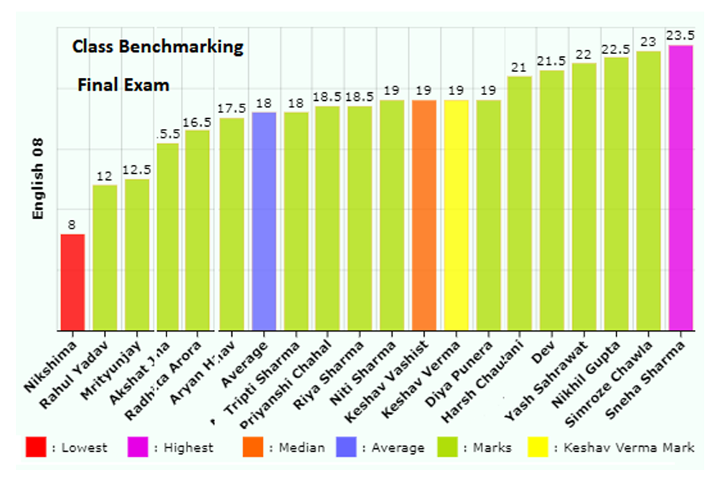

Report cards & Result Analysis
All-Round Performance Report(1/2)
Section VI
Student All Round Report
Going beyond academics, this report captures the overall personality of a student by including Extra curricular activity participation and other co-scholastic areas like sports.
Report card
Get Ready to Print files for Report Card - automatically for CBSE or any other board as per your requirements
Ability to take your 'Detailed Report Card' online through our technically superior Coding team to deliver automated Report cards as per CBSE specifications

Slide 92
Report cards & Result Analysis All Round
Performance Report(2/2)
Section VI
Performance Report
Result analysis (in-depth)
Comprehensive reports through Smart Reports* that gives a very detailed, incisive and thorough analysis
Subject wise & Exam wise meticulous analysis of academic performance with cross section analysis
PTM Dashboard Module
A comprehensive presentation and display of child’s All-Round performance including academics with elaborate and vivid graphs for quick understanding of relative child performance.
Also, allows a peek into student’s extra curricular, sports participation supplemented with personalized evaluation from respective class teacher.

Slide 93

AI-based proctoring Online tests for large volume
Section VI
The process of Manual Exam proctoring beyond 10 students becomes challenging due to the limited bandwidth of any single human engaged in the exercise.
Our AI-based proctoring can allow 1000s of simultaneous test-takers to be monitored and issue alerts for violations.
Our AI engine verifies the user's face and detects movements or sounds in the exam window.

Slide 94
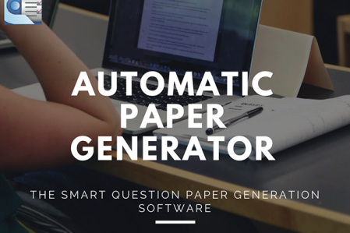
Randomized Question Paper
Generation
Section VI
While creating randomized question sets manually for up to 4 sets of question papers have been done before, but what if we tell you that our system lets you give all 40 students in the class a unique question paper.
And all the 40 sets conforming to the exact same criteria and standards that you choose.

Slide 95
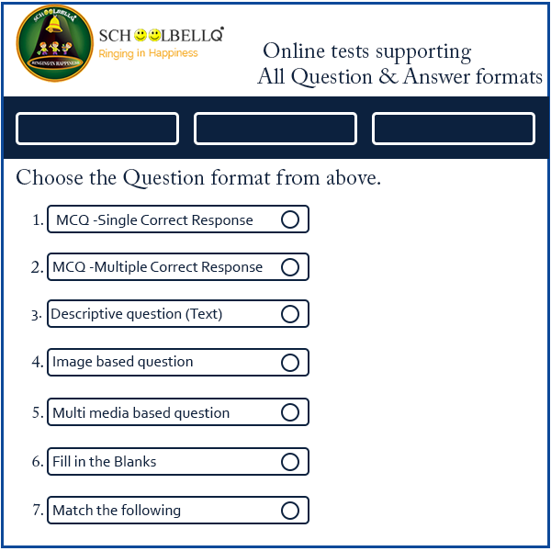
Online tests supporting All Question &
Answer formats
Section VI
Our systems allow users to overcome all limitations of the usual Online Test platforms.
They can set Questions beyond MCQs, the question that requires written descriptive response, Special Character support questions with special Scientific or Math symbols, Questions formats of 'Match the following' or 'Fill in the blank' etc.
QUESTION & ANSWER FORMATS

Slide 96
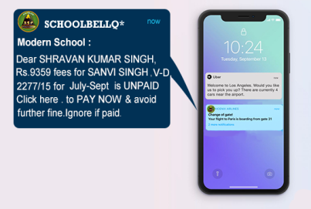
Custom Fees Notification
Section VI
Our system delivers personalized fees notifications that give a significantly better impact on payments.
The bulk notifications are personally marked with name, invoice number, student name, amount.
Every Parent gets a personalized payment link enabling payment in a single click in mail or SMS.

Slide 97
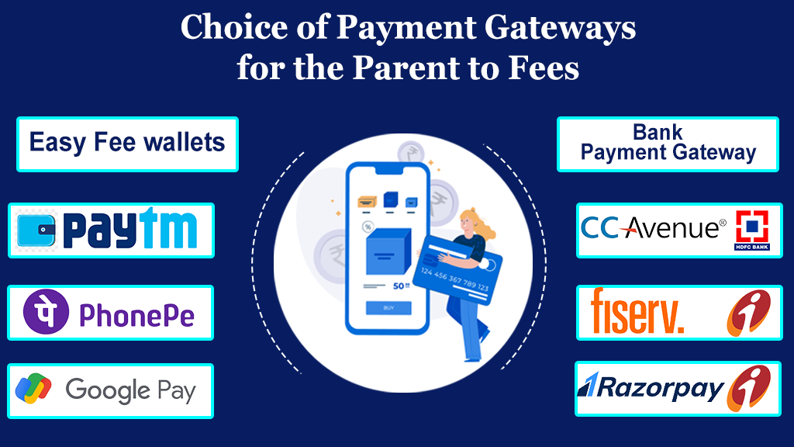
Choice of Payment Gateways for parents to fees payment
Section VI
This section showcases the payment options for parents for fees payment through different modes. Secure payment modes are provided for safe and hassle free transactions.
Easy fee wallets
Paytm
PhonePe
Google Pay
Bank payment Gateway
Razorpay ICICI
Fiserv. ICICI
CC Avenue Hdfc bank

Slide 98
Get The SchoolBellQ* Edge
Write to us at krishnapal.singh@schoolbellq.com info@schoolbellq.com
OR
Call for any queries: 9092005250

